Slide 1

2025 U.S. Benefits Annual Enrollment
October 29 – November 15, 2024
Notes:
We’re pleased to showcase all the benefits NXP offers to support you and your family’s well-being year-round.

Slide 2
Agenda
Introduction and Overview
What to Expect in 2025
2025 Benefit Enhancements
Benefits to Support Your Wellbeing
Your 401(k) Plan
Enrollment Reminders
Notes:
Here’s a preview of what you’ll hear about today.

Slide 3
What to Expect in 2025
Notes:
Here’s what to expect in 2025

Slide 4
What to Expect in 2025
Enhancements
Dental plan enhancements:
The orthodontia lifetime maximum is increasing from $2,000 to $2,500 per person.
The new maximum contribution limits for the Health Savings Account (HSA) will be $4,300 Single / $8,550 Family.*
The new maximum contribution limits for the Flexible Spending Accounts (Health Care and Limited FSA) will be $3,200 per household
Introducing NXP Care Connect: you and all members of your household are eligible for up to five face-to-face counseling sessions (per concern, per person, per year)―at no cost to you. Dependents who live away from home are also eligible.
Calm app:
Employees will now have free access to the Calm app
* Maximum contribution amounts include the employer seed from NXP. Depending on how much you receive in employer seed funding from NXP, your personal contribution limits will be lower.
Notes:
We are excited to offer the following benefit enhancements in 2025:
Our orthodontia lifetime maximum will be increased to $2,500 per person.
You will be able to contribute more to your Health Savings Account in 2025.
You will also be able to contribute more to your Health Care or Limited Flexible Spending Accounts in 2025.
Through our NXP Care Connect program, you and all members of your household are eligible for free counseling.
Also included in this program is free access to the Calm app.

Slide 5
What to Expect in 2025
Changes
Medical Plan 1 deductibles will increase to $1,650 Single/$3,300 Family to meet IRS requirements
There will be new rates for the Medical, Dental and Vision plans.
Fidelity will manage Flexible Spending Accounts (Healthcare, Limited Purpose and Dependent Care)
FSA rollover will end Dec. 31, 2024
You must use your funds by Dec. 31, 2024, or any remaining funds will be forfeited.
You have until March 31, 2025, to reimburse yourself for any eligible expenses incurred in 2024.
Notes:
In 2025, you will see a change to the Medical Plan 1 design. The deductibles will be increasing to meet IRS requirements.
There also will be new rates for the medical, dental and vision plans. These are posted on nxp.com/benefits.
Fidelity will be our new Flexible Spending Account vendor beginning in 2025.
As advertised during last year’s Annual Enrollment, the FSA rollover is no longer available. You must use any FSA funds by December 31 and any remaining funds will be forfeited. You will have until March 31 to reimburse yourself for any eligible expenses incurred in 2024.

Slide 6

What to Expect in 2025
Important Enrollment Information
Meet NXP’s new health & welfare administrator – Businessolver!
Businessolver will be where you make your 2025 Annual Enrollment elections and where you will go for ongoing benefits support effective January 1, 2025.
Same Support – New Number
The Benefits Service Center number will be changing to 1-888-532-3971 effective January 1, 2025. You will still have access to the same enrollment and benefits support as you do today.
Notes:
When you log in to complete your enrollment, you will notice it’s through a new platform. We have partnered with Businessolver as our new health and welfare administrator. They will support this year’s annual enrollment and will be the platform you will use for ongoing benefits support effective January 1, 2025.
As a result of the transition, we will have a new Benefits Service Center number effective January 1, 2025. We are excited to introduce some enhancements for the service center, including 24/7 chat support in multiple languages.

Slide 7
What to Expect in 2025
Benefits Annual Enrollment: October 29 – November 15
Important reminders:
Beneficiary information will not be migrated to Businessolver. Please log into the platform any time after October 29 to make your beneficiary elections.
If you do not make new elections by November 15, 2024, your current 2024 enrollment elections will carry over to 2025 except for spending accounts.
Your 2024 Flexible Spending Account elections and Health Savings Account elections will not automatically be renewed for 2025. You will be required to log in to Businessolver and make an election to contribute to the FSA and HSA again in 2025.
Review your benefits, and make any changes by Friday, November 15.
Visit nxp.com/benefits for details.
Notes:
It is important to note that beneficiary designations require a confirmation from you and, therefore, beneficiary information was not migrated to Businessolver. Please log into the platform any time after October 29 to re-select your beneficiary elections for 2025 and beyond.
If you do nothing, all of your current elections will automatically carry over to 2025 with the exception of spending accounts. You will need to log in and re-enroll if you wish to contribute to the Health Care FSA, Limited FSA, Dependent Care FSA or Health Savings Account in 2025.

Slide 8
Benefits for Your Health – Medical, Dental and Vision
Notes:
Now let’s review your medical, dental and vision benefits for 2025

Slide 9
*In-network coverage only
Medical Plan Comparisons
 | Medical Plan 1 (HSA-eligible)¹ | Medical Plan 2 (PPO)² | Medical Plan 3 (EPO)*² | Kaiser (CA only)³
Deductible | $1,650 employee-only / $3,300 family | $300 employee-only / $600 family | $200 employee-only / $400 family | $0
Coinsurance | Plan pays 80% for network benefits | Plan pays 80% for network benefits | Plan pays 90% for network benefits only (out-of-network services not covered) | Plan pays 100% for network benefits
Out-of-pocket limit | $4,000 employee-only / $7,350 family | $5,000 employee-only / $10,000 family | $5,000 employee-only / $10,000 family | $1,500 employee-only / $3,000 family
Copay | You pay 20% after deductible | $20 primary care physician / $40 specialist | $20 primary care physician / $40 specialist | $35 copay
Lab and X-ray in a physician's office | You pay 20% after deductible | You pay 20% | You pay 10% | $35 copay
NXP HSA contribution | $500 employee-only / $1,000 family | Not eligible | Not eligible | Not eligible
Beginning Jan. 1, 2025, Neurobiological and Autism Disorders will be reclassified from office visits to outpatient services for medical plans 2 and 3. Instead of the plan-level copay, you will pay 10% before deductible.
1 If you elect family coverage, the family deductible must be met before the plan begins to apply coinsurance towards in-network claims. The family deductible can be met by one family
member or a combination of covered family members
2 If you elect family coverage, the plan begins to apply coinsurance towards in-network claims for an individual once he or she meets their per person deductible. Once those per person
deductibles add up to meet the family deductible, the plan begins to apply coinsurance towards in-network claims for everyone in the family.
3 California employees have access to Kaiser HMO if they reside within Kaiser’s network service area
Notes:
NXP offers you a choice of three UnitedHealthcare medical and corresponding CVS Caremark pharmacy plans, including a Health Savings Account (or HSA)-eligible plan. Please note that Medical Plan 3 does not cover services you receive from out-of-network providers. If you reside in California, you may also have access to the Kaiser HMO Plan. The Kaiser HMO is a network that many find easy and convenient to use—plus, it keeps out-of-pocket costs low. You can opt out of the NXP medical plan if you prefer not to enroll.
For Medical Plan 1, the deductibles will increase to $1,650 Single/$3,300 Family to meet IRS requirements. If you enroll in this plan and elect family coverage, the family deductible must be met before the plan begins to apply coinsurance towards in-network claims. The family deductible can be met by one family member or a combination of covered family members.
For Medical Plans 2 and 3, if you elect family coverage, the plan begins to apply coinsurance towards in-network claims for an individual once he or she meets their per person deductible. Once those per person deductibles add up to meet the family deductible, the plan begins to apply coinsurance towards in-network claims for everyone in the family.
Beginning January 1, 2025, Neurobiological and Autism Disorders will be reclassified from office visits to outpatient services for medical plans 2 and 3. Instead of the plan-level copay, you will pay 10% before deductible.

Slide 10
Prescription Drug Plan Comparisons
 | Medical Plan 1 | Medical Plan 2 | Medical Plan 3 | Kaiser (CA only)*
30-day supply (short-term medications) | Generic: Preventive prescriptions 100% covered; you pay 20% after deductible for all others Preferred: You pay 20% after deductible Non-preferred: You pay 20% after deductible | Generic: You pay $5 Preferred: You pay 30% ($75 max) Non-preferred: You pay 50% ($100 max) | Generic: You pay $5 Preferred: You pay 30% ($75 max) Non-preferred: You pay 50% ($100 max) | Generic: You pay $10 Preferred: You pay $30 Non-preferred: You pay $30
90-day supply (100-day supply for Kaiser) or maintenance medications | Generic: You pay 20% after deductible Preferred: You pay 20% after deductible Non-preferred: You pay 20% after deductible | Generic: You pay $10 Preferred: You pay 30% ($175 max) Non-preferred: You pay 50% ($250 max) | Generic: You pay $10 Preferred: You pay 30% ($175 max) Non-preferred: You pay 50% ($250 max) | Generic: You pay $20 Preferred: You pay $60 Non-preferred: You pay $60
* California employees have access to Kaiser HMO if they reside within Kaiser’s network service area.
Medical Plans 1, 2 & 3 - Prudent Rx Program Information
The PrudentRx Copay Program allows you to get select specialty medications at no cost to you. Because certain specialty medications do not qualify as “essential health benefits” (EHB) under the Affordable Care Act (ACA), member cost share payments for these medications, whether made by you or a manufacturer copayment assistance program, do not count towards the Plan’s MOOP. A list of specialty medications that are not considered to be EHB can be found here .
Notes:
Prescription drug benefits under the UnitedHealthcare medical plans are administered by CVS Caremark. You can fill prescriptions at any participating pharmacy (not just CVS). Kaiser plan participants must fill prescriptions at Kaiser pharmacies.
For members of Medical Plans 1, 2 and 3, CVS offers a PrudentRx Copay Program, which allows you to get select specialty medications at no cost to you. Because certain specialty medications do not qualify as “essential health benefits” under the Affordable Care Act, member cost share payments for these medications, whether made by you or a manufacturer copayment assistance program, do not count towards the Plan’s Medical Out Of Pocket maximum. A list of specialty medications that are not considered to be EHB can be found online at nxp.com/benefits.

Slide 11
Dental and Vision Plans
Delta Dental Plan | Coverage
Deductible | $50 per person, up to $150 per family
Maximum | $2,000 per person each year
Preventive services – Exams, cleanings, X-ray, sealants and periodontal maintenance | 100% covered (limited to 2 per year)
Basic services – Fillings and root canals | You pay 20% after deductible
Major services – Crowns, bridges, implants | You pay 50% after deductible
Orthodontic (adults and children) | You pay 20% after deducible ($2,500 lifetime maximum)
VSP Vision Plan | Coverage
Vision exam | $20 copay (limited to 1 every year)
Prescription glasses | $20 copay
Frames | $250 allowance every year
Contact lens exam | 15% discount; not to exceed $20 copay
Contacts (instead of glasses) | $250 allowance every year
Computer vision coverage | $20 copay
Notes:
The NXP dental plan offers you and your family preventive, restorative, and orthodontic services. Although you can see any dentist you want, you’ll pay less when you receive dental care from a Delta Dental PPO and Premier network dentist. You’ll note that we have increased the orthodontia lifetime maximum to $2,500 beginning in 2025.
The vision plan provides coverage for a vision exam and prescription glasses or contacts once every year.

Slide 12
2025 Bi-weekly Rates*
Rates assume $300 Wellness Incentive is applied and non-smoker status
Plan Option | Employee Only | Employee + Spouse or Domestic Partner | Employee + Child(ren) | Family
Medical Plan 1 | $14 ($1) | $50 ($4) | $43 ($3) | $83 ($6)
Medical Plan 2 | $35 ($3) | $93 ($7) | $80 ($6) | $148 ($11)
Medical Plan 3 | $60 ($5) | $158 ($12) | $144 ($11) | $258 ($20)
Kaiser (CA only) | $66 ($5) | $179 ($14) | $162 ($13) | $256 ($20)
Dental | $8 ($2) | $16 ($3) | $17 ($3) | $26 ($5)
Vision | $6.25 ($2.25) | $11.81 ($0.81) | $12.47 ($0.47) | $19.44 ($0.44)
* All medical coverage contributions listed will increase $50 per month for each covered employee and/or spouse or domestic partner who uses tobacco.
($) represents amount of increase from 2024 to 2025.
Notes:
Here are the rates for 2025. NXP is contributing more this year, and employee contributions are also increasing for medical, dental and vision plans. The amount in parentheses represents the amount of the increases from 2024 to 2025.

Slide 13
Spending Accounts
Notes:
Let’s take a look at the tax-advantaged spending accounts that can help you save on current—and future—expenses.
To contribute to a Health Savings Account, Health Care Flexible Spending Account, or Dependent Care Flexible Spending Account in 2025, you will need to elect your contribution during Annual Enrollment. Your current elections will not roll over to 2025.

Slide 14
Health Savings Account (HSA)
Plan | Eligibility Requirements | Contribution Amounts | Rollover Limits
Health Savings Account (HSA) | Enrolled in Medical Plan 1 Can’t be covered by another non-high-deductible health medical plan Your spouse can’t have separate plan with an FSA Can’t be enrolled in Medicare | Receive $500 for employee-only coverage and $1,000 for family coverage from NXP Contribute up to an additional $3,800 with employee-only coverage or $7,550 with family coverage If you are 55 or older, you can contribute an additional $1,000 | You own your HSA. Your funds never expire. The entire account balance rolls over each year.
Reminder: You must log in and make an election to contribute to the HSA again in 2025.
Notes:
If you are enrolled in Medical Plan 1, you are eligible to contribute to a Health Savings Account, also known as an HSA. If you enroll in this account, you will receive free money from NXP as a contribution into this account that’s earmarked for you and your dependents current and future medical, dental or vision expenses. You must enroll in this account in order to receive the free money from NXP. This enrollment is separate from your medical plan enrollment.
You cannot have an HSA if your spouse is enrolled in a separate plan and is contributing to a Health Care Flexible Spending Account or if you enrolled in Medicare. You own your HSA, and your account balance will continue to grow year over year.
Remember, you must log in and make an election to contribute to an HSA in 2025.

Slide 15
Health Savings Account (HSA)
2025 HSA Maximum Funding | NXP Contribution | Employee Maximum Contribution*
$4,300 for single coverage | $500 | $3,800
$8,550 for family coverage | $1,000 | $7,550
*Employees ages 55 or older can contribute an additional $1,000 to their HSA.
Notes:
Annual contribution limits are set by the IRS and include the contributions made by NXP. NXP will contribute $500 if you have employee-only coverage and $1,000 if you have family coverage. For 2025, the maximum you can contribute is $3,800 if you have employee-only coverage or $7,550 if you have family coverage. If you are 55 or older, you can contribute an additional $1,000.

Slide 16
Health Care and Limited Use Flexible Spending Accounts
Plan | Eligibility | Contribution Amounts
Health Care Flexible Spending Account (FSA) | Enrolled in Medical Plans 2 or 3, Kaiser, or waived coverage | You can contribute up to $3,200 per household
Limited Use Flexible Spending Account (LFSA) | Enrolled in Medical Plan 1; can also contribute to an HSA | You can contribute up to $3,200 per household
Reminders:
You must log in and make an election to contribute to an FSA in 2025.
Unused FSA funds from 2024 will not roll over to 2025.
Notes:
Unlike the HSA, the Health Care Flexible Spending Account (FSA) doesn’t roll over from year to year. This is a use-it-or-lose-it account. You can contribute up to $3,200 pretax to pay for eligible health care expenses. You’ll forfeit any unused funds at the end of the year. And you must use your full contribution for 2025 by December 31, 2025.
If you’re enrolled in Medical Plan 1 and are contributing to an HSA, you can’t have a Health Care FSA, but you can contribute to the Limited Use FSA for dental and vision expenses only. The contribution limit for the Limited Use FSA is also $3,200.

Slide 17
Dependent Care Flexible Spending Account
Plan | Eligibility | Contribution Amounts | Rollover Limits
Dependent Care Flexible Spending Account (DFSA) | All full-time, benefits-eligible employees can participate | You can contribute up to $5,000 per household Employees earning more than $200,000 can contribute up to $2,500 | All funds must be used for expenses incurred in the same calendar year Any unused funds are forfeited
Reminder: You must log in and make an election to contribute to the Dependent Care FSA in 2025.
Notes:
A Dependent Care FSA lets you use pre-tax dollars to pay for eligible expenses related to care for your child, disabled spouse, elderly parent, or other dependent who is physically or mentally incapable of self-care, so that you can work. You can contribute up to $5,000 per household. Employees earning more than $200,000 can contribute up to $2,500.

Slide 18
Optional Benefits
Notes:
Since everyone’s situation is different, NXP also offers you a suite of optional benefits tailored to your specific needs. We’ve thought of everything: your kids, your pets, and your occasional purchases.

Slide 19

MetLife Legal Plans
MetLife Legal Plans help you navigate life’s planned and unplanned events – with no waiting period, no deductible and no claim forms.
Money matters, such as debt services and tax audits
Home sales, purchases, refinancing
Wills, powers of attorney, and other estate planning documents
Family and personal matters, such as adoption
Court matters and civil lawsuits
Traffic tickets
And more
Attorneys can also advise on almost any legal issues except for employment disputes.
Did you know? Your parents and parents-in-law can have access to some of these services if you enroll in the Parents Buy-Up option.
Price per Paycheck
MetLife Legal Plan | $7.62
MetLife Legal Plan Plus Parents | $9.92
Notes:
NXP’s legal assistance plan through MetLife Legal gives your whole family access to affordable attorneys. As long as you’re enrolled in the plan, you don’t have to stress about legal fees for common issues. Whether you’re buying a house or dealing with a family estate, this plan can simplify the legal process for you. And if you’re enrolled in the buy-up option, your parents and parents-in-law will have access to some legal services too.
Attorneys can advise on any legal issues except for employment disputes.

Slide 20
Employee Disability and Life Insurance
Disability
Long-term disability coverage: $15,000 per month
Employee Life insurance
Basic life insurance benefit: 2x salary (taxable)
Amounts over $50,000 are considered imputed income and will be taxed. Don’t want to be taxed? Choose a flat $50,000 benefit instead.
Employee Supplemental Life insurance
Current supplemental life and AD&D insurance elections automatically carry over to 2025.
During AE, you can increase your existing coverage by 1x salary (up to the lesser of 3x salary or $500,000) without EOI.
Notes:
The maximum benefit for long-term disability is $15,000 per month.
You automatically receive basic life insurance coverage from NXP, and it’s equal to 2 times your annual salary. This benefit is taxable, so you’ll see a tax on your paycheck stub. Don’t want to be taxed? When you log in to enroll in your benefits, choose a flat $50,000 in coverage, instead.
If you’d like to boost your coverage, you can buy supplemental life insurance that provides up to 8 times your annual earnings in the event of your death (up to $1.5 million). Depending on the coverage you choose, you may be required to provide evidence of insurability (EOI) (or proof of good health), which includes completing the MetLife Statement of Health Form and may also require a physical exam.
Any current elections will automatically carry over to 2024. If you enroll in supplemental life insurance for the first time during Annual Enrollment, you’ll be required to provide EOI. However, if you’re already enrolled, you can increase your existing coverage by one times your salary (up to the lesser of three times your basic annual earnings or $500,000) without providing EOI.

Slide 21
Identity Theft Protection through ID WatchDog
Protects against fraud, data breaches and more
Safeguards your credit score, medical records, bank accounts, internet presence, tax filings and more
Provides up to $1 million in identity theft protection
Price per Paycheck
 | Essentials Plan | Platinum Plus Plan
Employee | $2.26 | $3.18
Employee + Family | $4.11 | $5.72
Notes:
You have two ID Watchdog plan options to choose from, and you can cover yourself only or your entire family.
You’re protected from fraud, data breaches, and more with up to $1 million in identity theft protection.
Both options offer credit report monitoring, provide your credit report, give you $1 million in insurance protection, and have a mobile app that you can use to stay on top of your personal data. The Platinum Plus plan provides additional benefits, including safe browsing options for your devices, stolen funds reimbursement, and other features.
A mobile app helps you stay on top of your personal data.

Slide 22
Pet Insurance Through PetFirst Healthcare
Flexible products with straightforward pricing (based on age and breed)
Premium discounts
Customizable coverage limits
Hassle-free claims process
What does it cover?
Injuries and illnesses
Exam fees
Surgeries
Medications
Ultrasounds
Hospital stays
X-rays and diagnostic tests
And more
Register
Call 1-800-438-6388 (provide referral code 11010)
Visit www.metlife.com/getpetquote (use NXP for the employer name and register using your employee ID)
Notes:
Your furry friends are also covered. Pet insurance gives you the peace of mind to know that your animals’ health care is a lot more affordable and a little less scary. It covers routine checkups, prescriptions, sniffles, surgeries and more. The cost of pet insurance depends on your pet’s age and breed.

Slide 23
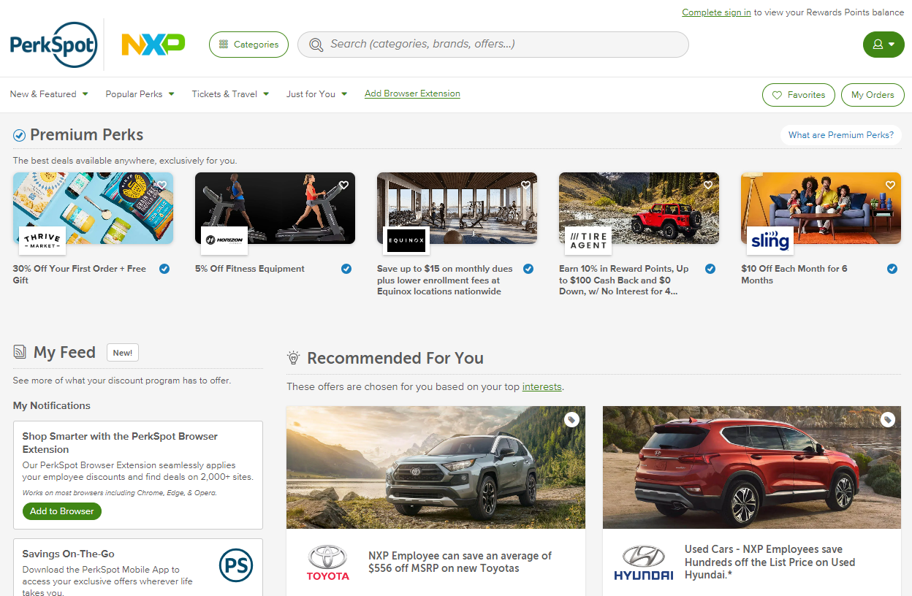
Discount Program
PerkSpot offers NXP employees preferred pricing on products, services and experiences.
Register at nxp.perkspot.com
Email our team at usbenefits.office@nxp.com to notify us of new or existing corporate partner discounts.
Notes:
NXP PerkSpot is an online discount program designed to put money back in your pocket. This program gives you unique discounts on brands you use every day. You can save on just about anything: groceries, entertainment, home goods, clothes, vehicles, electronics, getaways, and more. Just sign up, and poke around for what you need.

Slide 24
Benefits to Support Your Wellbeing
Notes:
Your benefits also cover big moments, big feelings, and the normalcy in between. We want you to be your best self and to have resources available when you need help figuring out how to do that.

Slide 25


Wellbeing@NXP
Now Powered by Personify Health – Effective January 1, 2025
Take small steps each day to improve physical, mental and financial wellbeing, plus earn rewards.
Personalized wellness support, including:
Challenges to build healthy habits and connect you with NXP team members across the globe
Health tracking tools
Self-paced wellness journeys
Daily health and wellness tips
Sign up at nxp.com/benefits under the Wellness tab
Notes:
Wellbeing@NXP is our global wellness platform and will help you make small, everyday changes to your wellbeing that are focused on the areas you want to improve the most. When you stick with it, you’ll build healthy habits, have fun with coworkers, and experience the lifelong rewards of better health and wellbeing.
This platform is powered by Virgin Pulse. Effective January 1, 2025, Virgin Pulse will be rebranding to Personify Health.
​
There will be no impact to you if you are currently utilizing the platform. You will continue to use the same app or URL to access the platform and your login credentials will remain valid. Once logged in, the look and feel of the platform itself will remain the same.
You will notice that the app will display the new name and logo in January. There will be a new QR code and URL for new team members to register on the platform.

Slide 26


UHC Resources and Tools
Ongoing UnitedHealthcare programs and tools:
Manage all your health care needs online or on the go with myuhc.com and the UnitedHealthcare app. Find a network doctor, review claims, and get cost estimates for care.
With Quit For Life, you get one-on-one support, digital tools and medications that help you quit tobacco for good.
Get up to five confidential visits with a therapist through NXP Care Connect. Find support for help with mental health issues, substance use, financial issues and other concerns at liveandworkwell.com.
Get care when you need it, wherever you are, through Virtual Visits. From treating flu and fevers to caring for migraines and allergies, doctors are available 24/7 via your smartphone or computer.
Notes:
UnitedHealthcare has one of the largest, most comprehensive health networks in the country. It also has top-notch resources to promote your well-being, including:
Lots of resources available online and through the mobile app
Help with kicking the smoking habit with Quit For Life
Virtual doctor visits through Teladoc
Free counseling sessions through NXP Care Connect (more on this in a few minutes)

Slide 27
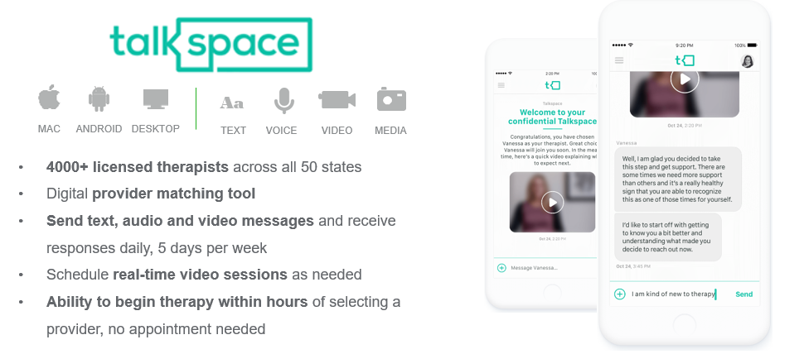
Virtual Therapy at Your Fingertips
Connecting people to quality care with an effective alternative to face-to-face therapy
Sessions are covered under your plan’s behavioral health benefits.
To register, go to talkspace.com/connect.
Notes:
When you or anyone in your family needs emotional support, your behavioral health benefits offer different options, including convenient apps, one-on-one counseling, and DIY tools and therapies.
Talkspace, for instance, offers access to therapists via text, voice, and video chat. This is a low-stress introduction to therapy if you haven’t done it before or are feeling uneasy about it.

Slide 28
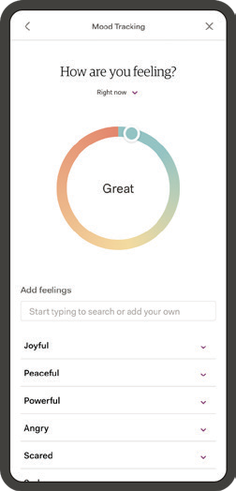
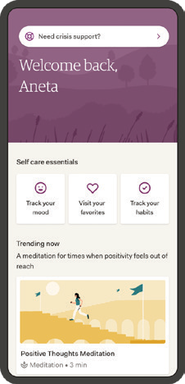
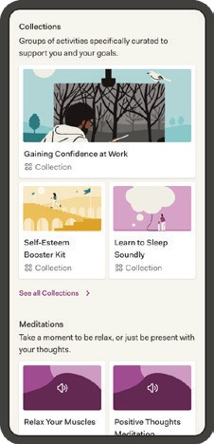
Virtual Therapy at Your Fingertips
SelfCare from AbleTo: On-demand self-help for stress, anxiety and depression—no diagnosis required
Self-help app based on cognitive behavioral therapy and mindful meditation
Relaxation techniques and coping tools (breathing techniques)
Mood and health data tracking over time
Learn new skills for dealing with anxiety
NXP Care Connect
Liveandworkwell.com key features include:
24/7 confidential support help line
5 free face-to-face counseling sessions per concern, per person, per year
Resources on a variety of topics
Visit liveandworkwell.com (access code: NXP).
For support anytime, call 1-866-248-4094.
Notes:
We have two other valuable behavioral health resources. The SelfCare app by AbleTo (formerly called Sanvello) helps you relax, manage depression and anxiety, track your mood, and more.
And NXP Care Connect is a free resource to address any issue you’re facing in your life: financial difficulties, marital or family conflict, mental health, substance abuse, life changes, and more. You get five free sessions, per issue, per person, per year. You never have to face what’s bothering you by yourself.

Slide 29
Benefits to Support You and Your Family
Notes:
In addition to wellbeing benefits, we offer many benefits to support our team members and their families.

Slide 30





Family Solutions
Because NXP cares about families, we offer these programs to support yours.
Paid maternity and parental leave. Maternity leave is provided at 100% salary pay during your approved short-term disability claim for six weeks and an additional six weeks is paid at 100% of your salary through parental leave, for a total of 12 weeks of paid leave. Parental leave will be covered up to six weeks at 100% of your salary. And you’re eligible for it after 90 days at NXP.
Transgender benefits are covered under the
medical UHC & Kaiser policies
Backup care. NXP partners with Bright Horizons to help US employees find and pay for temporary childcare, self-care or senior care when your regular plans are disrupted.
Tutoring. Offered through Bright Horizons, NXP covers the cost of in-person or online tutoring to students in 300+ subjects.
Optum® Fertility Solutions can help you get the fertility guidance and care you need, up to a $40,000 lifetime benefit maximum.
Sign up for UnitedHealthcare's Maternity Support Program to receive a gift and additional support through your pregnancy. Visit myuhc.com or call 1-877-201-5328.
Adoption assistance program. NXP reimburses up to $10,000 in eligible adoption expenses.
Notes:
We offer 12 weeks of Paid Maternity leave and 6 weeks of paid parental leave at 100% pay.
NXP offers a fertility benefit up to a $40,000 lifetime maximum for UnitedHealthcare members.
NXP also offers up to $10,000 towards adoption assistance
Transgender benefits are covered under the medical UHC and Kaiser policies.
NXP partners with Bright Horizons to help full-time U.S. team members find and pay for temporary childcare, self care or senior care when your regular care plans are disrupted.
NXP also covers the cost of tutoring services offered through Bright Horizons.
UHC members have access to UnitedHealthcare’s Maternity Support Program, which provides personalized support and guidance at every step of your pregnancy.

Slide 31
Benefits for your financial wellness
401(k) Retirement Plan
Employee Stock Purchase Plan (ESPP)
Notes:
NXP also offers financial wellness benefits that are here to help you save and grow your money.

Slide 32
Your 401(k) Plan
Three ways to contribute: pre-tax, Roth and after-tax contributions.
NXP matches your pre-tax and Roth contributions, including catch-up, dollar for dollar up to 5% of your eligible earnings. NXP does not match after-tax contributions.
You can use the Roth in-plan conversion feature to convert your after-tax and/or pre-tax contributions to Roth.
 | Pre-tax Contributions | Roth Contributions | After-tax Contributions | Employer Match
Are contributions taxed when made? | No | Yes | Yes | No
Are contributions taxed when distributed? | Yes | No¹ | No² | Yes
Are earnings taxed when distributed? | Yes | No¹ | Yes² | Yes
What are the IRS limits? | $23,000 for employee pre-tax and Roth contributions
 | $69,000 including employee pre-tax, Roth, after-tax and employer match contributions
What is the catch-up contribution limit for a person age 50 or older (by Dec 31)? | $7,500 - A catch-up contribution may be made on a pre-tax and/or Roth basis and is in addition to the pre-tax/Roth $23,000 limit and $69,000 additions limit.
What is the catch-up contribution limit for a person ages 60 - 63? | Employees ages 60 - 63 are eligible to contribute 150% of the annual IRS catch-up limit.
¹ A distribution from a Roth 401(k) is tax free and penalty free, provided that the five-year aging requirement has been satisfied and one of the following conditions is met: age 59½, disability, or death.
² A partial distribution from a qualified plan must include a proportional share of the pre-tax and after-tax amounts in the account. Therefore, while the portion of your distribution associated with your after-tax contribution is not taxable, the portion of your distribution associated with any pre-tax contributions or earnings on pre-tax or after-tax contributions is taxable.
The 2025 contribution limits will be posted to nxp.com/benefits when they are available.
Notes:
Although there are no required actions on your 401(k) during annual enrollment, it’s a great time to review your account.
When saving for retirement, how and when you pay taxes on your 401(k) matters. You can choose between pretax, Roth, and after-tax contributions.
Pretax contributions lower your taxable income today but are taxed at withdrawal. Roth contributions are taxed now, so withdrawals, including earnings, are tax-free if you’re 59½ and it’s been at least five years since your first contribution. You can also make after-tax contributions which allow you to contribute more than the annual pretax/Roth limits. However, NXP does not match after-tax contributions.
If you’re 50 or older by year-end, you’re eligible for catch-up contributions. If you’re age 60 to 63, additional catch-up contributions are available.
NXP matches 100% of the first 5% of eligible earnings you contribute to your 401(k) as pretax or Roth, including catch-up contributions.
Contribution limits are expected to increase in 2025, and the new limits will be posted on nxp.com/benefits once released by the IRS.

Slide 33
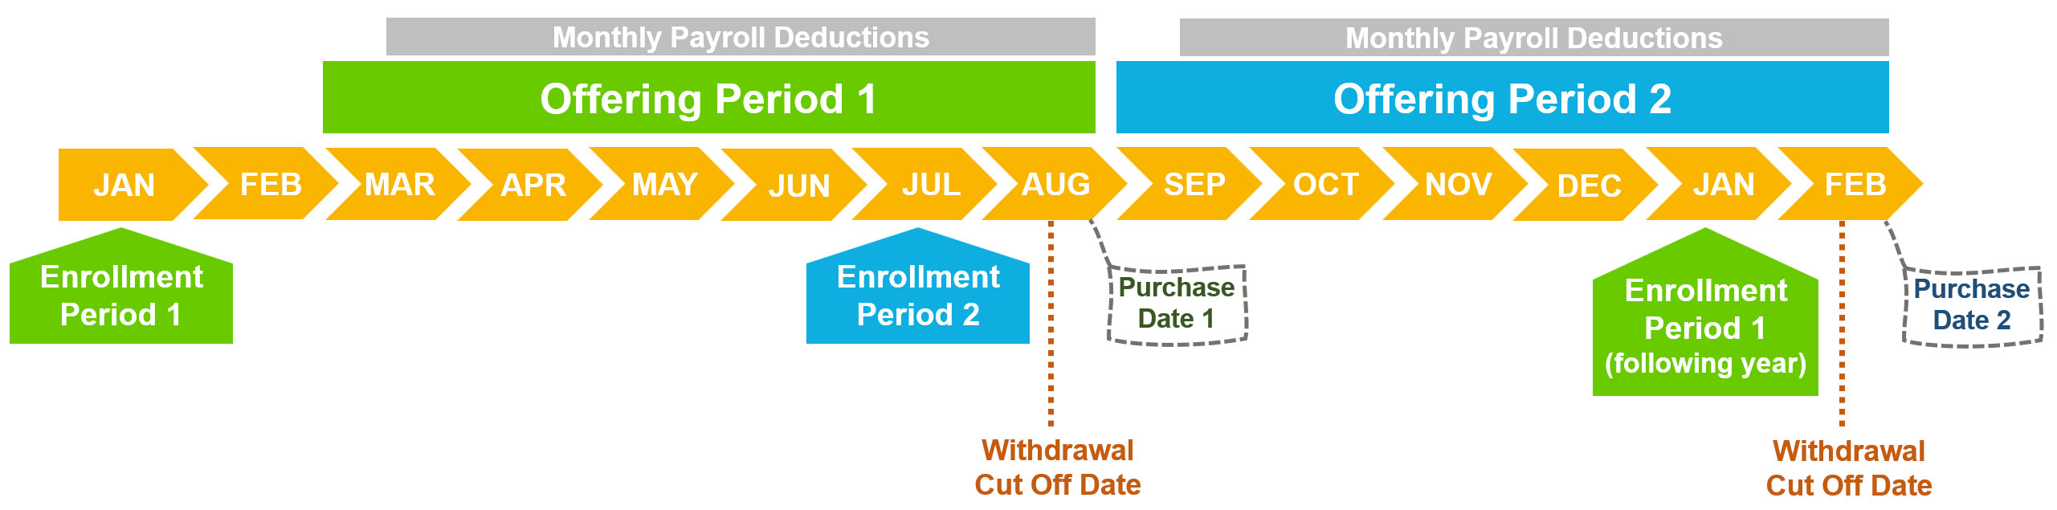

Employee Stock Purchase Plan (ESPP)
The ESPP is a voluntary plan that allows you to purchase NXP shares (NASDAQ: NXPI) at a 15% discount
Eligibility
You must be employed directly by an NXP group company to be eligible
Most employees are eligible - executives, contractors, interns/students, employees on a fixed term are not eligible
Contributions
Contribute 2% to 10% of your gross base pay; deductions are made from your pay each pay cycle during the 6-month Offering Period
Shares are purchased on the Purchase Date at the end of the Offering Period
Enrollment
To participate employees must enroll during an Enrollment Period in January or July at etrade.com/enroll
For more information visit NXP’s ESPP SharePoint page
Notes:
As a reminder NXP offers an Employee Stock Purchase Plan that allows you to purchase NXP stock at a 15% discount.
Contribute up to 10% of your base pay during a six-month Offering Period.
The maximum amount you can contribute is $25,000 or $21,250 with the 15% discount.
The next Enrollment Period opens in January 2025.

Slide 34
Tools and Resources
Notes:
Here are a few of the tools and resources we offer to help make it easier for our team members to access and utilize their benefits.

Slide 35
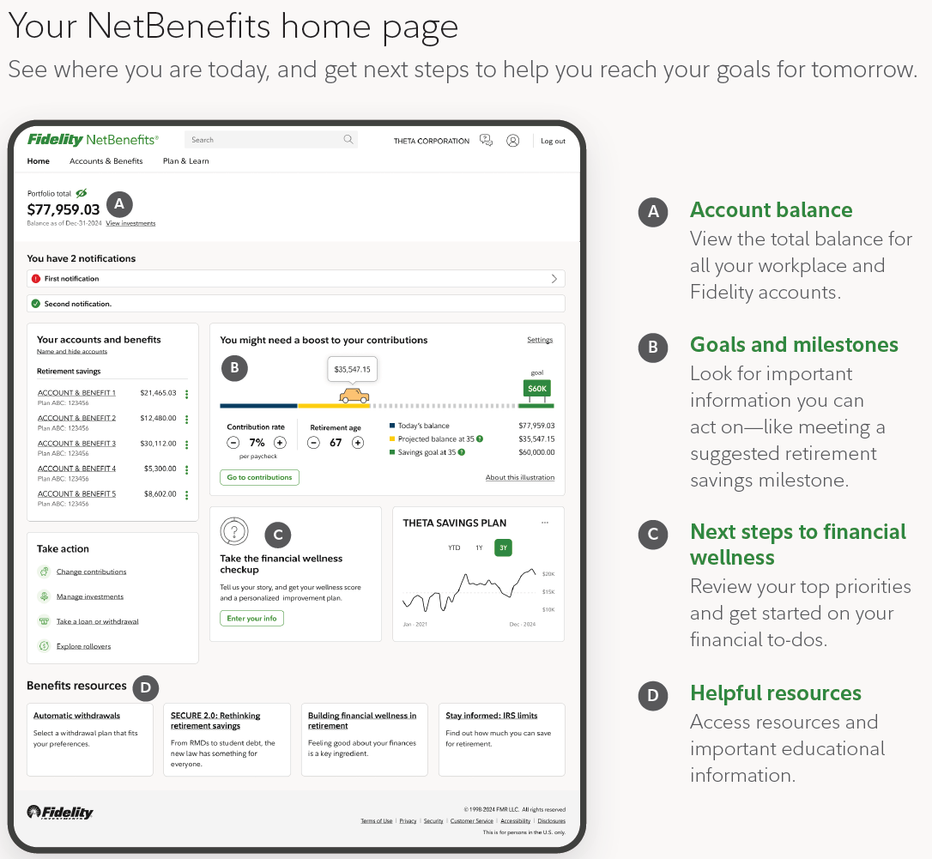
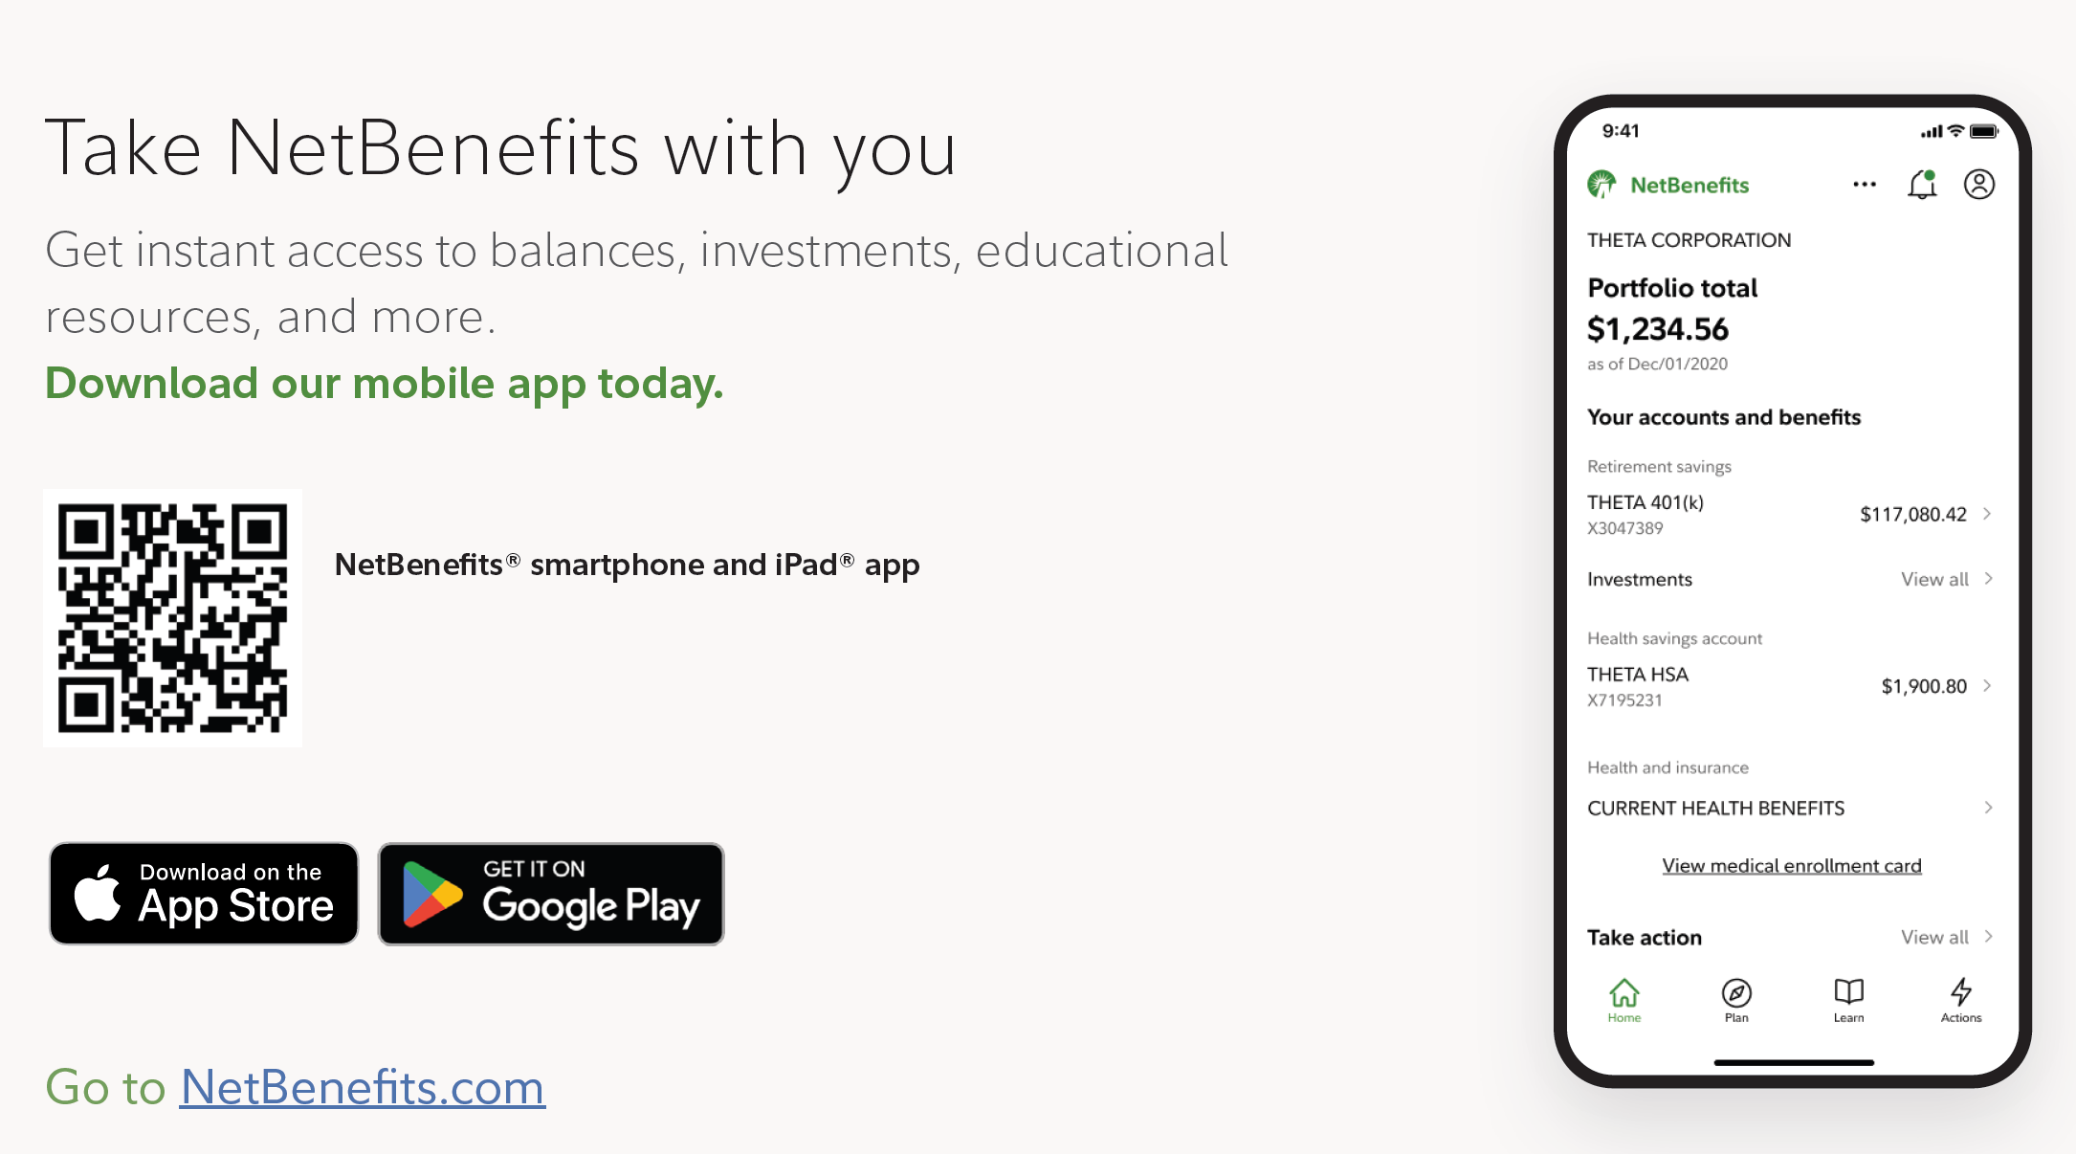
NXP 401(k) Plan
Review your account
Review your account balances, contribution amounts and investments at netbenefits.com
Track and forecast your savings on the home page
Download the NetBenefits Mobile App
Access all your Fidelity workplace accounts – anytime, anywhere – view, act, plan and learn
Visit Fidelity.com/go/NetBenefitsapp or scan the QR code in the image to the right
Notes:
At the beginning of the year, it is a good time to review your 401(k) balance, contributions, and investments at NetBenefits.com to ensure you are on track to meet your retirement savings goals.
With the NetBenefits app you can manage your retirement account anytime, anywhere. Track your balance and make updates right from your phone. It’s quick, easy, and secure.

Slide 36
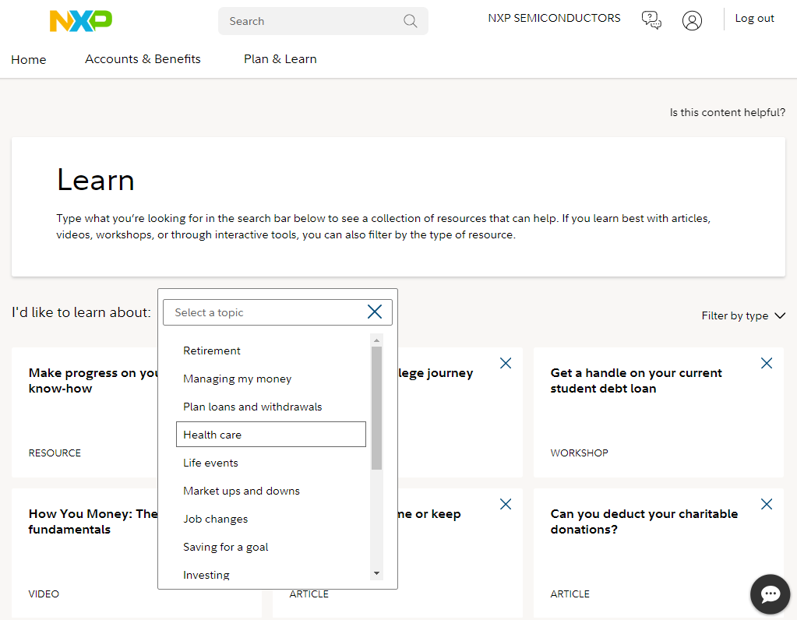
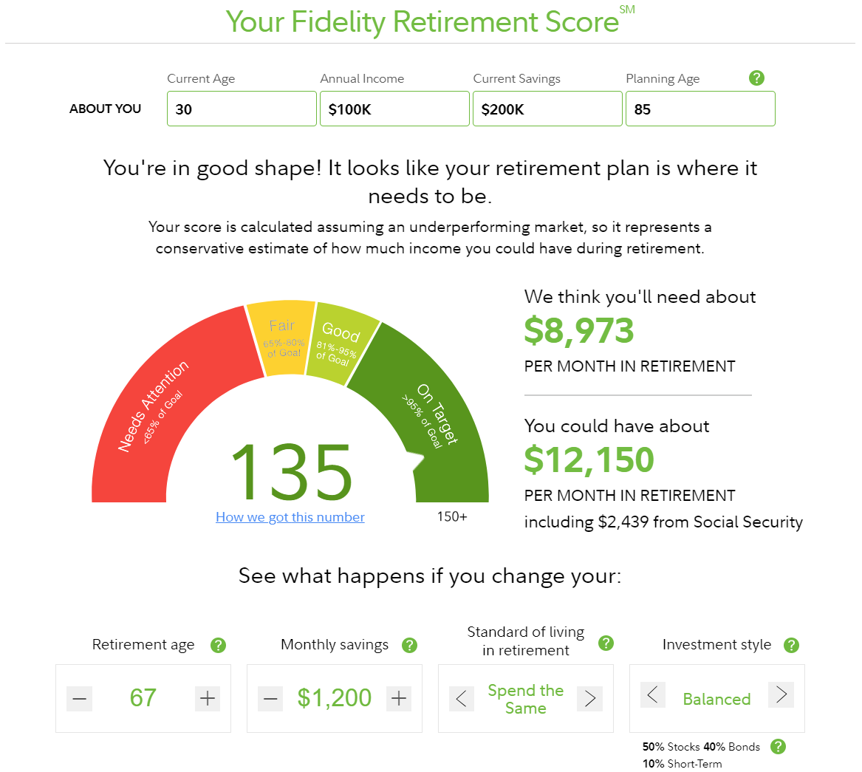
NXP 401(k) Plan
Take advantage of educational resources
Plan & Learn - Explore a collection of financial learning resources: articles, infographics, videos and more
Create a plan for your future – Model and plan for your financial goals using the Planning & Guidance Center at Fidelity.com/planningcenter
Review your beneficiary information
Log in to netbenefits.com
On the homepage select the person icon in the top corner, and select Beneficiaries to review/update your beneficiaries for your 401(k) & Health Savings Account (HSA)
Notes:
Check out the Plan & Learn tab in NetBenefits for a variety of educational resources to help you along your journey.
Visit the Planning & Guidance Center to create your financial plan.
Take a moment to review your beneficiary designations and give yourself peace of mind. Updating is quick and easy – don’t wait!

Slide 37
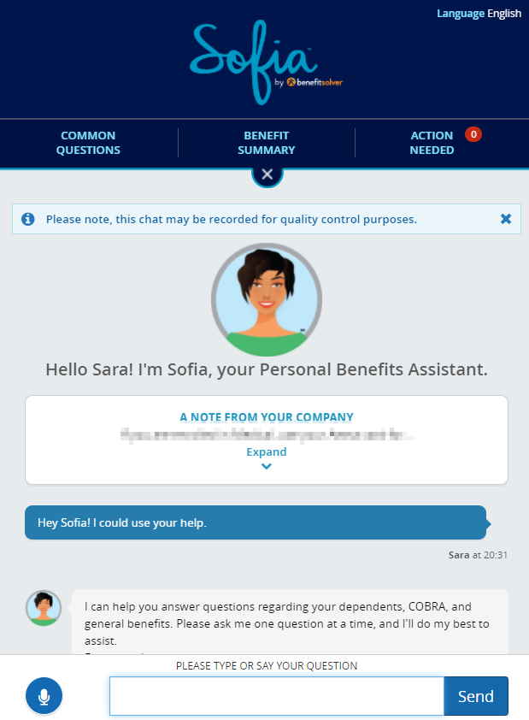
Sofia: A Virtual Benefits Assistant
Key Features of Sofia:
Real-time Support: Sofia provides live text-to-text responses on desktop or mobile, offering fast, easy, accessible support to employees during the annual enrollment period and throughout the year.
Multilingual Support: Sofia can provide accurate, automated responses in more than 50 languages, catering to a diverse workforce and ensuring effective communication with employees in different regions.
24/7 Availability: As a virtual benefits assistant, Sofia is available around the clock, assisting employees anytime, anywhere through the Benefitsolver platform or the MyChoice benefits app.
Personalization and Data Pulling: Sofia can pull forward relevant benefits information based on employees' questions, and proactively navigate employees to programs and resources to improve their health and wealth.
Notes:
With the transition to our new enrollment platform, we have access to a new tool - Sofia. She provides our employees with 24/7 chat support in multiple languages.

Slide 38


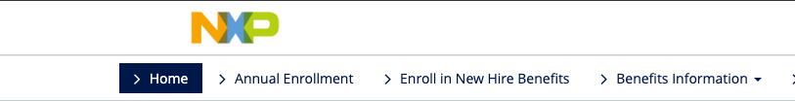
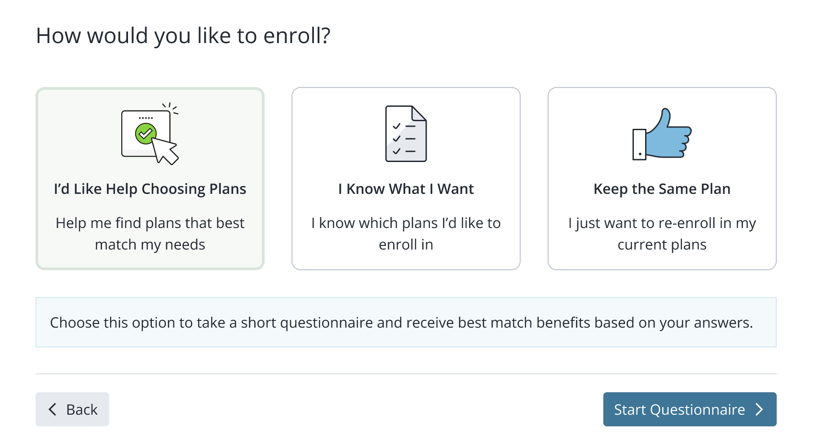
Decision Support Tool
Key Features:
A simple, easy-to-use process providing personalized results.
Considers your entire wellbeing, including financial, physical, and emotional needs.
Helps you plan for your future and understand the benefits you’re paying for.
Simplifies the selection process, reducing the frustration of too many choices.
Allows you to model different scenarios to identify components of care that drive out-of-pocket costs.
Gives you the confidence you need to make informed benefits decisions!
Notes:
Many of you are familiar with Ask Emma. Emma will be replaced with Businessolver’s Decision Support Tool. This tool will ask you a series of questions to help guide you to the best plan options for you and your family. All answers will be kept confidential and are never stored or shared.

Slide 39
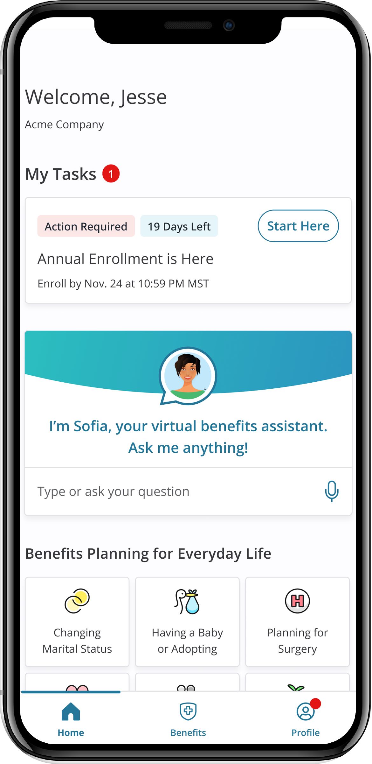
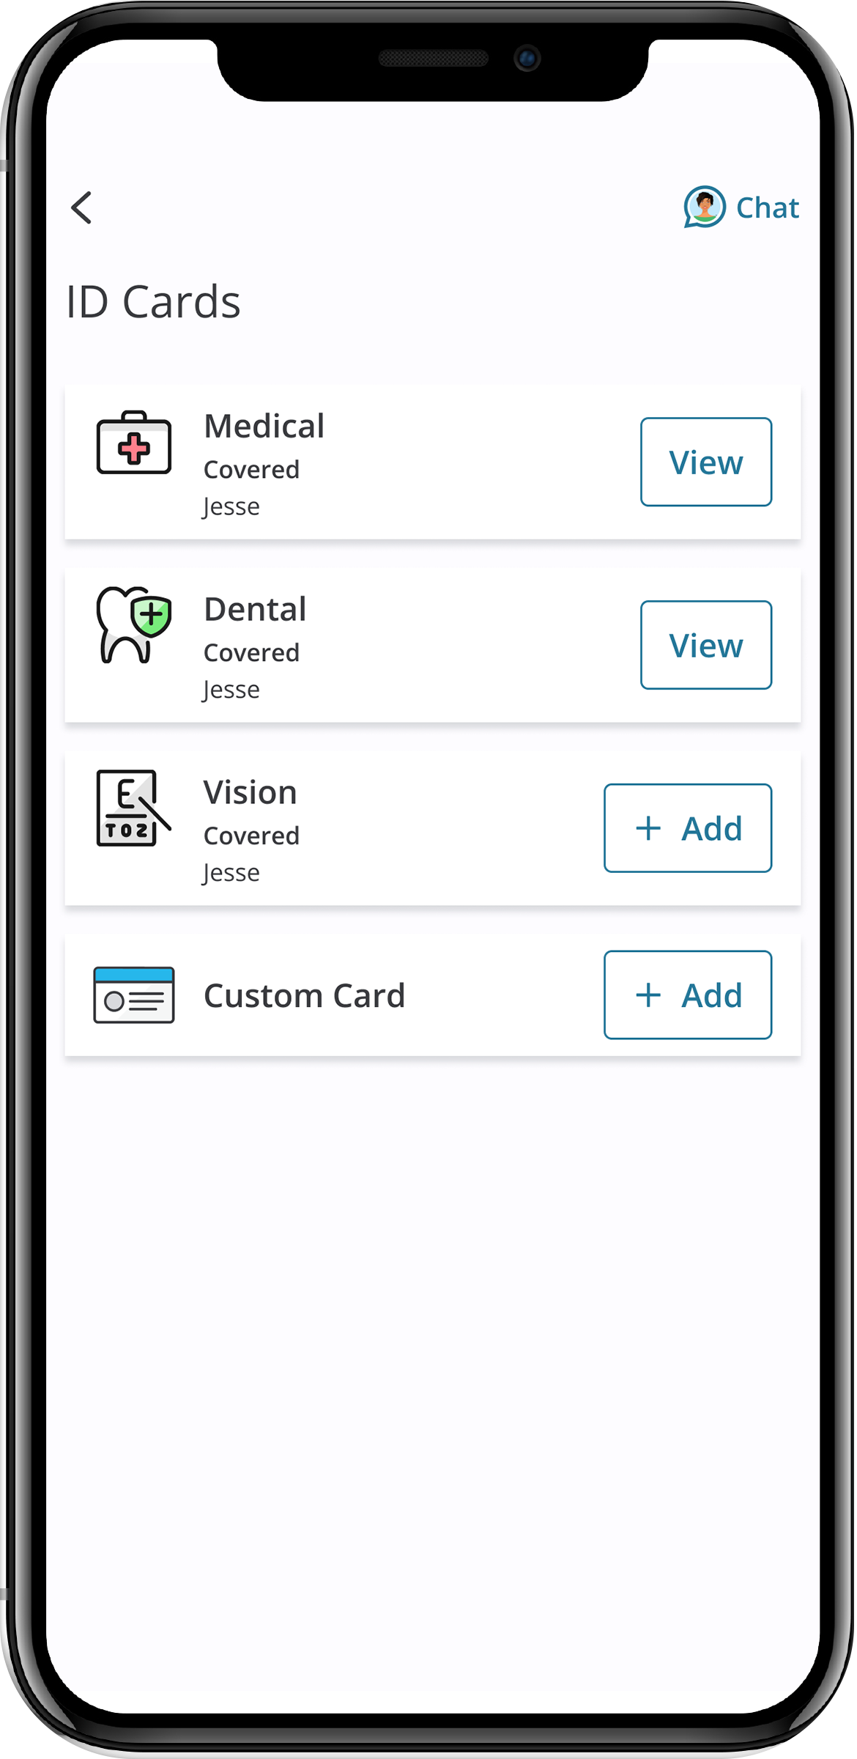
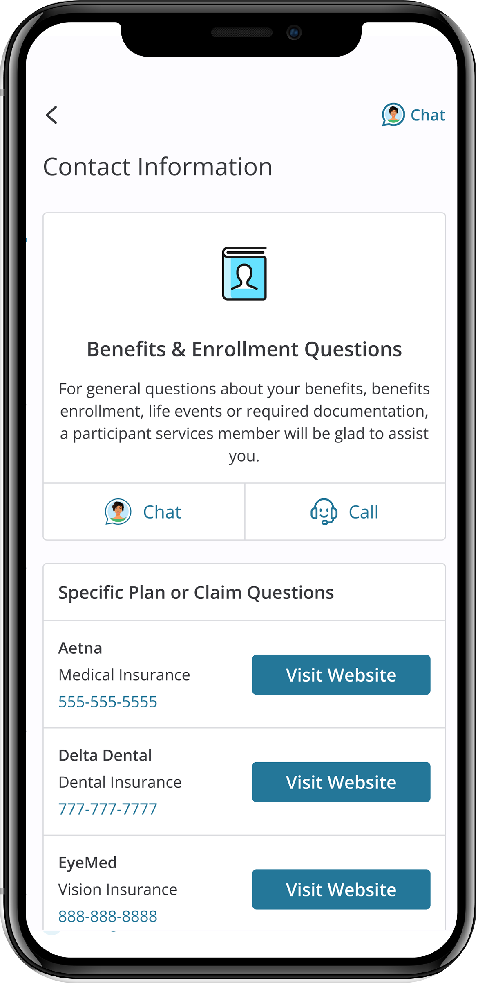

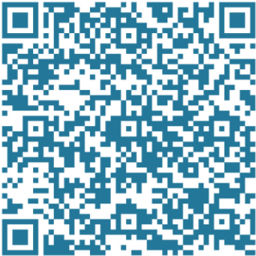


MyChoice® Benefits App
Once you've downloaded the app, simply log in using the 2025 Benefits Sign-in link on the nxp.com/benefits homepage.
With the MyChoice benefits app, you can:
Store pictures of your ID cards for quick and easy access.
Access detailed coverage information at your fingertips.
Make changes to your benefits with just a few taps... and much more!
Take control of your benefits like never before. Download the MyChoice benefits app today and experience the convenience of managing your benefits wherever you go!
Notes:
Make sure to download the new app for Businessolver, which can be found in the app store under “MyChoice Benefits”

Slide 40
Enrollment Reminders
Notes:
We are reaching the end of our presentation and want to leave you with some important enrollment reminders.

Slide 41
Prepare for Annual Enrollment
Annual Enrollment is October 29 – November 15
Get familiar with your benefits and plan options so that you’re ready to make choices that provide you and your family with the most value.
1
Think about what’s in store for you in 2025. Visit nxp.com/benefits to review your options and read the Benefits Enrollment Guide.
2
Learn what’s new by speaking to a Benefits Team member at the benefits tables during our Annual Enrollment fair.
3
Complete the new decision support tool, which is available after you start your enrollment, to receive personalized guidance on the best plans for you and your family.
Talk to Sofia and use the new Decision Support Tool to obtain personalized support and guidance on the best plan(s) for you and your family.
4
5
Enroll in the options that best meet your needs and budget by November 15, 2024, at nxp.com/benefits
Notes:
You’ll notice that we are giving you more time to enroll this year – closer to 3 weeks versus our standard 2 week enrollment timeline. We hope you appreciate the extra time to log in, get familiar with the new enrollment site, confirm your beneficiaries and review and make changes to your elections.
Our benefits team members will be on site during our Annual Enrollment vendor fair, if you have questions.
We encourage you to utilize the Decision Support Tool to help guide you in making some key benefit decisions.
As a reminder, you can ask Sofia, our virtual benefits advisor, many questions about our plans.

Slide 42
Learn More and Get Help
Visit nxp.com/benefits
Call: (888)532-3971
(Monday – Friday, 7a.m. – 7p.m. CT)
Follow us on Viva Engage
For 401(k), HSA and FSA questions, call the Retirement Service Center: (844)697-4015 (Monday – Friday, 7:30a.m. – 7:30p.m. CT)
Enroll by November 15
Important Reminders:
You must enroll to confirm your beneficiaries, change plans, add or delete dependents or contribute to an FSA or HSA in 2025.
Notes:
The new enrollment site and support number will be available on October 29. Visit nxp.com/benefits on that date to access the annual enrollment portal.

