Slide 1
2026 U.S. Benefits Annual Enrollment
October 20 – October 31

Slide 2



Agenda
Introduction and Overview
What to Expect in 2026
2026 Benefit Enhancements
Benefits to Support Your Wellbeing
Your 401(k) Plan
Enrollment Reminders

Slide 3
What to Expect in 2026

Slide 4

U.S. Benefits Strategy
NXP continues to support competitive benefit programs for all employees and their families
2026 Medical and pharmacy costs are projected to increase 7% to ~$90M
Cost share will remain at 87% NXP costs and 13% for the employee premiums
Based off Medical Plan design options that you chose, you will pay 7% to 10% more in premiums than 2025
Dental and Vision premiums will not increase for 2026
Notes:
NXP continues to support competitive benefit programs for all employees and their families.
Looking ahead to 2026, medical and pharmacy costs are projected to rise by 7%.
Despite this increase, NXP will maintain its current cost-sharing structure—covering 87% of the cost, while employees will continue to contribute 13% through premiums.
Depending on the medical plan you choose, your premiums may increase by 7 to 10% compared to 2025.
The good news is that there will be no premium increases for dental or vision coverage in 2026.”

Slide 5
What to Expect in 2026
New Pharmacy Provider – Rightway Healthcare
Pharmacy coinsurance/copays will remain the same
Medical plan deductibles have changed to the following:
Medical Plan 1 $1,700 employee only / $3,400 family
Medical Plan 2 $500 single / $1,000 family
Medical Plan 3 $400 single/ $800 family
Employee Assistance Program (EAP) – Care Connect phone number changes to 855-591-1565
401(k) – If you are age 50 or older in 2026 and your 2025 FICA wages (Box 3 on your 2025 W-2) is over $145,000, any catch-up contributions you make in 2026 will automatically be after-tax Roth
Notes:
We are excited to announce our new Pharmacy Provider Rightway Healthcare
There also will be new rates for the medical plans dental and vision plans will remain the same as 2025. These are posted on nxp.com/benefits.
401(k) Catch-up – If you’re catch-up eligible, age 50 or older by the end of the year, and your total NXP 2025 FICA wages (Box 3 on your 2025 form W-2) were over $145,000*, SECURE 2.0 Act requires any catch-up contributions you make in 2026 to be made as after-tax Roth contributions.

Slide 6

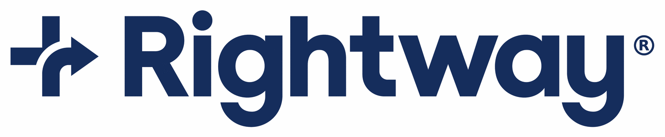






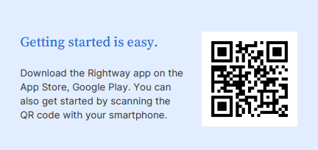











NEW Pharmacy provider
Why the change?
We are excited to partner with Rightway Medical for our Pharmacy needs! Rightway has a transparent financial model that allows the rebates to go directly to NXP employees at point of service
No mandates in place for employees to change most prescriptions when medically necessary
Will my Pharmacy be in network?
As you can see these pharmacies listed are just a few of the many pharmacies within the Rightway network
Please call Rightway at 888-665-1678 to locate a pharmacy near you
Notes:
We are excited to partner with Rightway Healthcare for our Pharmacy needs!
Rightway has pharmacist to support you directly, so do not hesitate to reach out.
Rightway has a transparent financial model that allows the rebates to go directly to NXP vs the Pharmacy Provider allowing us to return the savings to our employees.
As you can see these pharmacies listed are just a few of the many pharmacies within the Rightway network, so most likely your current pharmacy is in network.
You can still use CVS as your pharmacy as well as any other in network pharmacies
All Prior authorizations will transfer over from CVS to Rightway, no action is necessary
The Rightway app is the front door to your pharmacy benefits.
Be aware that the Chat feature on the app will work prior to January 1st, however you will not be able to log in to the app until after annual enrollment is over. You can also reach out to the Rigthway team by utilizing the phone number provided to check if your pharmacy and drug are in network.

Slide 7
Your new Pharmacy Benefits with
Mail Order
Specialty Prescriptions
Member ID Card
If your current mail-order or specialty pharmacy is no longer considered in network, you’ll receive a letter with details on how to obtain prescriptions from one of Rightway’s trusted pharmacy partners.
If coverage for your current medication is changing, you’ll receive a letter at your home address with details on alternative options covered under the plan
If appropriate, our pharmacy team can help you switch to a more cost-effective medication
The prescription may have copay assistance available
The amount you pay for select specialty medications may be set to the maximum of the current benefit design, $0, or the amount determined by the manufacturer-funded copay assistance program
Once copay assistance is exhausted, the amount you pay will be no more than your benefit design allows
Copay assistance programs will not be considered member out-of-pocket costs and will not count toward your deductible and/or out-of-pocket maximums.
You will receive a Rightway prescription ID card in the mail before January 1
A digital copy is also available in the Rightway app.
On January 1, 2026, you will need to present this card when filling a prescription
Phone: 833-502-8179
Email: rwrx@rightwayhealthcare.com
You can also chat with a pharmacist through the Rightway app after the benefit launch date.
Notes:
If your current mail-order or specialty pharmacy is no longer considered in network, you’ll receive a letter with details on how to obtain prescriptions from one of Rightway’s trusted pharmacy partners.
Visit joinrightway.com/rx for more information on mail-order and specialty pharmacy.
What about prior authorizations
Prior authorizations will automatically transfer to the Rightway network, you will not have to obtain a new prior auth.
Member ID Card – please ensure you update your address in workday, if more than 5 dependents more cards will be generated

Slide 8
Prescription Drug Plan Comparisons
 | Medical Plan 1 | Medical Plan 2 | Medical Plan 3 | Kaiser (CA only)*
30-day supply (short-term medications) | Generic Preventive prescriptions 100% covered; you pay 20% after deductible for all others Preferred: You pay 20% after deductible Non-preferred: You pay 20% after deductible | Generic: You pay $5 Preferred: You pay 30% ($75 max) Non-preferred: You pay 50% ($100 max) | Generic: You pay $5 Preferred: You pay 30% ($75 max) Non-preferred: You pay 50% ($100 max) | Generic: You pay $10 Preferred: You pay $30 Non-preferred: You pay $30
90-day supply (100-day supply for Kaiser) or maintenance medications | Generic: You pay 20% after deductible Preferred: You pay 20% after deductible Non-preferred: You pay 20% after deductible | Generic: You pay $10 Preferred: You pay 30% ($175 max) Non-preferred: You pay 50% ($250 max) | Generic: You pay $10 Preferred: You pay 30% ($175 max) Non-preferred: You pay 50% ($250 max) | Generic: You pay $20 Preferred: You pay $60 Non-preferred: You pay $60
* California employees have access to Kaiser HMO if they reside within Kaiser’s network service area.
Notes:
Prescription drug benefits under the UnitedHealthcare medical plans are administered by Rightway. You can fill prescriptions at any participating pharmacy (not just CVS). Kaiser plan participants must fill prescriptions at Kaiser pharmacies.
For members of Medical Plans 1, 2 and 3, The Rightway Client Success team provided the language below for the CAP program which replaces PrudentRx. Please let us know if you have any questions.
All medical and pharmacy co-pays go towards your out of pocket maximum, but not deductible.
For Specialty medications, we previously used PrudentRX program through CVS, that program is now Rightway Healthcare Specialty Drug Program.

Slide 9
In-network coverage only
Medical Plan Comparisons
 | Medical Plan 1 (HSA-eligible)¹ | Medical Plan 2 (PPO)² | Medical Plan 3 (EPO) ² | Kaiser (CA only)³
Deductible | $1,700 employee-only / $3,400 family | $500 employee-only / $1,000 family | $400 employee-only / $800 family | $0
Coinsurance | Plan pays 80% for network benefits | Plan pays 80% for network benefits | Plan pays 90% for network benefits only (out-of-network services not covered) | Plan pays 100% for network benefits
Out-of-pocket limit | $4,000 employee-only / $7,350 family | $5,000 employee-only / $10,000 family | $5,000 employee-only / $10,000 family | $1,500 employee-only / $3,000 family
Copay | You pay 20% after deductible | $20 primary care physician / $40 specialist | $20 primary care physician / $40 specialist | $35 copay
Lab and X-ray in a physician's office | You pay 20% after deductible | You pay 20% | You pay 10% | $35 copay
NXP HSA contribution | $500 employee-only / $1,000 family | Not eligible | Not eligible | Not eligible
¹ If you elect family coverage, the family deductible must be met before the plan begins to apply coinsurance towards in-network claims. The family deductible can be met by one family
member or a combination of covered family members
² If you elect family coverage, the plan begins to apply coinsurance towards applicable in-network claims for an individual once he or she meets their per person deductible. Once those per person
deductibles add up to meet the family deductible, the plan begins to apply coinsurance towards in-network claims for everyone in the family.
³ California employees have access to Kaiser HMO if they reside within Kaiser’s network service area
Notes:
NXP offers you a choice of three UnitedHealthcare medical and corresponding Rightway pharmacy plans, including a Health Savings Account (or HSA)-eligible plan. Please note that Medical Plan 3 does not cover services you receive from out-of-network providers. If you reside in California, you may also have access to the Kaiser HMO Plan. The Kaiser HMO is a network that many find easy and convenient to use—plus, it keeps out-of-pocket costs low. You can opt out of the NXP medical plan if you prefer not to enroll.
For Medical Plan 1, the deductibles will increase to $1,700 Single/$3,400 Family to meet IRS requirements. If you enroll in this plan and elect family coverage, the family deductible must be met before the plan begins to apply coinsurance towards in-network claims. The family deductible can be met by one family member or a combination of covered family members.
For Medical Plans 2 and 3, if you elect family coverage, the plan begins to apply coinsurance towards in-network claims for an individual once he or she meets their per person deductible. Once those per person deductibles add up to meet the family deductible, the plan begins to apply coinsurance towards in-network claims for everyone in the family.

Slide 10
Dental and Vision Plans
Delta Dental Plan | Coverage
Deductible | $50 per person, up to $150 per family
Maximum | $2,000 per person each year
Preventive services – Exams, cleanings, X-rays, sealants and periodontal maintenance | 100% covered (limited to 2 per year)
Basic services – Fillings and root canals | You pay 20% after deductible
Major services – Crowns, bridges, implants | You pay 50% after deductible
Orthodontic (adults and children) | You pay 20% after deducible ($2,500 lifetime maximum)
VSP Vision Plan | Coverage
Vision exam | $20 copay (limited to 1 every year)
Prescription glasses | $20 copay
Frames | $250 allowance every year
Contact lens exam | 15% discount; not to exceed $20 copay
Contacts (instead of glasses) | $250 allowance every year
Computer vision coverage | $20 copay
Notes:
There are no changes for dental and vision plans for 2026
The NXP dental plan offers you and your family preventive, restorative, and orthodontic services. Although you can see any dentist you want, you’ll pay less when you receive dental care from a Delta Dental PPO and Premier network dentist. The orthodontia lifetime maximum is $2,500
The vision plan provides coverage for a vision exam and prescription glasses or contacts once every year.

Slide 11
2026 Bi-weekly Rates*
Rates assume $300 Wellness Incentive is applied and non-smoker status
Plan Option | Employee Only | Employee + Spouse or Domestic Partner | Employee + Child(ren) | Family
Medical Plan 1 | $15 ($1) | $55 ($5) | $47 ($4) | $91 ($8)
Medical Plan 2 | $39 ($4) | $102 ($9) | $88 ($8) | $163 ($15)
Medical Plan 3 | $66 ($6) | $174 ($16) | $158 ($14) | $284 ($26)
Kaiser (CA only) | $73 ($7) | $196 ($17) | $178 ($16) | $281 ($25)
Dental | $8 | $16 | $17 | $26
Vision | $6.25 | $11.81 | $12.47 | $19.44
* All medical coverage contributions listed will increase $50 per month for each covered employee and/or spouse or domestic partner who uses tobacco.
($) represents amount of increase from 2025 to 2026.
Notes:
Here are the rates for 2026, the amount in parentheses represents the amount of the increases from 2025 to 2026.

Slide 12
Spending Accounts
Notes:
Let’s take a look at the tax-advantaged spending accounts that can help you save on current—and future—expenses.
To contribute to a Health Savings Account, Health Care Flexible Spending Account, or Dependent Care Flexible Spending Account in 2026, you will need to elect your contribution during Annual Enrollment. Your current elections will not roll over to 2026.

Slide 13
Health Savings Account (HSA)
Plan | Eligibility Requirements | Contribution Amounts | Rollover Limits
Health Savings Account (HSA) | Enrolled in Medical Plan 1 Can’t be covered by another non-high-deductible health medical plan Your spouse can’t have separate plan with an FSA Can’t be enrolled in Medicare | Receive $500 for employee-only coverage and $1,000 for family coverage from NXP Contribute up to $4,400 with employee-only coverage or $8,750 with family coverage If you are 55 or older, you can contribute an additional $1,000 NXP’s contributions are based on your initial coverage level. Changing from Employee-Only to Family coverage does not result in additional contributions | You own your HSA Your funds never expire The entire account balance rolls over each year.
2026 HSA Maximum Funding | NXP Contribution | Employee Maximum Contribution
$4,400 for single coverage | $500 | $3,900
$8,750 for family coverage | $1,000 | $7,750
Reminder: You must log in and make an annual election (enter $0 if you do not want to contribute but want to receive the employer contribution)
Notes:
If you are enrolled in Medical Plan 1, you are eligible to contribute to a Health Savings Account, also known as an HSA. If you enroll in this account, you will receive free money from NXP as a contribution into this account that’s earmarked for you and your dependents current and future medical, dental or vision expenses. You must enroll in this account in order to receive the free money from NXP. This enrollment is separate from your medical plan enrollment.
You cannot have an HSA if your spouse is enrolled in a separate plan and is contributing to a Health Care Flexible Spending Account or if you enrolled in Medicare. You own your HSA, and your account balance will continue to grow year over year.
Annual contribution limits are set by the IRS and include the contributions made by NXP. NXP will contribute $500 if you have employee-only coverage and $1,000 if you have family coverage. For 2026, the maximum you can contribute is $3,900 if you have employee-only coverage or $7,750 if you have family coverage. If you are 55 or older, you can contribute an additional $1,000.
Remember, you must log in and make an election to contribute to an HSA in 2026, you will not get company contribution if you do not register an account.

Slide 14
Health Care, Limited Use, and Dependent Care Flexible Spending Accounts
Plan | Eligibility | Contribution Amounts
Health Care Flexible Spending Account (FSA) | Enrolled in Medical Plans 2 or 3, Kaiser, or waived coverage | You can contribute up to $3,300 per household
Limited Use Flexible Spending Account (LFSA) | Enrolled in Medical Plan 1; can also contribute to an HSA | You can contribute up to $3,300 per household
Dependent Care Flexible Spending Account (DFSA) | All full-time, benefits-eligible employees can participate | You can contribute up to $7,500 per household Employees earning more than $200,000 can contribute up to $3,200
Most Dental and Vision claims must be substantiated by sending Fidelity the Explanation of Benefits from the insurance company
Cosmetic procedures and prescriptions are not covered, and the debit card can not be used to purchase these items
Teeth whitening
Wrinkle cream
Non-prescription sunglasses
Unused FSA funds from 2025 will not roll over to 2026
Notes:
Unlike the HSA, the Health Care Flexible Spending Account (FSA) doesn’t roll over from year to year. This is a use-it-or-lose-it account. You can contribute up to $3,300 pretax to pay for eligible health care expenses. You’ll forfeit any unused funds at the end of the year. There is a grace period that will allow you to submit any 2025 expenses up to March 31st, however your card will not work after December 31st 2025, you will need to manually submit the claim.
FSA accounts are governed by the IRS, all rules and regulations for substantiation must be followed. Only qualified medical, dental and vision expenses are allowed. If an expense is paid for with an FSA card that is not qualified, you will be asked to pay back the amount, a good example would be Accutane for the use of wrinkles because this is cosmetic use, not medically necessity. You may also be required to provide proof of medical necessity, and a great way to do this is providing the Explanation of Benefits(EOB) from your myuhc.com account.Any communication is going to be sent to the email that you have set up on your Fidelity.net account.
If you’re enrolled in Medical Plan 1 and are contributing to an HSA, you can’t have a Health Care FSA, but you can contribute to the Limited Use FSA for dental and vision expenses only. The contribution limit for the Limited Use FSA is also $3,300.
A Dependent Care FSA lets you use pre-tax dollars to pay for eligible expenses related to care for your child, disabled spouse, elderly parent, or other dependent who is physically or mentally incapable of self-care, so that you can work. You can contribute up to $7,500 per household. Employees earning more than $200,000 can contribute up to $3,200.

Slide 15
Commuter Account
Plan | Eligibility Requirements | Contribution Amounts | Rollover Limits
Commuter | Work at least 20 hours per week On U.S. payroll Reside in California | Receive $50 per month parking and/or transit from NXP Contribute up to $325 per month for parking and/or transit on a pre-tax basis Contribution amounts can be updated month to month. | Funds roll over year over year. However, your unspent funds are forfeited when you leave NXP.
Reminder: You must log in and make an election to contribute each year.

Slide 16
Optional Benefits
Notes:
Since everyone’s situation is different, NXP also offers you a suite of optional benefits tailored to your specific needs. We’ve thought of everything: your kids, your pets, and your occasional purchases.

Slide 17
MetLife Legal Plans
MetLife Legal Plans help you navigate life’s planned and unplanned events – with no waiting period, no deductible and no claim forms.
Price per Paycheck
MetLife Legal Plan | $7.62
MetLife Legal Plan Plus Parent Buy-up | $9.92
Money matters, such as debt services and tax audits
Home sales, purchases, refinancing
Wills, powers of attorney, and other estate planning documents
Family and personal matters, such as adoption
Court matters and civil lawsuits
Traffic tickets
And more
NOTE: Attorneys can advise on any legal issues except for employment disputes.
Notes:
NXP’s legal assistance plan through MetLife Legal gives your whole family access to affordable attorneys. As long as you’re enrolled in the plan, you don’t have to stress about legal fees for common issues. Whether you’re buying a house or dealing with a family estate, this plan can simplify the legal process for you. And if you’re enrolled in the buy-up option, your parents and parents-in-law will have access to some legal services too.
Attorneys can advise on any legal issues except for employment disputes.

Slide 18
Employee Disability and Life Insurance
Disability
Short-term disability : 75% of your base salary, up to 26 weeks
*Short-term disability buy-up: 90% of base salary for the full duration of 180 days
Long-term disability coverage: 60% of base salary, up to $15,000 per month
Employee Life insurance
Basic life insurance benefit: 2x salary (taxable)
Amounts over $50,000 are considered imputed income and will be taxed. Don’t want to be taxed? Choose a flat $50,000 benefit instead.
Employee Supplemental Life insurance
Current supplemental life and AD&D insurance elections automatically carry over to 2026.
During AE, you can increase your existing coverage by 1x salary (up to the lesser of 3x salary or $500,000) without EOI if you already have Supplemental Insurance.
Notes:
Short term disability is 75% of weekly earnings for 26 weeks, there is a 7 day eligibility period, the benefit will kick in on the 8th day
A small change was made to Short term disability buy-up is an employee paid insurance, this coverage will now allow 90% of base salary for the full180 days.
The maximum benefit for long-term disability is $15,000 per month. This kicks in after 181 days of being disabled.
You automatically receive basic life insurance coverage from NXP, and it’s equal to 2 times your annual salary. This benefit is taxable, so you’ll see a tax on your paycheck stub. Don’t want to be taxed? When you log in to enroll in your benefits, choose a flat $50,000 in coverage, instead.
If you’d like to boost your coverage, you can buy supplemental life insurance that provides up to 8 times your annual earnings in the event of your death (up to $1.5 million). Depending on the coverage you choose, you may be required to provide evidence of insurability (EOI) (or proof of good health), which includes completing the MetLife Statement of Health Form and may also require a physical exam.
Any current elections will automatically carry over to 2025. If you enroll in supplemental life insurance for the first time during Annual Enrollment, you’ll be required to provide EOI. However, if you’re already enrolled, you can increase your existing coverage by one times your salary (up to the lesser of three times your basic annual earnings or $500,000) without providing EOI.

Slide 19
ID Watchdog
Identity Theft Protection
Plan Specific Features | Essentials | Platinum Plus
Credit Reports & Vantage Score Credit Scores | 1 Bureau Monthly | 1 Bureau Daily & 3 Bureau Annual
Credit Report Monitoring | 1 Bureau | 3 Bureau
Reimbursement & Support
Identity Theft Insurance | Up to $1M (per plan) | Up to $5M (per adult)
Stolen Funds Reimbursement | $1M | Checking & Savings Accounts | $1M | Checking & Savings Accounts $1M | 401K/HSA/529 Accounts
Price per Paycheck
 | Essentials Plan | Platinum Plus Plan
Employee | $2.26 | $3.18
Employee + Family | $4.11 | $5.72
NOTE:
All employees will have protection from unemployment claims fraud.
Coverage is not available to overage dependents (26yrs)
Notes:
All employees with have protection from unemployment claims fraud regardless if you opt into the Essentials or Platinum Plus plans.
You have two ID Watchdog plan options to choose from, and you can cover yourself only or your entire family.
You’re protected from fraud, data breaches, and more with up to $1 million in identity theft protection.
Both options offer credit report monitoring, provide your credit report, give you $1 million in insurance protection, and have a mobile app that you can use to stay on top of your personal data. The Platinum Plus plan provides additional benefits, including safe browsing options for your devices, stolen funds reimbursement, and other features.
A mobile app helps you stay on top of your personal data.
Once a dependent is overage for medical coverage(age 26) they are no longer eligible to be covered under ID Theft

Slide 20
Pet Insurance Through PetFirst Healthcare
Flexible products with straightforward pricing (based on age and breed)
Premium discounts
Customizable coverage limits
Hassle-free claims process
What does it cover?
Injuries and illnesses
Exam fees
Surgeries
Medications
Ultrasounds
Hospital stays
X-rays and diagnostic tests
And more
Register
Call 1-800-438-6388 (provide referral code 11010)
Visit www.metlife.com/getpetquote (use NXP for the employer name and register using your employee ID)
Notes:
Your furry friends are also covered. Pet insurance gives you the peace of mind to know that your animals’ health care is a lot more affordable and a little less scary. It covers routine checkups, prescriptions, sniffles, surgeries and more. The cost of pet insurance depends on your pet’s age and breed.

Slide 21
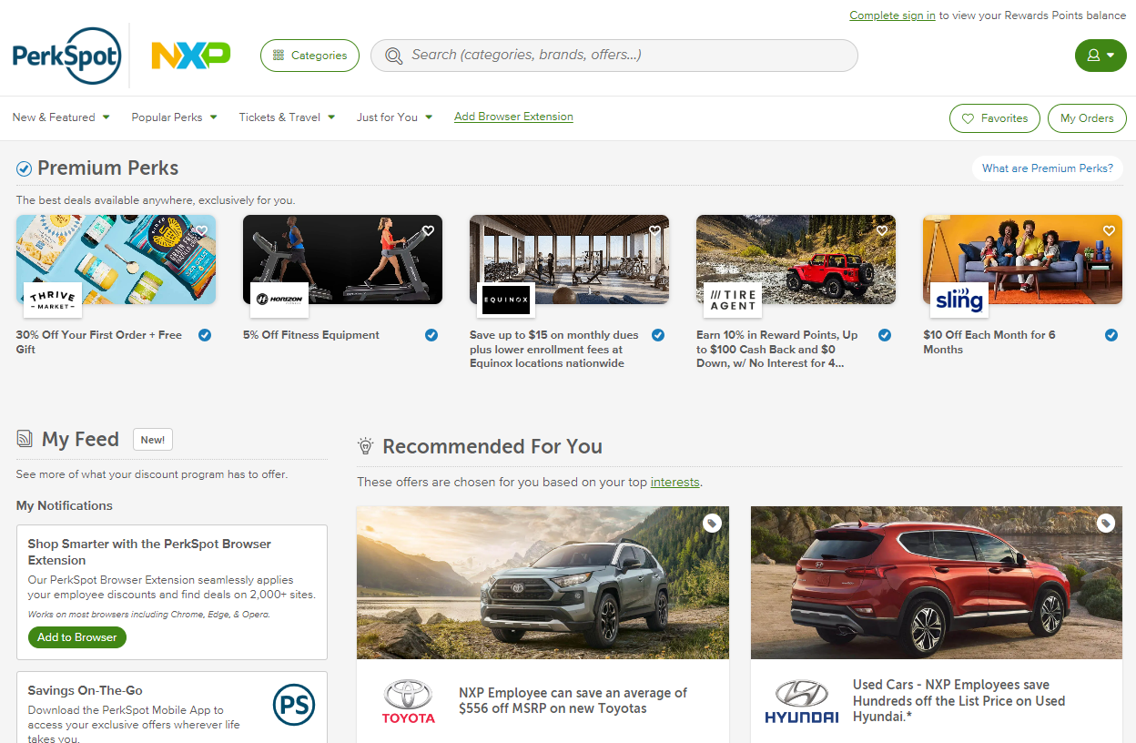
Discount Program
PerkSpot offers NXP employees preferred pricing on products, services and experiences.
Register at nxp.perkspot.com
Notes:
NXP PerkSpot is an online discount program designed to put money back in your pocket. This program gives you unique discounts on brands you use every day. You can save on just about anything: groceries, entertainment, home goods, clothes, vehicles, electronics, getaways, and more. Just sign up, and poke around for what you need.

Slide 22
Benefits to Support Your Wellbeing
Notes:
Your benefits also cover big moments, big feelings, and the normalcy in between. We want you to be your best self and to have resources available when you need help figuring out how to do that.

Slide 23

Gym Reimbursement
Changes for 2026 program:
Effective for 2026 and beyond, gym reimbursement must be submitted to the HR Helpdesk by January 31, 2026
Up to $240 reimbursement annually
Eligible expenses: fitness centers, fitness classes and personal training
Ineligible Expenses for Reimbursement
Acupuncture | Apparel/clothing
Chiropractic care | Exercise equipment
Body composition scans | Food/supplements
Health Education | League/League fees
Recreational activities | Race entries
Rentals of any kind(lockers, equipment, etc.) | Weight management, watches or any smart/tracking devices
Subscriptions
Notes:
Gym Reimbursement is still $240 for 2026. All reimbursement requests must be submitted to the HR helpdesk.
Eligible expenses are fitness centers, fitness classes and personal training.

Slide 24

Wellbeing@NXP
Powered by Personify Health
Take small steps each day to improve physical, mental and financial wellbeing, plus earn rewards.
Personalized wellness support, including:
Challenges to build healthy habits and connect you with NXP team members across the globe
Health tracking tools
Self-paced wellness journeys
Daily health and wellness tips
Sign up at https://join.personifyhealth.com/nxp
Notes:
Wellbeing@NXP is our global wellness platform and will help you make small, everyday changes to your wellbeing that are focused on the areas you want to improve the most. When you stick with it, you’ll build healthy habits, have fun with coworkers, and experience the lifelong rewards of better health and wellbeing.
This platform is powered by Personify Health.
​

Slide 25


UHC Resources and Tools
Ongoing UnitedHealthcare programs and tools:
Manage all your health care needs online or on the go with myuhc.com and the UnitedHealthcare app. Find a network doctor, review claims, and get cost estimates for care.
With Quit For Life, you get one-on-one support, digital tools and medications that help you quit tobacco for good.
Get up to five confidential visits with a therapist through NXP Care Connect. Find support for help with mental health issues, substance use, financial issues and other concerns at liveandworkwell.com.
Get care when you need it, wherever you are, through Virtual Visits. From treating flu and fevers to caring for migraines and allergies, doctors are available 24/7 via your smartphone or computer.
Notes:
UnitedHealthcare has one of the largest, most comprehensive health networks in the country. It also has top-notch resources to promote your well-being, including:
Lots of resources available online and through the mobile app
Help with kicking the smoking habit with Quit For Life
Virtual doctor visits through Teladoc
Free counseling sessions through NXP Care Connect (more on this in a few minutes)

Slide 26
Benefits to Support You and Your Family
Notes:
In addition to wellbeing benefits, we offer many benefits to support our team members and their families.

Slide 27






Family Solutions
Because NXP cares about families, we offer these programs to support yours.
Paid maternity and parental leave. Maternity leave is provided at 100% salary pay during your approved short-term disability claim for six weeks and an additional six weeks is paid at 100% of your salary through parental leave, for a total of 12 weeks of paid leave. Parental leave will be covered up to six weeks at 100% of your salary. And you’re eligible for it after 90 days at NXP.
Employee Assistance Program (EAP) – Care Connect through Optum has changed their number to 855-591-1565
Backup care. NXP partners with Bright Horizons to help US employees find and pay for temporary childcare, self-care or senior care when your regular plans are disrupted.
Tutoring. Offered through Bright Horizons, NXP covers the cost of in-person or online tutoring to students in 300+ subjects.
Optum® Fertility Solutions can help you get the fertility guidance and care you need, up to a $40,000 lifetime benefit maximum.
Sign up for UnitedHealthcare's Maternity Support Program ”Maven” to receive a gift and additional support through your pregnancy. Visit myuhc.com or call 1-877-201-5328.
Adoption assistance program. NXP reimburses up to $10,000 in eligible adoption expenses.
Notes:
We offer 12 weeks of Paid Maternity leave and 6 weeks of paid parental leave at 100% pay.
NXP offers a fertility benefit up to a $40,000 lifetime maximum for UnitedHealthcare members.
NXP also offers up to $10,000 towards adoption assistance
NXP partners with Bright Horizons to help full-time U.S. team members find and pay for temporary childcare, self care or senior care when your regular care plans are disrupted.
NXP also covers the cost of tutoring services offered through Bright Horizons.
UHC members have access to Maven Maternity Support Program, which provides personalized support and guidance at every step of your pregnancy. If you are already enrolled in UHCs Maternity support program a nurse will reach out to you to transition over to the Maven platform.

Slide 28
Benefits for your Financial Wellness
Notes:
NXP also offers financial wellness benefits that are here to help you save and grow your money.

Slide 29
Your 401(k) Plan
Three ways to contribute: pre-tax, Roth and after-tax contributions.
NXP matches your pre-tax and Roth contributions, including catch-up, dollar for dollar up to 5% of your eligible earnings. NXP does not match after-tax contributions.
Use the Roth in-plan conversion feature to convert after-tax and/or pre-tax to Roth.
¹ A distribution from a Roth 401(k) is tax free and penalty free, provided that the five-year aging requirement has been satisfied and one of the following conditions is met: age 59½, disability, or death.
² A partial distribution from a qualified plan must include a proportional share of the pre-tax and after-tax amounts in the account. Therefore, while the portion of your distribution associated with your after-tax contribution is not taxable, the portion of your distribution associated with any pre-tax contributions or earnings on pre-tax or after-tax contributions is taxable.
³ In 2025, catch-up contributions may be made on a pre-tax and/or Roth basis and are in addition to the pre-tax/Roth $23,500 limit and $70,000 additions limit. For 2026, employees with FICA wages over $145,000 in 2025, must make all 2026 catch-up contributions as Roth.
⁴ Employer match contributions are taxed the same whether an employee contributes pre-tax and/or Roth (employer contributions and the related earnings are taxed when distributed).
2026 limits will be posted at nxp.com/benefits > Retirement and Financial > 401(k) Retirement Plan when available
Notes:
Although there are no required actions on your 401(k) during annual enrollment, it’s a great time to review your account.
When saving for retirement, how and when you pay taxes on your 401(k) matters. You can choose between pretax, Roth, and after-tax contributions.
Pretax contributions lower your taxable income today but are taxed at withdrawal. Roth contributions are taxed now, so withdrawals, including earnings, are tax-free if you’re 59½ and it’s been at least five years since your first contribution. You can also make after-tax contributions which allow you to contribute more than the annual pretax/Roth limits. However, NXP does not match after-tax contributions.
If you’re 50 or older by year-end, you’re eligible for catch-up contributions. If you’re age 60 to 63, additional catch-up contributions are available. Effective January 2026, if you’re catch-up eligible (age 50 or older by Dec 31st) and your total NXP 2025 FICA wages (Box 3 on your 2025 form W-2) were over $145,000*, any catch-up contributions you make must be made as Roth contributions.
NXP matches 100% of the first 5% of eligible earnings you contribute to your 401(k) as pretax or Roth, including catch-up contributions. NXP does not match after-tax contributions.

Slide 30
Your 401(k) Plan
SECURE 2.0 Act
Effective January 2026, if you’re catch-up eligible (age 50 or older by Dec 31) and your total NXP 2025 FICA wages (Box 3 on your 2025 form W-2) were over $145,000*, any catch-up contributions you make must be made as Roth contributions.
Only earnings at NXP will be considered
If you have elected only pre-tax contributions, we will automatically convert your catch-up contributions to Roth
Catch-up contributions will show as Roth catch-up on your paystub and post to the Roth catch-up source in your Fidelity 401(k) account
To learn more about Roth contributions:
Visit nxp.com/benefits > Retirement and Financial > 401(k) Retirement Plan
Log into your Fidelity NetBenefits account > click on the three dots next to your plan balance > Plan Information and Documents > After-tax and Roth In-Plan Conversion eBrochure
Reminder, effective January 2025, employees aged 60 – 63 are eligible for “super catch-up”. For 2025, “super catch-up” was an additional $3,750 in allowable employee contributions.
*Indexed annually
Notes:
NotesSECURE 2.0 Act – Catch-Up Contributions Update
Effective January 2026
If you're age 50 or older by Dec 31, 2025 and your 2025 NXP FICA wages (Box 3 on W-2) exceed $145,000, → All catch-up contributions must be Roth (after-tax).
Only NXP earnings count toward the $145,000 threshold.
If you've elected only pre-tax contributions, NXP will automatically convert your catch-up contributions to Roth.
These will appear as Roth catch-up on your paystub and in your Fidelity 401(k) account.
Resources
Visit: nxp.com/benefits → Retirement and Financial → 401(k) Retirement Plan
Log into Fidelity NetBenefits → Plan Info & Documents → “After-tax and Roth In-Plan Conversion” brochure
Super Catch-Up Contributions (Effective January 2025)
Employees aged 60–63 are eligible for enhanced catch-up limits.
For 2025, the super catch-up limit is $11,250 (150% of the standard $7,500 catch-up). [New SECURE...Ages 60-63]
This provision is optional for employers, but NXP has implemented it.

Slide 31
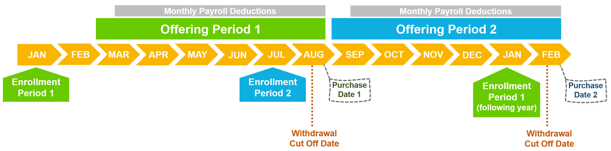

Employee Stock Purchase Plan (ESPP)
The ESPP is a voluntary plan that allows you to purchase NXP shares (NASDAQ: NXPI) at a 15% discount.
Eligibility
You must be employed directly by an NXP group company to be eligible. Executives, contractors, interns/students and employees on a fixed term are not eligible.
Contributions
Contribute 2% to 10% of your gross base pay, deducted each pay cycle during a 6-month Offering Period.
Shares are purchased on the Purchase Date at the end of the Offering Period.
Enrollment
To participate, employees must enroll during an Enrollment Period in January or July.
Watch for email notifications or digital banners on TVs around the office notifying you when enrollment is open.
For more information visit NXP’s ESPP SharePoint page
Notes:
As a reminder NXP offers an Employee Stock Purchase Plan that allows eligible employees to purchase NXP stock at a 15% discount.
Most employees are eligible however executives, contractors, interns/students, and employees on a fixed term are not .
Contribute between 2% and 10% of your base pay during a six-month Offering Period.
The maximum amount you can contribute in a year is $25,000 or $21,250 with the 15% discount.
The next Enrollment Period opens in January 2026. Watch for emails notifying you that the enrollment period is open.

Slide 32
Tools and Resources
Notes:
Here are a few of the tools and resources we offer to help make it easier for our team members to access and utilize their benefits.

Slide 33


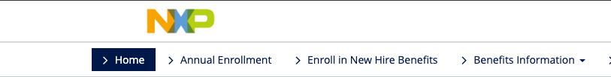
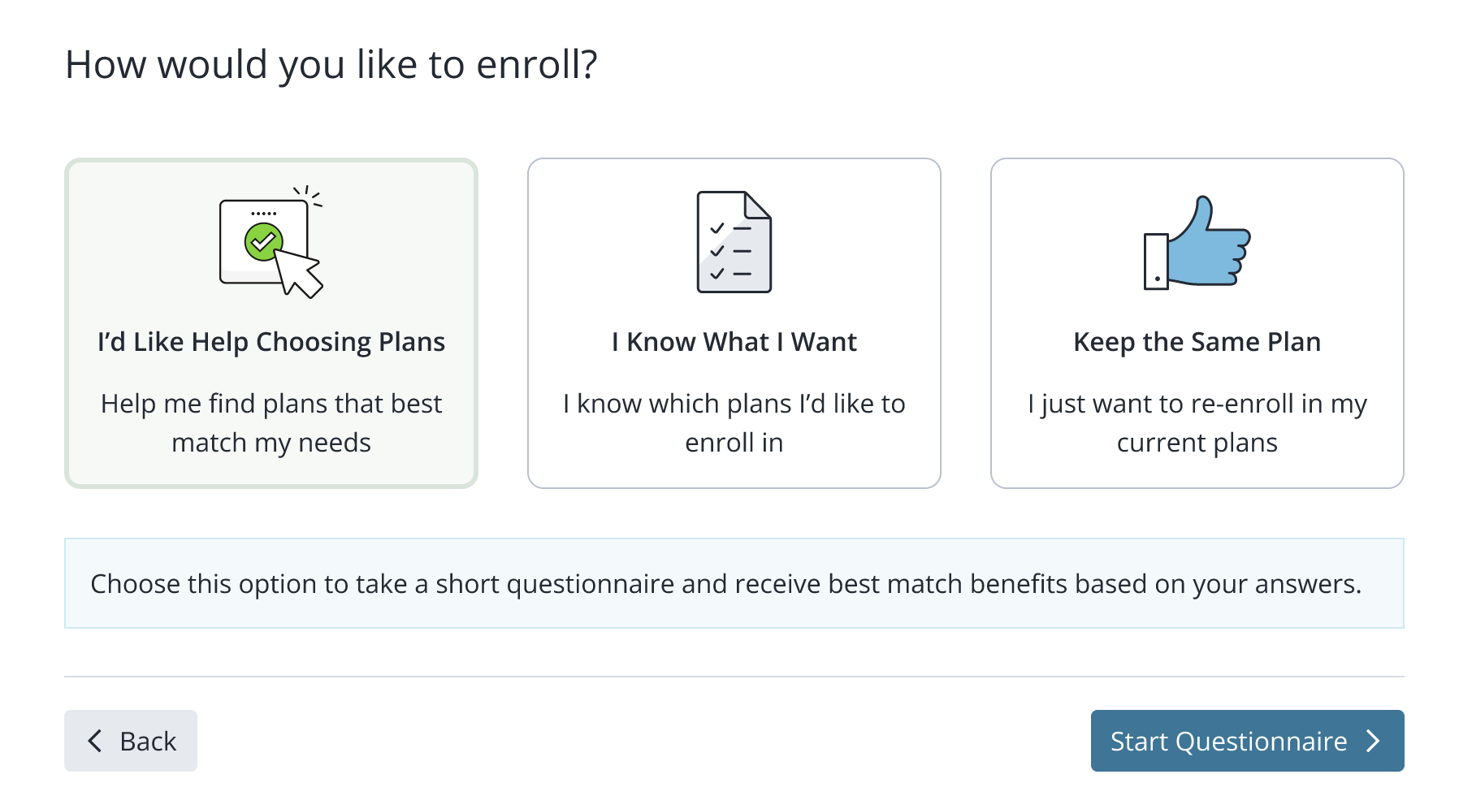
Decision Support Tool
Key Features:
A simple, easy-to-use process providing personalized results.
Considers your entire wellbeing, including financial, physical, and emotional needs.
Helps you plan for your future and understand the benefits you’re paying for.
Simplifies the selection process, reducing the frustration of too many choices.
Allows you to model different scenarios to identify components of care that drive out-of-pocket costs.
Gives you the confidence you need to make informed benefits decisions!
Notes:
We also have Businessolver’s Decision Support Tool. This tool will ask you a series of questions to help guide you to the best plan options for you and your family. All answers will be kept confidential and are never stored or shared.

Slide 34
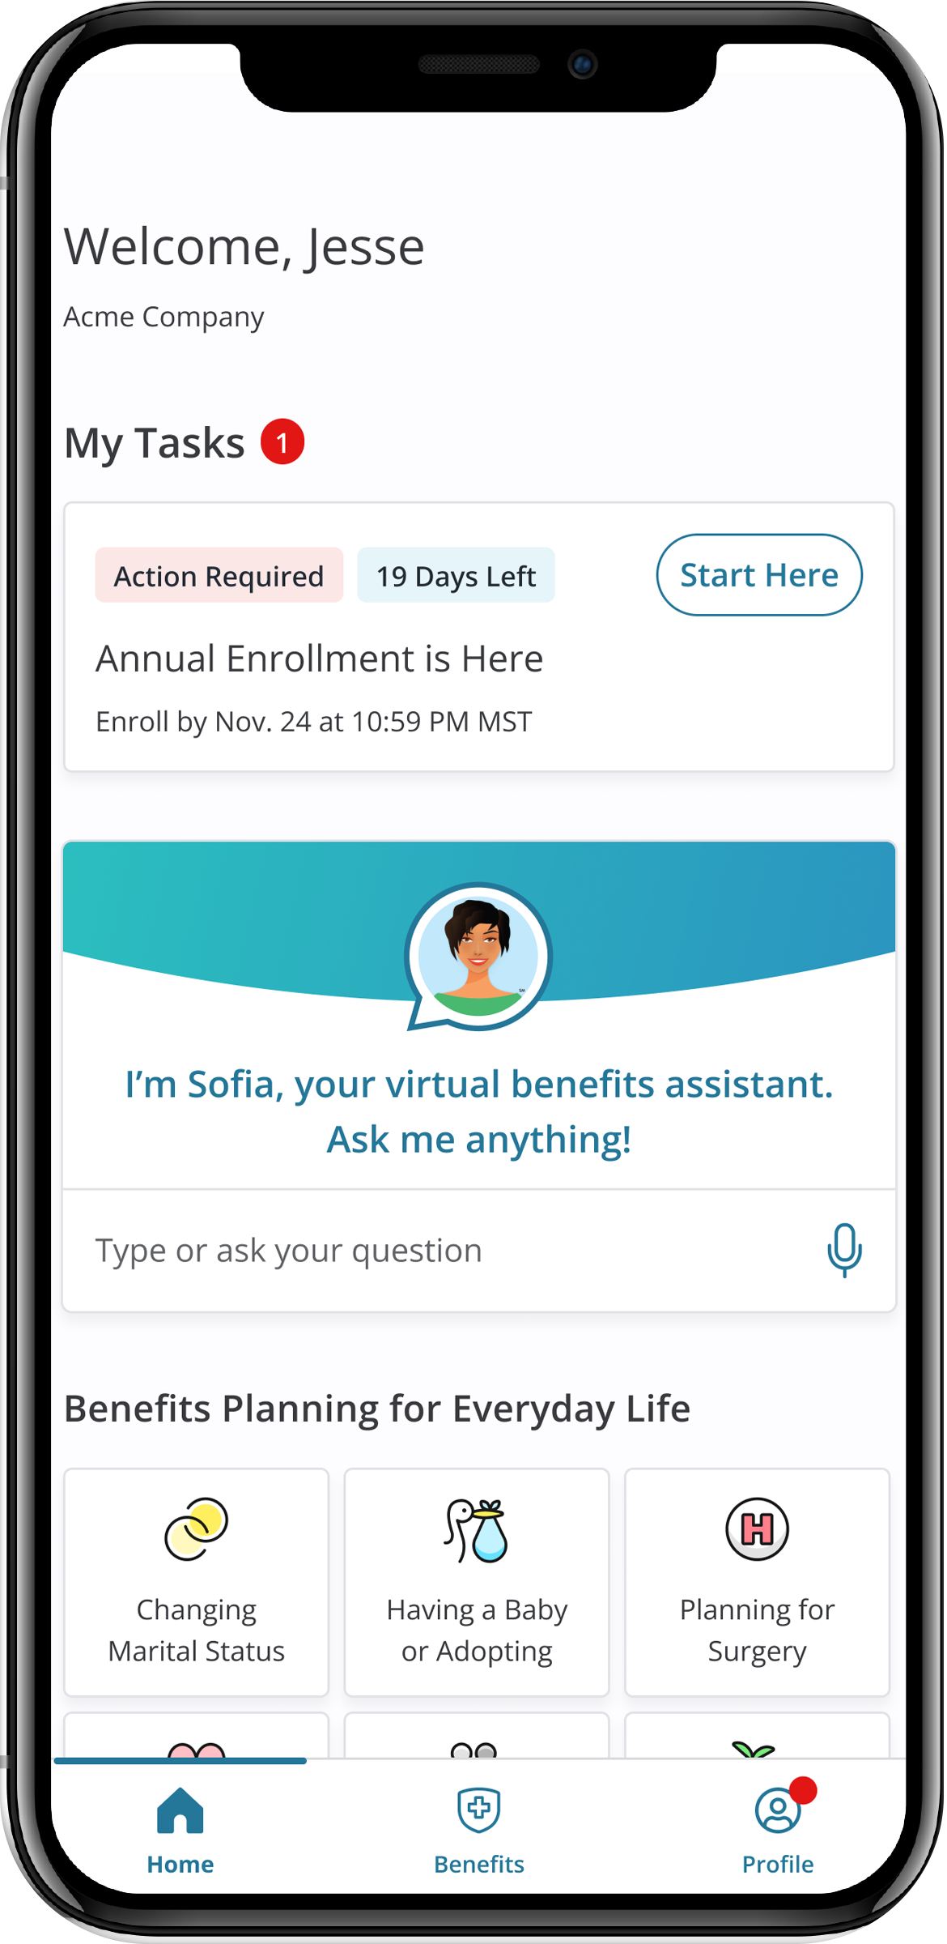
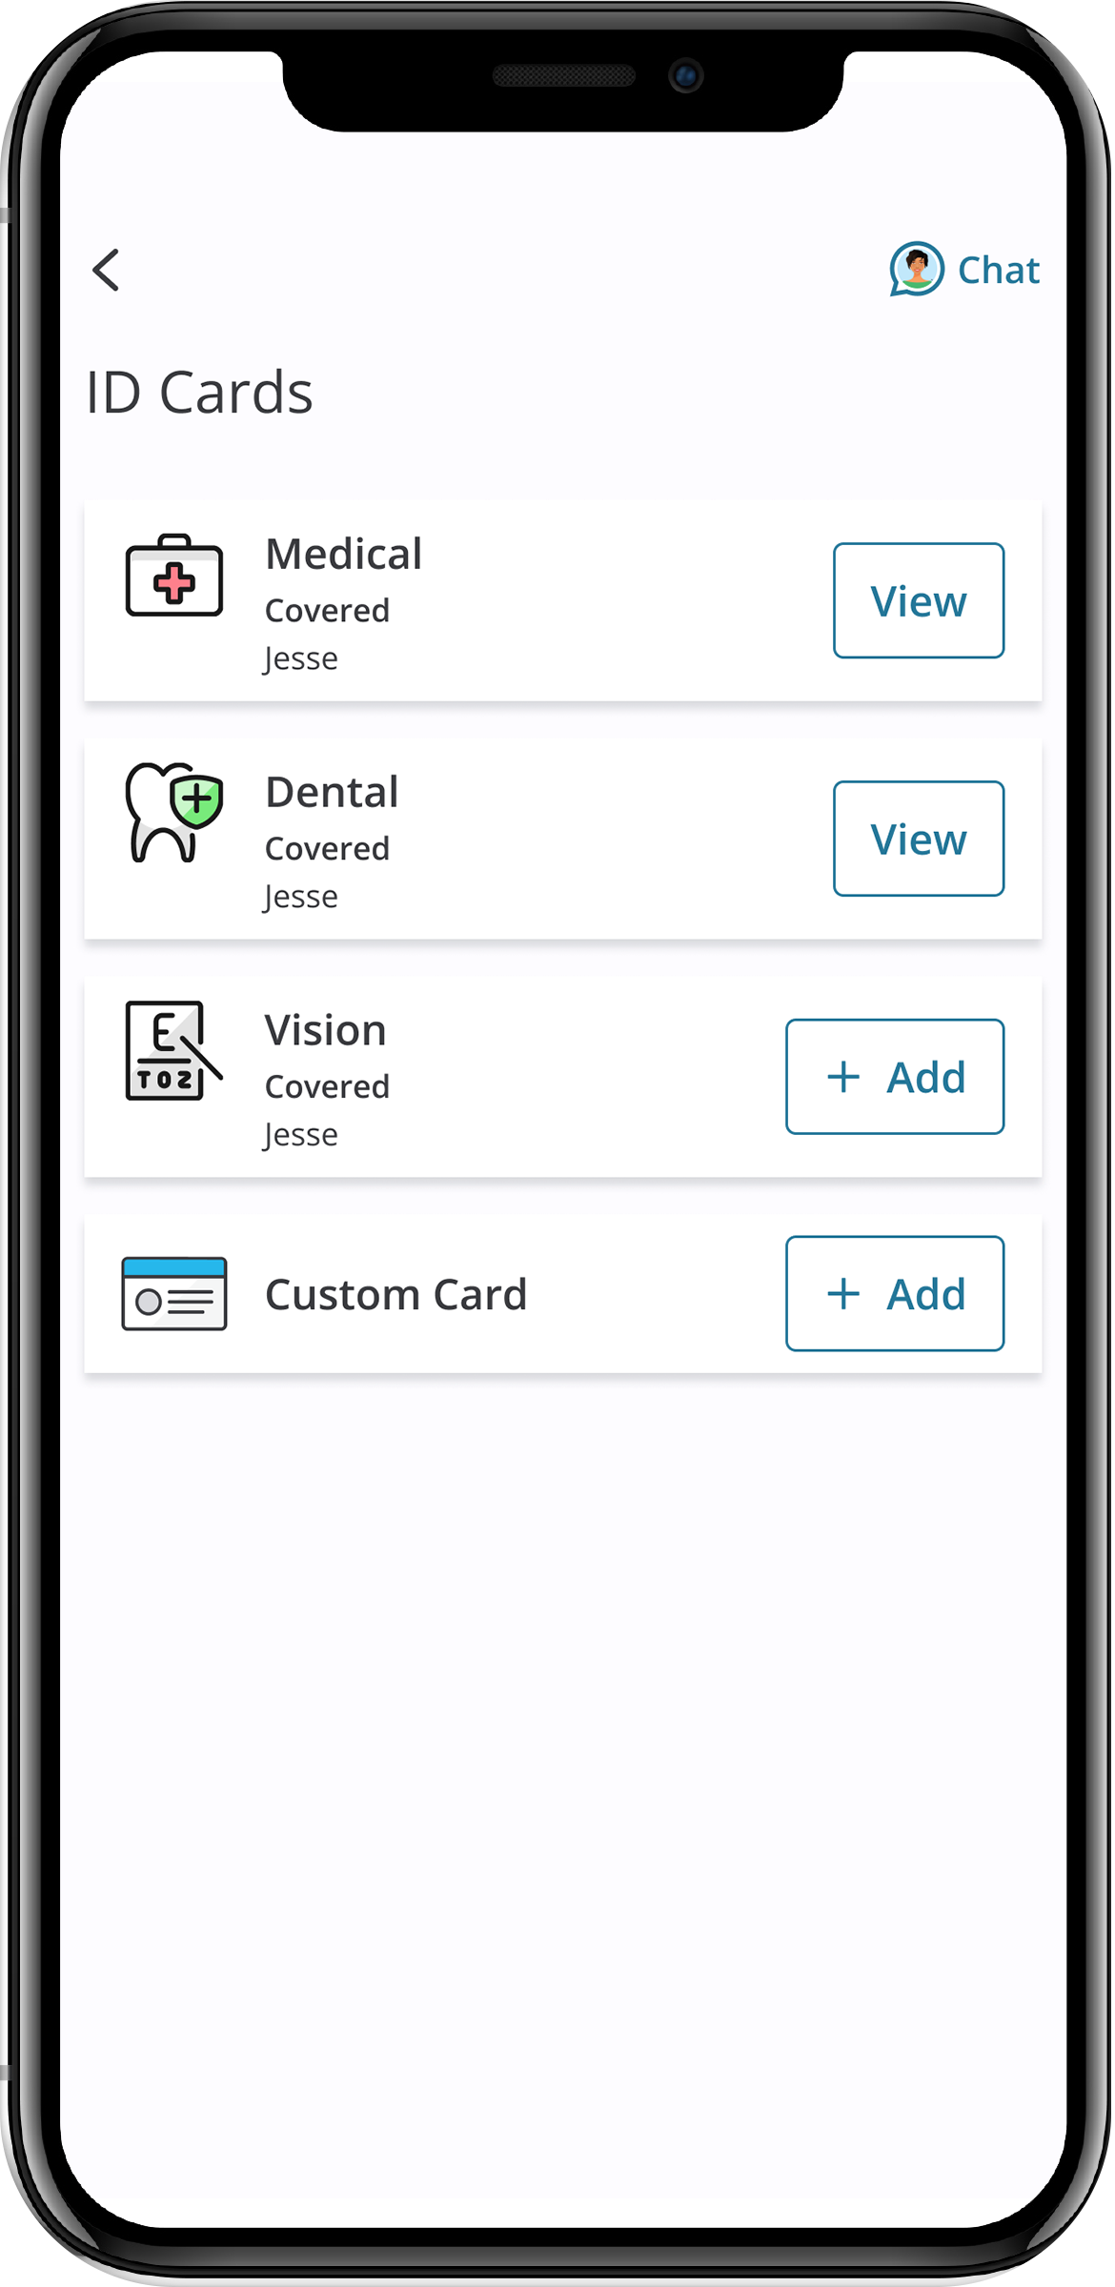
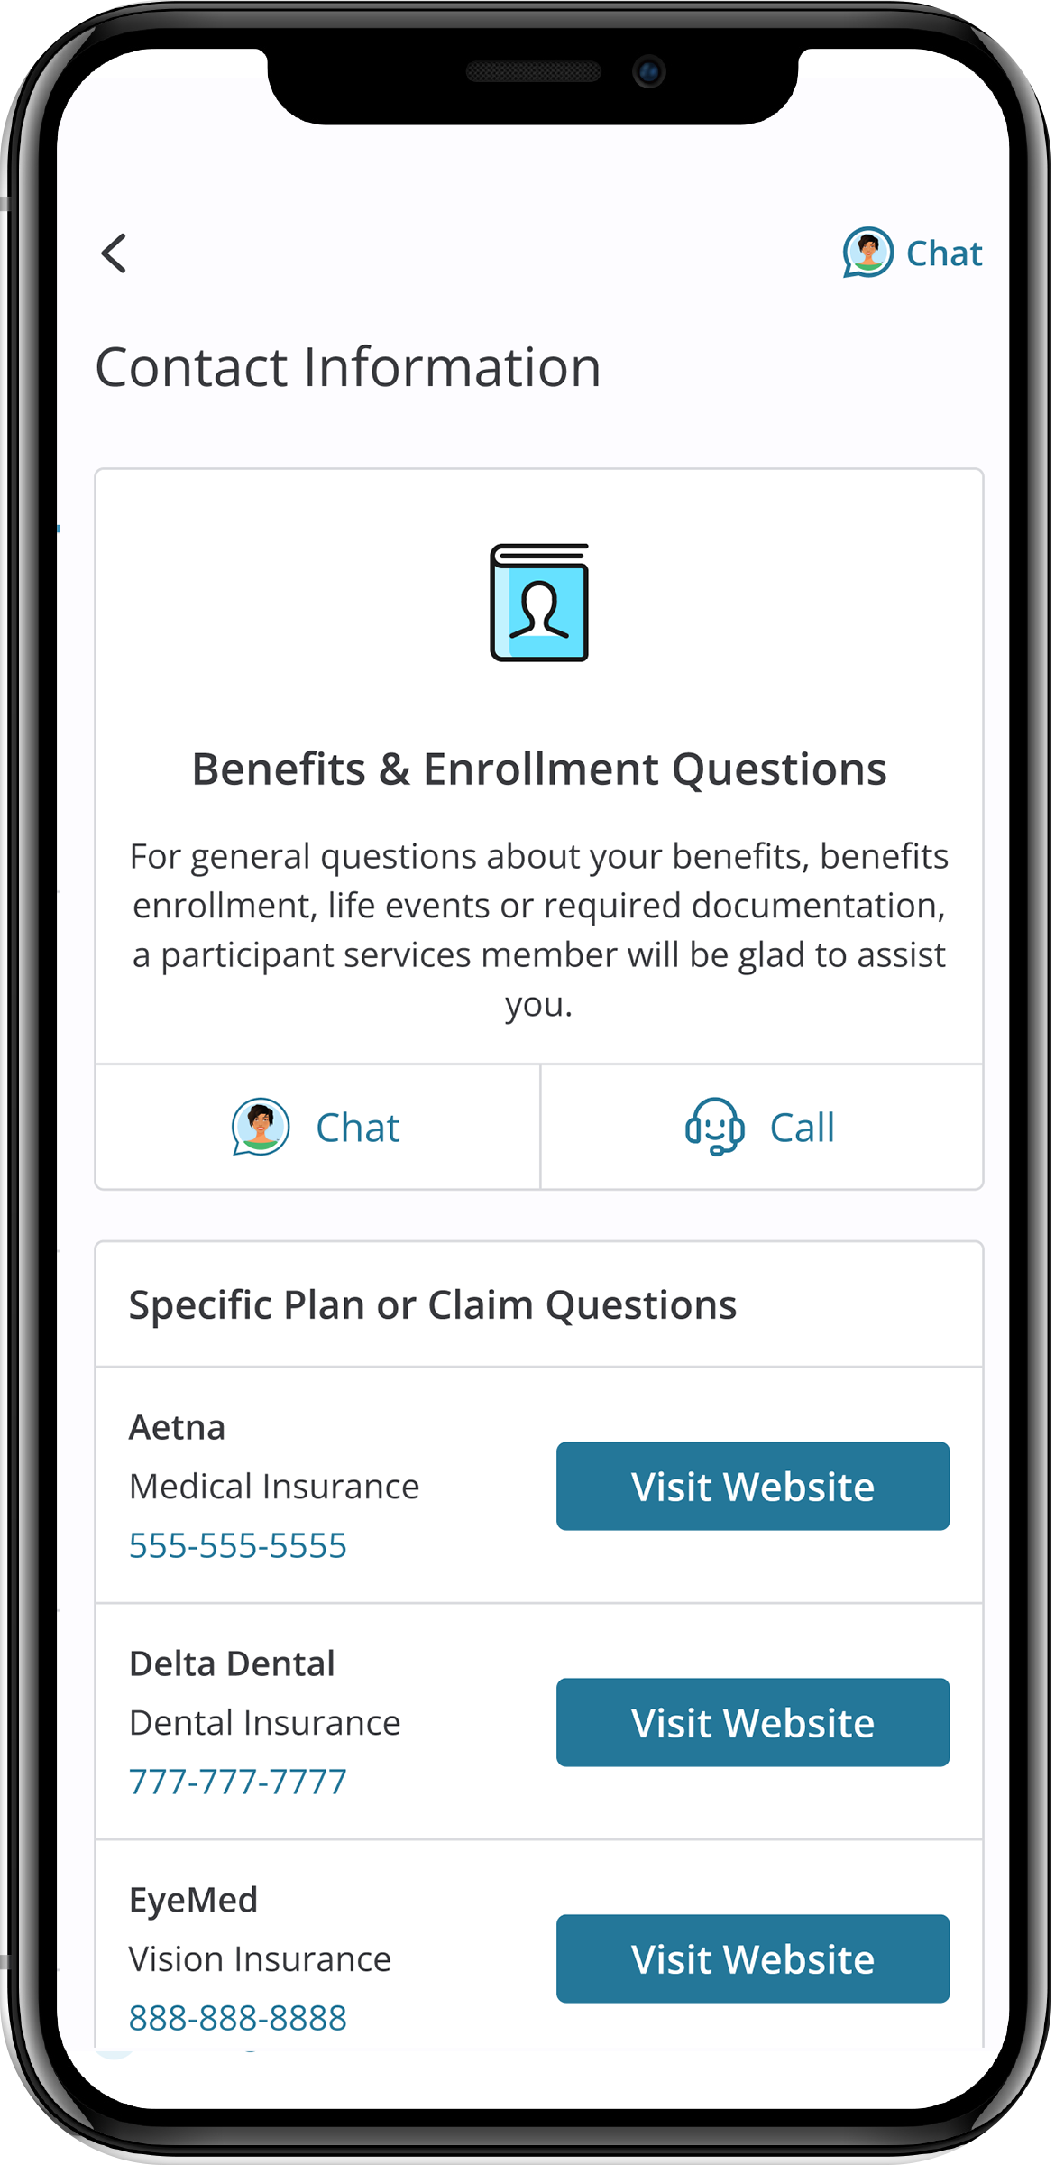
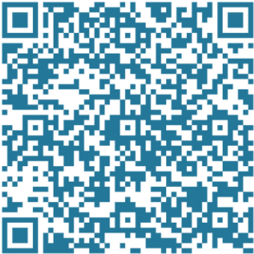



MyChoice® Benefits App
With the MyChoice benefits app, you can:
Store pictures of your ID cards for quick and easy access.
Access detailed coverage information at your fingertips.
Make changes to your benefits with just a few taps... and much more!
Experience the convenience of managing your benefits wherever you go!
Notes:
Make sure to download the app for Businessolver, which can be found in the app store under “MyChoice Benefits”

Slide 35
Enrollment Reminders
Notes:
We are reaching the end of our presentation and want to leave you with some important enrollment reminders.

Slide 36
Important Reminders
If you do not make new elections by October 31, 2025, your current 2025 enrollment elections will carry over to 2026 except for spending accounts.
Your 2025 Flexible Spending Account, Dependent Care Account, Health Savings and Commuter elections will not automatically be renewed for 2026.
Your current election amount will default to zero.
You will be required to log in to Businessolver and make an election to contribute to the FSA, DCFSA and HSA again in 2026. Commuter elections can be made via NetBenefits.
Review your benefits, and make any changes by Friday, October 31.
Visit nxp.com/benefits for details.

Slide 37
Prepare for Annual Enrollment
Annual Enrollment is October 20 – October 31
Get familiar with your benefits and plan options so that you’re ready to make choices that provide you and your family with the most value.
1
Think about what’s in store for you in 2026. Visit nxp.com/benefits to review your options and read the Benefits Enrollment Guide.
2
Learn what’s new by speaking to a Benefits Team member at the benefits tables during our Annual Enrollment fair.
3
Complete the decision support tool, which is available after you start your enrollment, to receive personalized guidance on the best plans for you and your family.
4
Talk to Sofia and use the Decision Support Tool to obtain personalized support and guidance on the best plan(s) for you and your family.
5
Enroll in the options that best meet your needs and budget by October 31, 2025, at nxp.com/benefits
Notes:
Our benefits team members will be on site during prior to Annual Enrollment and while we are not having vendor fairs this year, our team members will be there to assist if you have questions.
We encourage you to utilize the Decision Support Tool to help guide you in making some key benefit decisions.
As a reminder, you can ask Sofia, our virtual benefits advisor, many questions about our plans.

Slide 38
Learn More and Get Help
Visit nxp.com/benefits
Call: (888)532-3971
(Monday – Friday, 7a.m. – 7p.m. CT)
Follow us on Viva Engage
For 401(k), HSA and FSA questions, call the Retirement Service Center: (844)697-4015 (Monday – Friday, 7:30 a.m. – 7:30 p.m. CT)
Enroll by October 31
Important Reminders:
You must enroll to contribute to an FSA or HSA in 2026
Unused 2025 funds will not roll over into 2026
Notes:
The 2026 enrollment site and support number will be available on October 20. Visit nxp.com/benefits on that date to access the annual enrollment portal. The portal will no longer be available after Midnight on October 31st.

Slide 40
Q&A
usbenefits.office@nxp.com

