Slide 1


2027 U.S. Benefits Annual Enrollment
October 19 – October 30
1
| NXP | Internal
Notes:
We are pleased to showcase all 2027 NXP benefits to support you and your family’s well-being year-round.

Slide 2

Agenda
Introduction and Overview
What to Expect in 2027
Benefits to Support Your Wellbeing
Your 401(k) Plan
Enrollment Reminders
4 | NXP | Internal
4 | NXP | Internal
Notes:
For today’s agenda we will discuss what is coming in 2027, benefits to support your wellbeing, your 401k plan, as well as enrollment reminders.

Slide 3
On-Site Benefits Events
SAN JOSE
OAK HILL
EVENT
DATE
TIME
ROOM / LOCATION
EVENT
DATE
TIME
ROOM / LOCATION
Flu Shots
Wed., Oct. 7
9 a.m. – 2 p.m.
Holger Way Lounge
Flu Shots
Tue., Oct. 13 & Wed., Oct. 14
9 a.m. – 2 p.m.
Oak Hill Café
Benefits Presentation
Wed., Oct. 7
2 – 3 p.m.
Holger Way Lounge
Benefits Presentation
Tue., Oct. 13
1 – 2 p.m.
Oak Hill Café
Benefits Table
Wed., Oct. 7
9 a.m. – 3:30 p.m.
Holger Way Lounge
Benefits Table
Tue., Oct. 13 & Wed., Oct. 14
9 a.m. – 3 p.m.
Oak Hill Café
ARIZONA
ED BLUESTEIN
EVENT
DATE
TIME
ROOM / LOCATION
EVENT
DATE
TIME
ROOM / LOCATION
Flu Shots
Tue., Oct. 20
4 – 6:30 p.m.
Bldg. E/W Hallway, near fab breakroom
Flu Shots
Tue., Oct. 27 & Wed., Oct. 28
9 a.m. – 1 p.m.; 4 – 6 p.m.
Bldg. M Hallway, near Grand Canyon
Flu Shots
Wed., Oct. 21
9 a.m. – 1 p.m.; 4 – 6:30 p.m.
Bldg. E/W Hallway, near fab breakroom
Benefits Presentation
Tue., Oct. 27 & Wed., Oct. 28
9 – 10 a.m.
Grand Canyon & Canyon de Chelly
Flu Shots
Thu., Oct. 22
9 a.m. – 1 p.m.
Bldg. E/W Hallway, near fab breakroom
Benefits Presentation
Tue., Oct. 27 & Wed., Oct. 28
4:30 – 5:30 p.m.
Grand Canyon & Canyon de Chelly
Benefits Presentation
Tue., Oct. 20 & Thu., Oct. 22
10 – 11 a.m.
Manufacturing Conference Room
Benefits Table
Tue., Oct. 27 & Wed., Oct. 28
9 a.m. – 6 p.m.
Bldg. M Hallway, near Grand Canyon
Benefits Table
Tue., Oct. 20 & Wed., Oct. 21
9 a.m. – 6:30 p.m.
Bldg. E/W Hallway, near fab breakroom
Benefits Table
Thu., Oct. 29
9 a.m. – 1 p.m.
Bldg. M Hallway, near Grand Canyon
Benefits Table
Thu., Oct. 22
9 a.m. – 2 p.m.
Bldg. E/W Hallway, near fab breakroom
3
| NXP | Internal
Notes:
Please ensure you are attending your onsite events for presentations, flu shots and benefit tables where we will have representatives there to help you with any enrollment questions you may have.

Slide 4

What to Expect in 2027
New Life Insurance Provider – Securian
Medical Plan 1 deductible has increased, while Medical Plan 2 and 3 remain unchanged. Premiums have increased across all medical plan options.
HSA Annual Limits
  $4,500 for individual, $9,000 for family coverage
  NXP Contribution remains $500 Individual/$1,000 for family coverage
FSA Annual Limits
  $3,400 per household
  FSA does not roll over; this is a use it or lose it spending account
Payroll Notices
  First paycheck will be January 4th
  Your 401(k) and Employee Stock Purchase Plan deductions will start January 4, 2027, pay date
  Your first benefit deduction will occur on January 15, 2027
As of October 1, 2026 NXP employees will no longer allow borrowed PTO (40 hours may be borrowed/approved for leave of absence only) Any existing owed time will roll over to UKG.
Notes:
Here is what to expect in 2027

Slide 5
U.S. Benefits
Strategy
NXP continues to support competitive benefit programs
for all employees and their families
2027 DIRECTION
Competitive coverage
that supports the health, mental and financial wellbeing of our employees.
COST SHARE
NXP cost share increases to 88%; employee share decreases to 12%
MEDICAL
Premium increases remain below 7% across all medical plans
NXP
DENTAL + VISION
Dental premium increases averages 6.7%; vision premiums remain unchanged
Notes:
NXP continues to support competitive benefit programs for all employees and their families. The cost share for NXP has increased to 88%, while employee share has decreased to 12%.
Medical premiums have less thana 7% increase across all plans while dental premiums averaged a 6.7% increase, all vision premiums will remain unchanged.

Slide 6
Payroll Notice
There will be 27 pay periods in 2027
The first paycheck will be issued January 4th
There will be NO benefit deductions or spending account contributions on the first pay period on January 4, 2027
401(k) and Employee Stock Purchase Plan contributions will be taken on all 27 pay dates
All other benefit deductions will start on January 15, 2027
6
| NXP | Internal
Notes:
There will be 27 pay periods in 2027
The first paycheck will be issued January 4th
There will be NO benefit deductions or spending account contributions on the first pay period on January 4, 2027
401(k) and Employee Stock Purchase Plan contributions will be taken on all 27 pay dates
All other benefit deductions will start on January 15, 2027

Slide 7

Benefits Eligibility
Who is an eligible employee? All regular U.S. employees who
work at least 20 hours per week.
Who is an eligible dependent?
  Spouse: Your legally recognized spouse, claimed as your federal tax dependent. If you are legally married, including a common-law marriage, in a state that recognizes same-sex spouses, your same-sex spouse is eligible for coverage as your spouse.
  Domestic partner: Your same-sex or opposite sex domestic partner who has lived with you for at least six months, is not a blood relative of yours, is not legally married or in another domestic partner relationship and is at least 18 years old.
  Dependent children: Your married and unmarried children through the end of the month in which they reach age 26.
NXP

Slide 8


New Life Insurance Carrier
Why NXP selected Securian:
Supplemental Life: Increased guaranteed issue to up to $750K, or 3x annual salary
Quicker turn around in death claims processing
Paramedical exam fees covered for EOI exams
Empathy App- helps beneficiaries navigate the process
Flexibility to align with NXP's existing plan design and employee experience
Legal resources – wills, estate planning, immigration and more
Notes:
Losing a loved one is an incredibly difficult life event. Our new partnership with Securian enhances the beneficiary claims experience by enabling faster information sharing from Businessolver, reducing processing delays. Securian also offers the Empathy program, which provides compassionate support and resources to help beneficiaries through every step of the process.

Slide 9

Medical Plan Comparisons
In-network coverage only
 | Medical Plan 1 (HSA-eligible)¹ | Medical Plan 2 (PPO)² | Medical Plan 3 (EPO) ² | Kaiser (CA only)³
Deductible | $1,750 employee-only / $3,500 family | $500 employee-only / $1,000 family | $400 employee-only / $800 family | $0
Coinsurance | Plan pays 80% for network benefits | Plan pays 80% for network benefits | Plan pays 90% for network benefits only (out-of-network services not covered) | Plan pays 100% for network benefits
Out-of-pocket limit | $4,000 employee-only / $7,350 family | $5,000 employee-only / $10,000 family | $5,000 employee-only / $10,000 family | $1,500 employee-only / $3,000 family
Copay | You pay 20% after deductible | $20 primary care physician / $40 specialist | $20 primary care physician / $40 specialist | $35 copay
Lab and X-ray in a physician's office | You pay 20% after deductible | You pay 20% | You pay 10% | $35 copay
NXP HSA contribution | $500 employee-only / $1,000 family | Not eligible | Not eligible | Not eligible
¹ If you elect family coverage, the family deductible must be met before the plan begins to apply coinsurance towards in-network claims. The family deductible can be met by one family member or a combination of covered family members
² If you elect family coverage, the plan begins to apply coinsurance towards applicable in-network claims for an individual once he or she meets their per person deductible. Once those per person deductibles add up to meet the family deductible, the plan begins to apply coinsurance towards in-network claims for everyone in the family.
³ California employees have access to Kaiser HMO if they reside within Kaiser’s network service area
Notes:
NXP offers you a choice of three UnitedHealthcare medical and corresponding Rightway pharmacy plans, including a Health Savings Account (or HSA)-eligible plan. Please note that Medical Plan 3 does not cover services you receive from out-of-network providers. If you reside in California, you may also have access to the Kaiser HMO Plan. The Kaiser HMO is a network that many find easy and convenient to use—plus, it keeps out-of-pocket costs low. You can opt out of the NXP medical plan if you prefer not to enroll.
For Medical Plan 1, the deductibles will increase to $1,750 Single/$3,500 Family to meet IRS requirements. If you enroll in this plan and elect family coverage, the family deductible must be met before the plan begins to apply coinsurance towards in-network claims. The family deductible can be met by one family member or a combination of covered family members.
For Medical Plans 2 and 3, if you elect family coverage, the plan begins to apply coinsurance towards in-network claims for an individual once he or she meets their per person deductible. Once those per person deductibles add up to meet the family deductible, the plan begins to apply coinsurance towards in-network claims for everyone in the family.

Slide 10
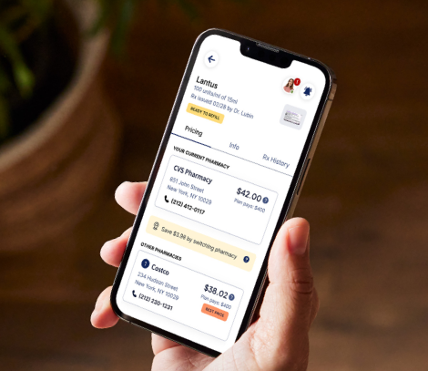

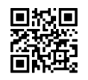
Rightway Healthcare AppEasy to use and simplifies healthcare benefits
Provides personalized support from live pharmacists
Helps members find quality providers
Shows lowest prices at pharmacies near you
Helps members make informed healthcare decisions with confidence
Notes:
Remember our pharmacy provider is now Rightway Healthcare
"The Rightway app is easy to use and makes managing healthcare benefits much simpler. I appreciate the personalized support, ability to find quality providers, and clear guidance on prescriptions and healthcare costs,use the app the find the best value for your family.

Slide 11
Prescription Drug Plan Comparisons
 | Medical Plan 1 | Medical Plan 2 | Medical Plan 3 | Kaiser (CA only)*
30-day supply (short-term medications) | Generic Preventive prescriptions 100% covered; you pay 20% after deductible for all others Preferred: You pay 20% after deductible Non-preferred: You pay 20% after deductible | Generic: You pay $5 Preferred: You pay 30% ($75 max) Non-preferred: You pay 50% ($100 max) | Generic: You pay $5 Preferred: You pay 30% ($75 max) Non-preferred: You pay 50% ($100 max) | Generic: You pay $10 Preferred: You pay $30 Non-preferred: You pay $30
90-day supply (100-day supply for Kaiser) or maintenance medications | Generic: You pay 20% after deductible Preferred: You pay 20% after deductible Non-preferred: You pay 20% after deductible | Generic: You pay $10 Preferred: You pay 30% ($175 max) Non-preferred: You pay 50% ($250 max) | Generic: You pay $10 Preferred: You pay 30% ($175 max) Non-preferred: You pay 50% ($250 max) | Generic: You pay $20 Preferred: You pay $60 Non-preferred: You pay $60
* California employees have access to Kaiser HMO if they reside within Kaiser’s network service area.
Notes:
Prescription drug benefits under the UnitedHealthcare medical plans are administered by Rightway. You can fill prescriptions at any participating pharmacy (not just CVS). Kaiser plan participants must fill prescriptions at Kaiser pharmacies.
For Specialty medications we will continue to use Rightway Healthcare Specialty Drug Program.
Rightway continues to partner with Walgreens for all mail order prescriptions

Slide 12


Dental and Vision Plans
Delta Dental Plan | Coverage
Deductible | $50 per person, up to $150 per family
Maximum | $2,000 per person each year
Preventive services – exams, cleanings, X-rays, sealants and periodontal maintenance | 100% covered (limited to 2 per year)
Basic services – fillings and root canals | You pay 20% after deductible
Major services – crowns, bridges, implants | You pay 50% after deductible
Orthodontic (adults and children) | You pay 20% after deducible ($2,500 lifetime maximum)
VSP Vision Plan | Coverage
Vision exam | $20 copay (limited to 1 every year)
Prescription glasses | $20 copay
Frames | $250 allowance every year
Contact lens exam | 15% discount; not to exceed $20 copay
Contacts (instead of glasses) | $250 allowance every year
Computer vision coverage | $20 copay
Notes:
Plans will remain the same for 2027, with a slight increase in the premium.
The NXP dental plan offers you and your family preventive, restorative, and orthodontic services. Although you can see any dentist you want, you’ll pay less when you receive dental care from a Delta Dental PPO and Premier network dentist. The orthodontia lifetime maximum is $2,500
The vision plan provides coverage for a vision exam and prescription glasses or contacts once every year.

Slide 13
Expanded Kaiser Fertility Coverage
Comprehensive support for eligible California Kaiser members
Core fertility care
Testing and diagnostics
Expanded family building
Specialist consultations and exams
IUI and IVF procedures
Fertility medications
Lab work and imaging
Diagnostic surgery and biopsy
Genetic evaluation and screening
Donor sperm, eggs, or embryos
Donor-related clinical services
Embryo transfer to a gestational carrier
Cryopreservation and storage of sperm, eggs, and embryos may be covered when applicable.
13
| NXP | Internal
Notes:
Kaiser has expanded it’s Fertility coverage to comply with California Senate Bill 729 requirements.
Improve access to fertility treatment, including IVF and IUI
Support diverse paths to parenthood through donor and gestational carrier services
Cover medically necessary fertility preservation services
Provide more equitable fertility benefits for California members

Slide 14
2027 Diabetes Supplies Coverage Update
Better access. No cost to you.
Beginning September 1, 2026, eligible diabetes supplies move from the pharmacy benefit to the UHC medical benefit.
APPROVED VENDORS
WHAT’S CHANGING
Edgepark
WHAT’S NOT CHANGING
✓
Preferred insulin pumps and related supplies move to the medical benefit
Daily testing supplies, continuous glucose monitors and medication remain covered under pharmacy
Byram
✓
Test strips • Lancets
Insulin syringes • Pen needles
Control solution • Alcohol swabs
Ketone test strips
Edwards EHCS
Orders are placed through approved diabetes supply vendors
✓
Prior authorization or documentation may be required
Advanced Diabetes Supply
Questions? UnitedHealthcare Member Services (844) 210-5428
1.
Talk with your provider
2.
Confirm authorization needs
3.
Order through an approved vendor
14
| NXP | Internal
Notes:
Diabetic supplies are covered at 100%, please keep in mind some of these supplies are only covered at 100% if your medical coverage is presented.
What’s changing:
Preferred insulin pumps and related supplies move to the medical benefit
Orders are placed through approved diabetes supply vendors, these vendors have a direct relationship with United Healthcare
Prior authorization or documentation may be required. Each vendor may have different coverages regarding brands of pumps, please r
What is not changing and will continue to remain under pharmacy coverage:
Daily testing supplies, continuous glucose monitors and medication remain covered under pharmacy
Test strips • Lancets
• Insulin syringes • Pen needles
• Control solution • Alcohol swabs
• Ketone test strips

Slide 15
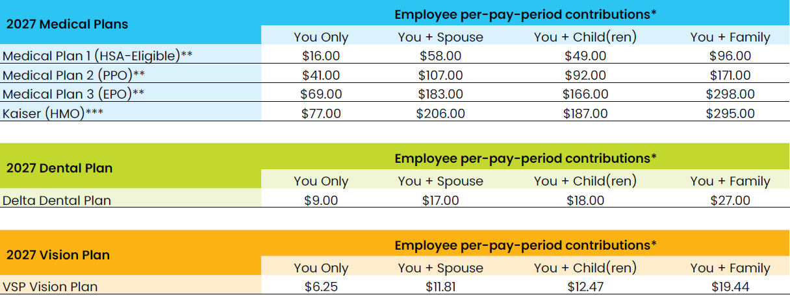
2027 Bi-Weekly Rates*
Rates assume $300 Wellness Incentive is applied and non-smoker status
*Rates above assume wellness incentive completion.
**A $50 monthly Tobacco Use Penalty will be assessed in addition to above rates, as applicable.
***Enrollments subject to geographic restrictions.
Notes:
* All medical coverage contributions listed will increase $50 per month for each covered employee and/or spouse or domestic partner who uses tobacco.
If hired within 2027, you will have automatic wellness incentive for 2027
You must get biometric screening in 2027 to have incentive for 2028

Slide 16


Spending Accounts
5 | NXP | Confidential

Slide 17
Health Savings Account (HSA)
Plan | Eligibility Requirements | Contribution Amounts | Account Details
Health Savings Account (HSA) | Enrolled in Medical Plan 1 Can’t be covered by another non-high-deductible health medical plan Your spouse can’t have separate plan with an FSA Can’t be enrolled in Medicare | Employer will contribute $500 for employee-only coverage and $1,000 for family coverage Employee can contribute up to $4,500 with employee-only coverage or $9,000 with family coverage If you are 55 or older, you can contribute an additional $1,000 NXP’s contributions are based on your initial coverage level. Changing from Employee-Only to Family coverage does not result in additional contributions | You own your HSA The entire account balance rolls over each year. You can invest your funds
Notes:
If you are enrolled in Medical Plan 1, you are eligible to contribute to a Health Savings Account, also known as an HSA. If you enroll in this account, you will receive free money from NXP as a contribution into this account that’s earmarked for you and your dependents current and future medical, dental or vision expenses. You must enroll in this account in order to receive the free money from NXP. This enrollment is separate from your medical plan enrollment.
You cannot have an HSA if your spouse is enrolled in a separate plan and is contributing to a Health Care Flexible Spending Account or if you enrolled in Medicare. You own your HSA, and your account balance will continue to grow year over year.
HSA contribution limits have increased to $4,500 for individual coverage and $9,000 for family coverage. NXP will continue to contribute $500 for individual coverage and $1,000 for family coverage. Because the NXP contribution counts toward the IRS maximum, your maximum personal contribution is $4,000 for individual coverage and $8,000 for family coverage.
As of 2027 HSA accounts are automatically opened if you opt into having an HSA account, you may log into your Fidelity account to see your balance.

Slide 18
Health Care, Limited Use and Dependent Care Flexible Spending Accounts
Plan | Eligibility | Contribution Amounts
Health Care Flexible Spending Account (FSA) | Enrolled in Medical Plans 2 or 3, Kaiser, or waived coverage | You can contribute up to $3,400 per household
Limited Use Flexible Spending Account (LFSA) | Enrolled in Medical Plan 1; can also contribute to an HSA | You can contribute up to $3,400 per household
Dependent Care Flexible Spending Account (DFSA) | All full-time, benefits-eligible employees can participate | You can contribute up to $7,500 per household Employees earning more than $200,000 can contribute up to $5,000
Most Dental and Vision claims must be substantiated by sending Fidelity the Explanation of Benefits from the appropriate vendor
Cosmetic procedures and prescriptions are not covered, and the debit card can not be used to purchase these items
  Teeth whitening
  Wrinkle cream
  Non-prescription sunglasses
Notes:
Unlike the HSA, the Health Care Flexible Spending Account (FSA) doesn’t roll over from year to year. This is a use-it-or-lose-it account. You can contribute up to $3,400 pretax to pay for eligible health care expenses. You’ll forfeit any unused funds at the end of the year. There is a grace period that will allow you to submit any 2026 expenses up to March 31st, however your card will not work after December 31st 2026, so if you have outstanding bills, you will need to manually submit the claim.
FSA accounts are governed by the IRS, all rules and regulations for substantiation must be followed. Only qualified medical, dental and vision expenses are allowed. If an expense is paid for with an FSA card that is not qualified, you will be asked to pay back the amount, a good example would be Accutane for the use of wrinkles because this is cosmetic use, not medically necessity. You may also be required to provide proof of medical necessity, and a great way to do this is providing the Explanation of Benefits(EOB) from your myuhc.com account.Any communication is going to be sent to the email that you have set up on your Fidelity.net account.
If you’re enrolled in Medical Plan 1 and are contributing to an HSA, you can’t have a Health Care FSA, but you can contribute to the Limited Use FSA for dental and vision expenses only. The contribution limit for the Limited Use FSA is also $3,400.
A Dependent Care FSA lets you use pre-tax dollars to pay for eligible expenses related to care for your child, disabled spouse, elderly parent, or other dependent who is physically or mentally incapable of self-care, so that you can work. You can contribute up to $7,500 per household. Employees earning more than $200,000 can contribute up to $5,000 which is an increase from $3,200.

Slide 19
Commuter Account – California Employees Only
Plan | Eligibility Requirements | Contribution Amounts | Rollover Limits
Commuter | Work at least 20 hours per week On U.S. payroll Reside in California | Commuter funds will be employee funded only NXP will no longer fund the account | Funds roll over year over year. However, your unspent funds are forfeited when you leave NXP.
Reminder: You must log in to Fidelity and make an election to contribute each year.
Notes:
NXP offers commuter benefits for Parking and Transit. Eligible employees can enroll in a Fidelity Commuter Account, allowing payroll deductions to cover commuting costs.
As of January 1st 2027 commuter funds are only employee funded accounts.

Slide 20
Optional Benefits

Slide 21
MetLife Legal Plans
MetLife Legal Plans help you navigate life’s planned and unplanned events – with no waiting period, no deductible and no claim forms.
Price per Paycheck
MetLife Legal Plan | $7.62
MetLife Legal Plan Plus Parent Buy-up | $9.92
Money matters, such as debt services and tax audits
Home sales, purchases, refinancing
Wills, powers of attorney, and other estate planning documents
Family and personal matters, such as adoption
Court matters and civil lawsuits
Traffic tickets
And more
NOTE: Attorneys can advise on any legal issues except for employment disputes.
Notes:
NXP’s legal assistance plan through MetLife Legal gives your whole family access to affordable attorneys. As long as you’re enrolled in the plan, you don’t have to stress about legal fees for common issues. Whether you’re buying a house or dealing with a family estate, this plan can simplify the legal process for you. And if you’re enrolled in the buy-up option, your parents and parents-in-law will have access to some legal services too.
Attorneys can advise on any legal issues except for employment disputes.

Slide 22
ID Watchdog - Identity Theft Protection
Plan Specific Features | Essentials | Platinum Plus
Credit Reports & Vantage Score Credit Scores | 1 Bureau Monthly | 1 Bureau Daily & 3 Bureau Annually
Credit Report Monitoring | 1 Bureau | 3 Bureau
Identity Theft Insurance | Up to $1M (per plan) | Up to $5M (per adult)
Stolen Funds Reimbursement | $1M | Checking & Savings Accounts | $1M | Checking & Savings Accounts $1M | 401K/HSA/529 Accounts
Price per Paycheck
 | Essentials Plan | Platinum Plus Plan
Employee | $2.26 | $3.18
Employee + Family | $4.11 | $5.72
NOTE:
All employees will have protection from unemployment claims fraud
Coverage is not available to overage dependents (26 yrs)
Notes:
Even if you choose to not have ID Watchdogs Identity Theft Program, all employees will automatically have protection from unemployment claims fraud
You have two ID Watchdog plan options to choose from, and you can cover yourself only or your entire family.
You’re protected from fraud, data breaches, and more with up to $1 million in identity theft protection.
Both options offer credit report monitoring, provide your credit report, give you $1 million in insurance protection, and have a mobile app that you can use to stay on top of your personal data. The Platinum Plus plan provides additional benefits, including safe browsing options for your devices, stolen funds reimbursement, and other features.
A mobile app helps you stay on top of your personal data.
Once a dependent is overage for medical coverage(age 26) they are no longer eligible to be covered under ID Theft

Slide 23
Employee Disability and Life Insurance
Disability
Short-term disability: 75% of your base salary, up to 26 weeks
Short-term disability buy-up: 90% of your base salary for the full duration of 180 days
Maternity: 12 weeks at 100% pay (after 90 days of hire date)
Paternity Leave: 6 weeks at 100% pay (after 90 days of hire date)
Long-term disability coverage: 60% of base salary, up to $15,000 per month
Employee Life insurance
Basic life insurance benefit: 2x salary (taxable)
Amounts over $50,000 are considered imputed income and will be taxed. Don’t want to be taxed? Choose a flat $50,000 benefit instead.
Employee Supplemental Life insurance
Current supplemental life and AD&D insurance elections automatically carry over to 2026
New guaranteed issue amount is $750K or coverage up to 8x your annual earnings, max $1.5 million
Notes:
Short term disability is 75% of weekly earnings for 180 days, there is a 7 day eligibility period, the benefit will kick in on the 8th day
Short term disability buy- up increases to 90% of weekly earnings for the full duration of180 days.
The maximum benefit for long-term disability is $15,000 per month. This kicks in after 181 days of being disabled.
You automatically receive basic life insurance coverage from NXP, and it’s equal to 2 times your annual salary. This benefit is taxable, so you’ll see a tax on your paycheck stub. Don’t want to be taxed? When you log in to enroll in your benefits, choose a flat $50,000 in coverage, instead.
This year because we made the change to Securian financial, we are allowing an increase in supplemental life insurance up to $750K, or coverage up to 8x your annual earnings, a max of $1.5 million, without medical questions.

Slide 24
Pet Insurance Through PetFirst Healthcare
Flexible products with straightforward pricing (based on age and breed)
Premium discounts
Customizable coverage limits
Hassle-free claims process
What does it cover?
Injuries and illnesses
Exam fees
Surgeries
Medications
Ultrasounds
Hospital stays
X-rays and diagnostic tests
And more
Register
Call 1-800-438-6388 (provide referral code 11010)
Visit www.metlife.com/getpetquote (use NXP for the employer name and register using your employee ID)
Notes:
Your furry friends are also covered. Pet insurance gives you the peace of mind to know that your animals’ health care is a lot more affordable and a little less scary. It covers routine checkups, prescriptions, sniffles, surgeries and more. The cost of pet insurance depends on your pet’s age and breed you will be able to get a quote at metlife.com using NXP credentials.

Slide 25
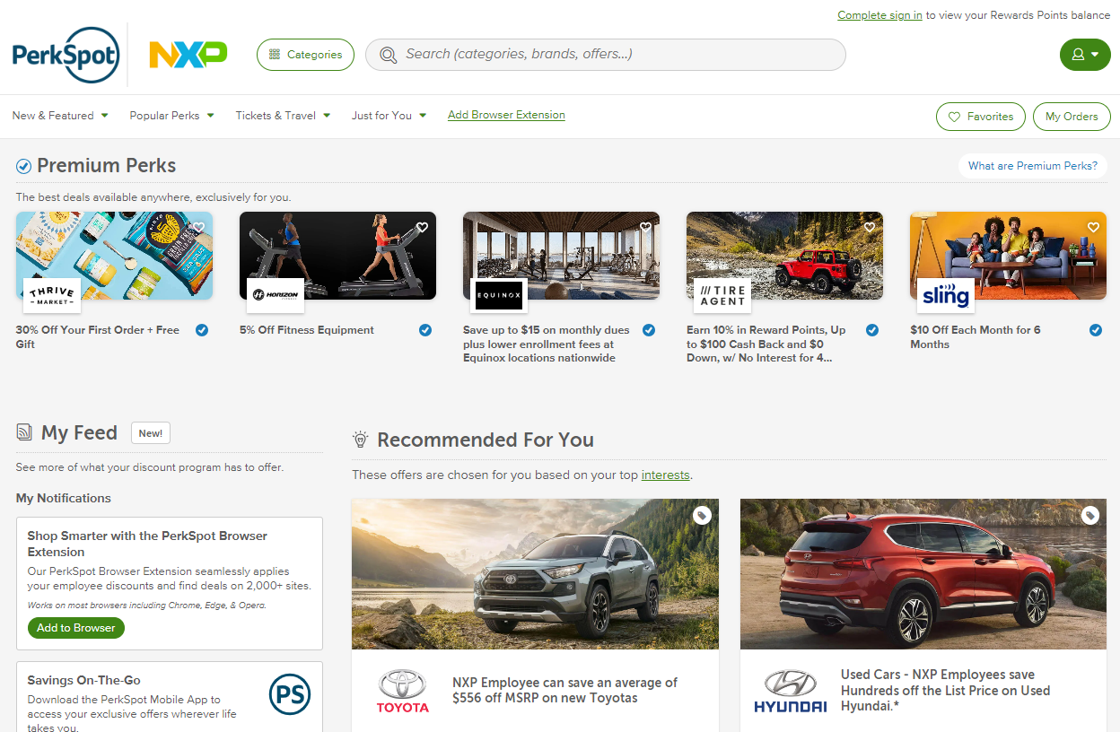
Discount Program
PerkSpot offers NXP employees preferred pricing on products, services and experiences.
Register at nxp.perkspot.com
Notes:
NXP PerkSpot is an online discount program designed to put money back in your pocket. This program gives you unique discounts on brands you use every day. You can save on just about anything: groceries, entertainment, home goods, clothes, vehicles, electronics, getaways, and more. Just sign up, and poke around for what you need.

Slide 26
Benefits to Support Your Wellbeing
26
| NXP | Internal

Slide 27
Perks & Other Programs
Onsite activity centers and group fitness classes at some locations
Gym Reimbursement
Onsite flu shots
Weight Management Program
Notes:
Take advantage of all the perks and programs we have to offer at NXP.

Slide 28

Gym Reimbursement
  Up to $240 reimbursement annually
  Eligible expenses: fitness centers, fitness classes and personal training
Ineligible Expenses for Reimbursement
Acupuncture | Apparel/clothing
Chiropractic care | Exercise equipment
Body composition scans | Food/supplements
Health Education | League/League fees
Recreational activities | Race entries
Rentals of any kind(lockers, equipment, etc.) | Weight management, watches, smart/ tracking devices
Subscriptions
Notes:
Gym Reimbursement is still $240 for 2027. All reimbursement requests must be submitted to the HR helpdesk.
Eligible expenses are fitness centers, fitness classes and personal training.

Slide 29
Take small steps each day to improve physical, mental and financial wellbeing, plus earn rewards.
Personalized wellness support, including:
Challenges to build healthy habits and connect you with NXP team members across the globe
Health tracking tools
Self-paced wellness journeys
Daily health and wellness tips
Sign up at https://join.personifyhealth.com/nxp
Notes:
Wellbeing@NXP is our global wellness platform powered by Personify Health, formerly known as Virgin Pulse. Note that the Personify Health platform is the same as Virgin Pulse and you can use the same credentials to login.

Slide 30




Additional Family Support
Because NXP cares about families, we offer these programs to support yours.
Optum® Fertility Solutions can help you get the fertility guidance and care you need, up to a $40,000 lifetime benefit maximum.
Tutoring and College financial planning. Offered through Bright Horizons, NXP covers the cost of in-person or online tutoring to students in 300+ subjects.
Adoption assistance program. NXP reimburses up to $10,000 in eligible adoption expenses.
Employee Assistance Program (EAP). No-cost support to help employees and their families navigate personal, emotional, financial, legal, and family-related challenges, with access to professional resources and counseling whenever needed.
Care Connect 855-591-1565 or visit liveandworkwell.com.
Backup care. NXP partners with Bright Horizons to help US team members find and pay for temporary childcare, self-care or senior care when your regular plans are disrupted.
Notes:
NXP offers a fertility benefit up to a $40,000 lifetime maximum for UnitedHealthcare members.
NXP also offers up to $10,000 towards adoption assistance
NXP partners with Bright Horizons to help full-time U.S. team members find and pay for temporary childcare, self care or senior care when your regular care plans are disrupted.
NXP also covers the cost of tutoring services offered through Bright Horizons.
NXP has an employee assistance program through Care Connect. This is a no cost solution to help families navigate personal, emotional, financial, legal and family related challenges.

Slide 31
Tools and Resources
31
| NXP | Internal

Slide 32


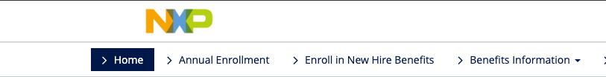
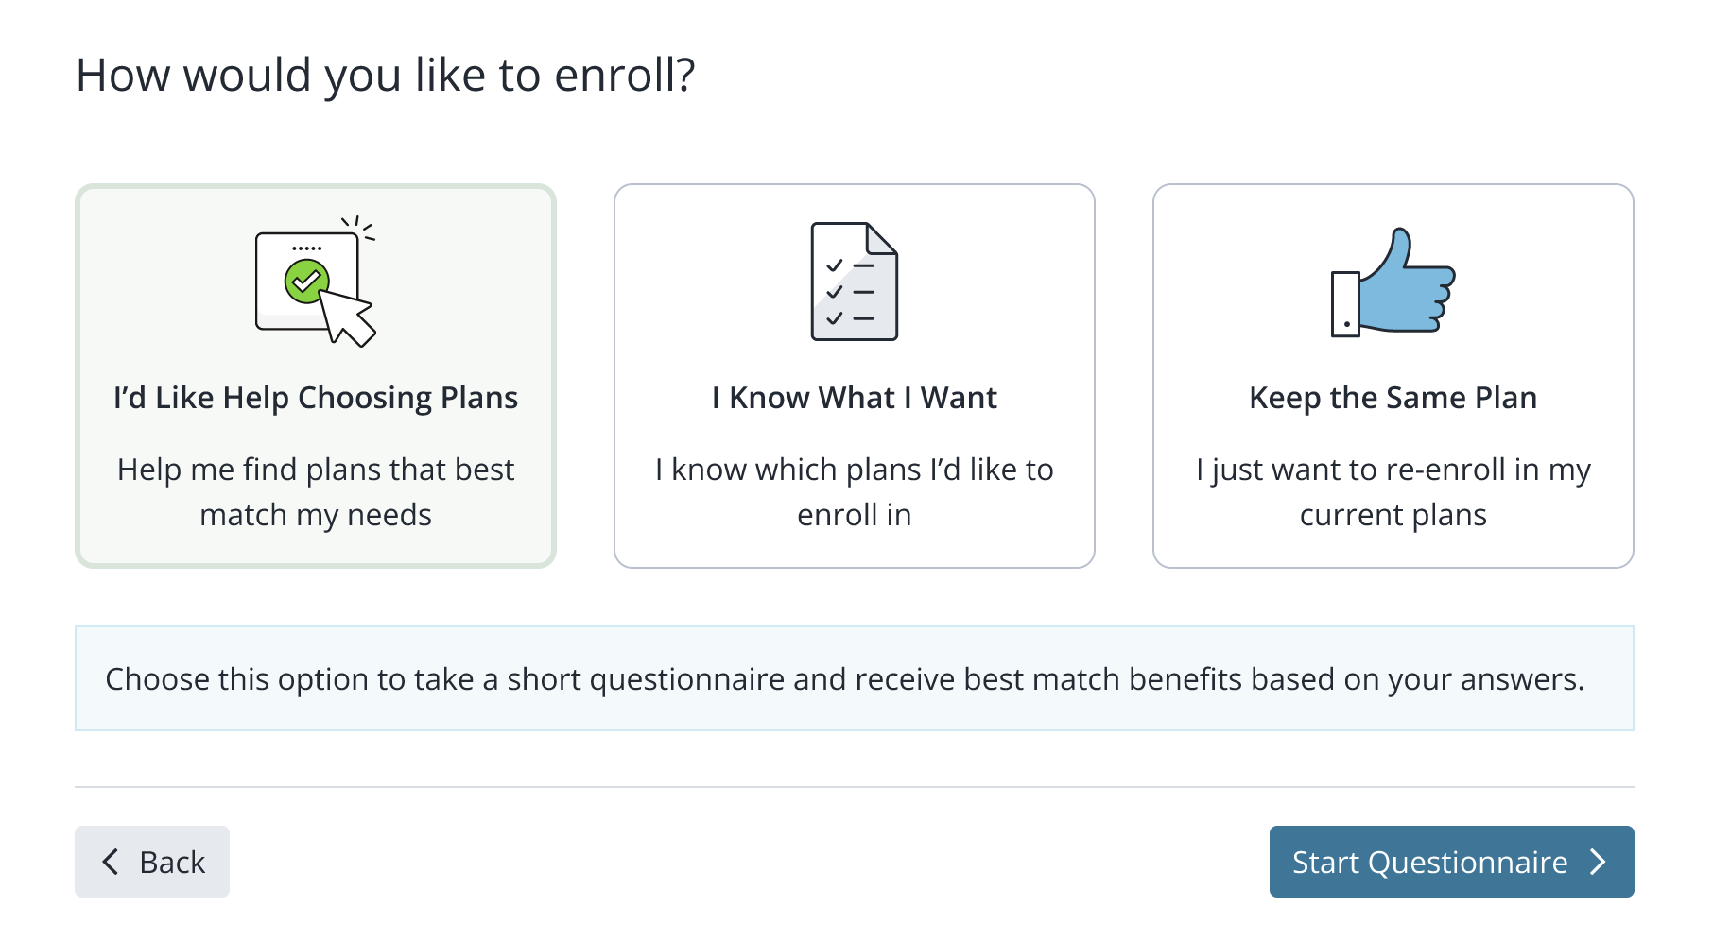
Decision Support Tool
Key Features:
A simple, easy-to-use process providing personalized results.
Considers your entire wellbeing, including financial, physical, and emotional needs.
Helps you plan for your future and understand the benefits you’re paying for.
Simplifies the selection process, reducing the frustration of too many choices.
Allows you to model different scenarios to identify components of care that drive out-of-pocket costs.
Gives you the confidence you need to make informed benefits decisions!
Visit decision support tool by clicking here.
Notes:
We also have Businessolver’s Decision Support Tool. This tool will ask you a series of questions to help guide you to the best plan options for you and your family. All answers will be kept confidential and are never stored or shared.

Slide 33
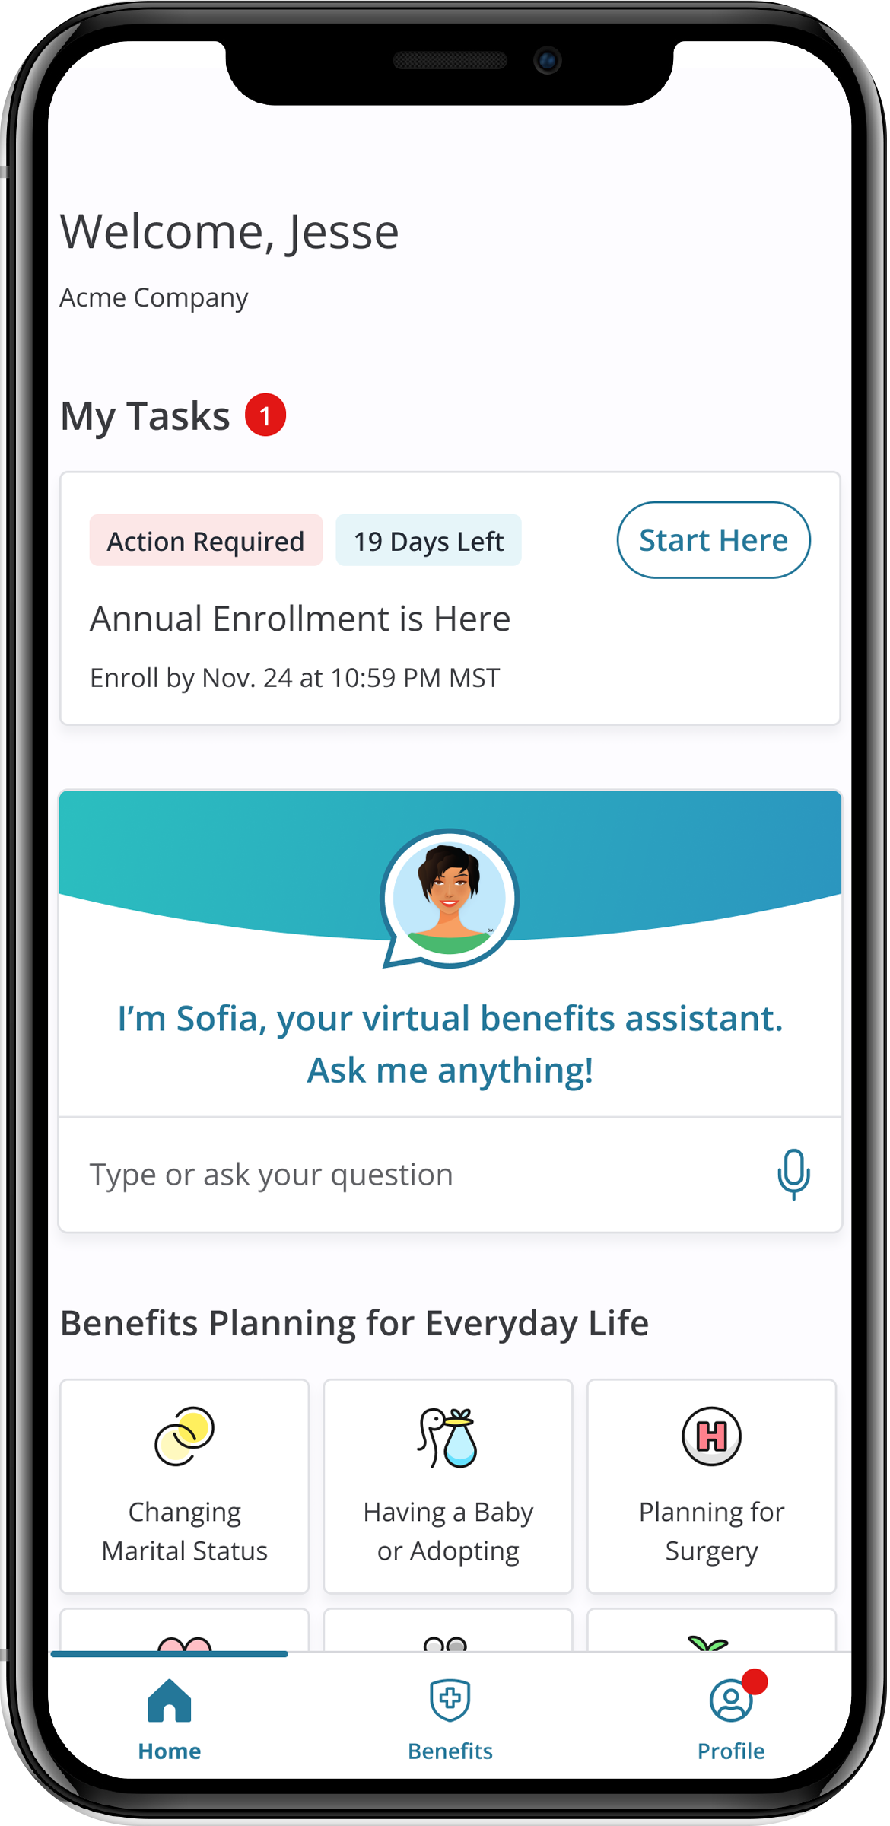
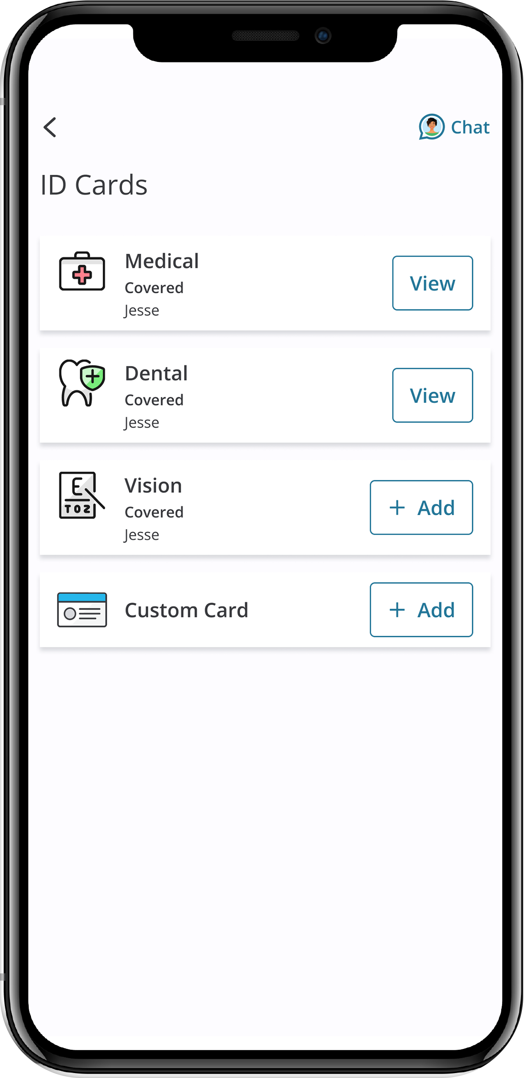
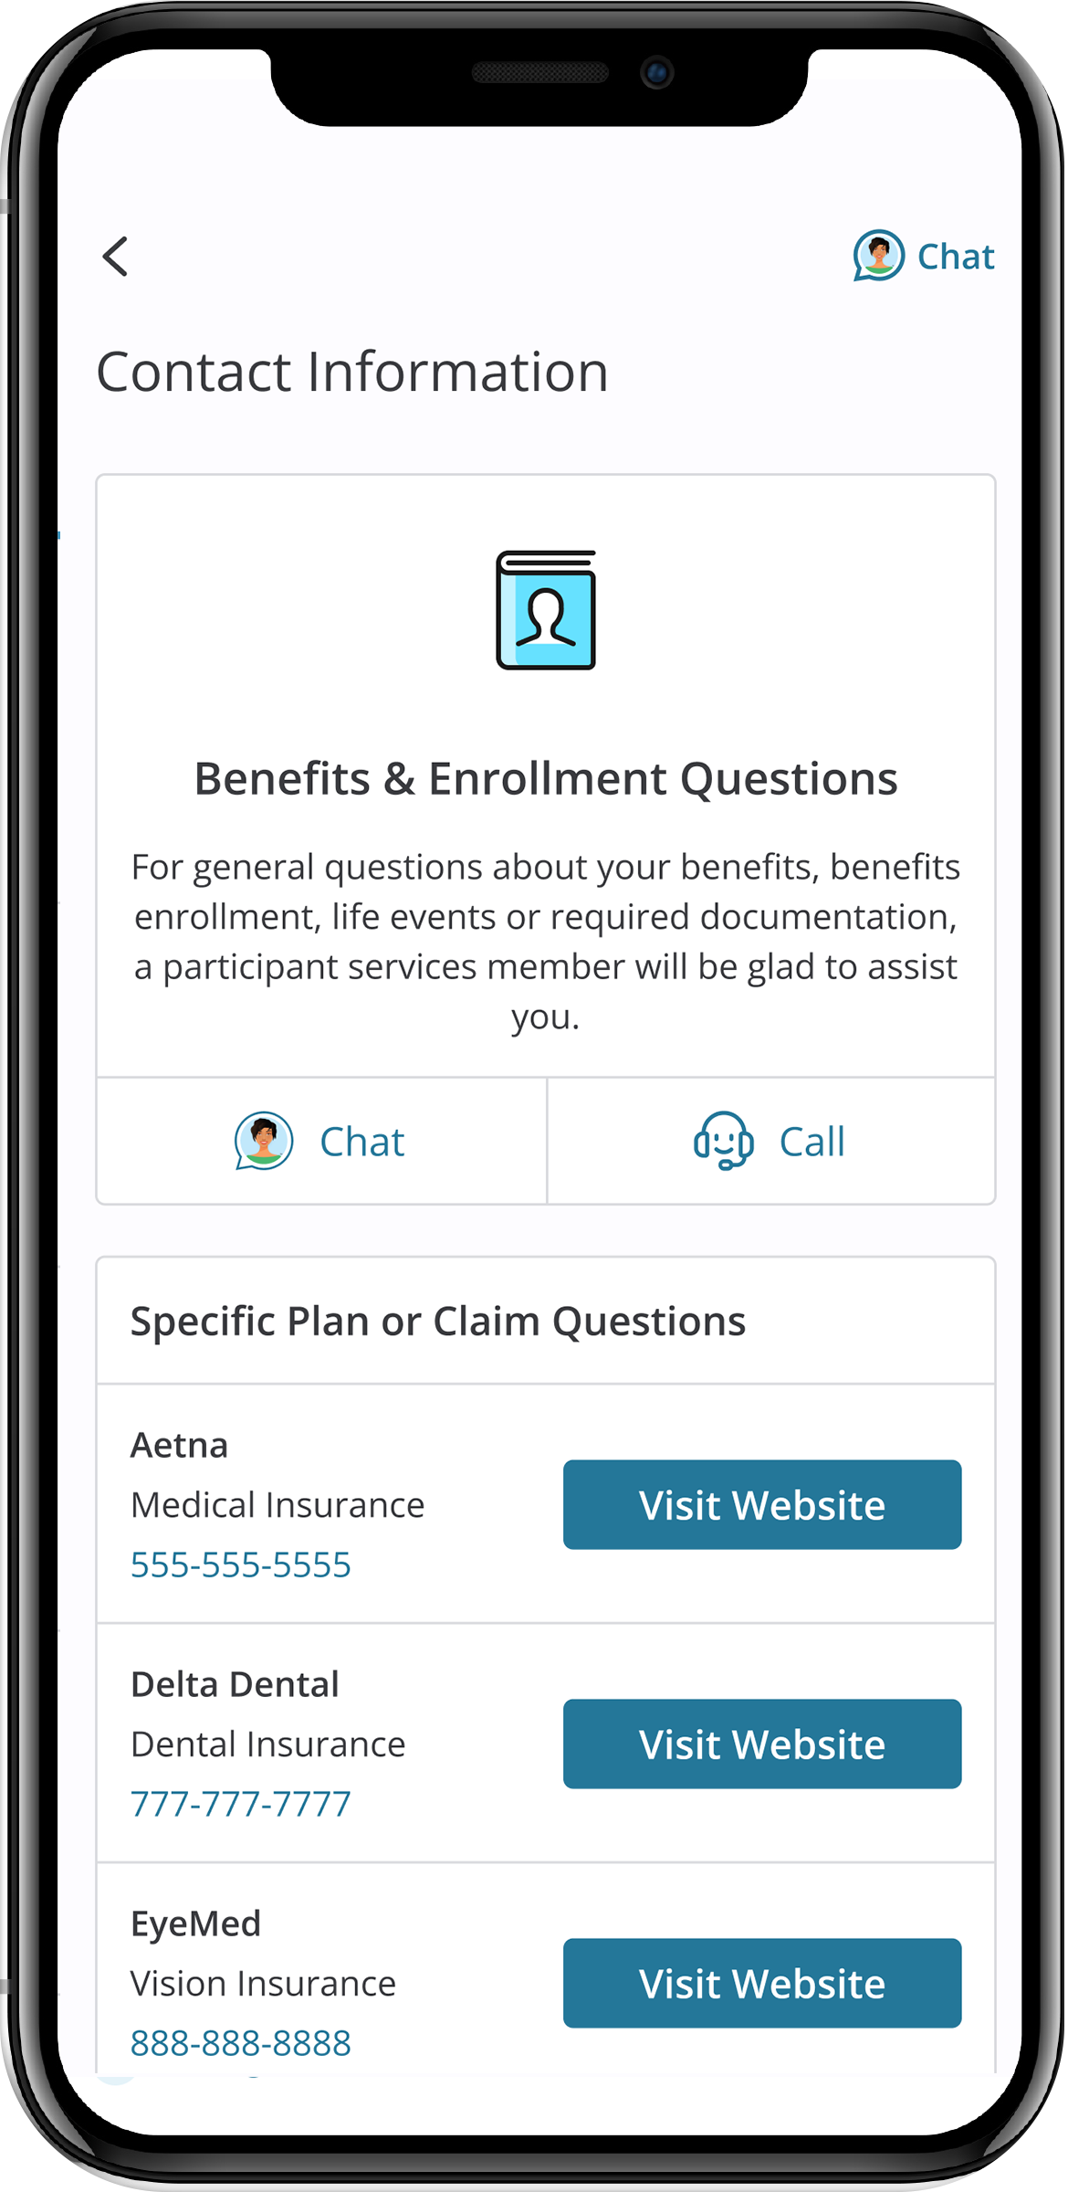

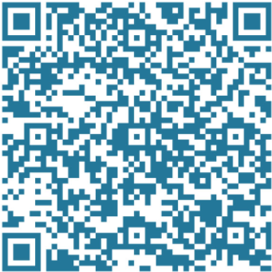


MyChoice® Benefits App
With the MyChoice benefits app, you can:
  Store pictures of your ID cards for quick and easy access.
  Access detailed coverage information at your fingertips.
  Make changes to your benefits with just a few taps... and much more!
Experience the convenience of managing your benefits wherever you go!
Notes:
Make sure to download the new app for Businessolver, which can be found in the app store under “MyChoice Benefits”

Slide 34
Learn More and Get Help
Visit nxp.com/benefits
Call: (888)532-3971
(Monday – Friday, 7 a.m. – 7 p.m. CT)
Follow us on Viva Engage
For 401(k), HSA and FSA questions, call the Retirement Service Center: (844)697-4015
(Monday – Friday, 7:30 a.m. – 7:30 p.m. CT)
usbenefits.office@nxp.com

Slide 35

Holiday and Recharge Days
Holidays
New Year’s Day – Jan 1 (Observed on Dec 31)
Martin Luther King Jr. Day – Jan 18
Memorial Day – May 31
Independence Day – July 4 (Observed Jul 5)
Labor Day – Sept 6
Thanksgiving Day – Nov 25
Day after Thanksgiving – Nov 26
Christmas Eve and Christmas day – Dec 24 & 25 (Observed Dec 23 & Dec 24)
Global Recharge Days (exempt employees only)
March 26 & 29
  Good Friday/Easter Monday
  Chakri Day (Thailand)
  Tomb Sweeping Day (Taiwan)
  Good Friday
July 2 & 5
  U.S. Independence Day
October 1
  Yom Kippur Eve
  National Day(China, Hong Kong)
  Armed Forces Day (S. Korea)
October 29th
  Diwali
Notes:
Juneteenth has been removed, and MLK day has been added.
Recharge days: Remember recharge days are used to encourage you to eliminate internal meetings and limit all non-critical emails and other lower priority work activities. This time can be used to catch up on priorities, explore personal development and growth activities, or focus on a new innovation or ideas. Alternatively, you may choose to consider using your annual leave or PTO during this time when many colleagues will be away for a holiday. Taking little allowances like these can help make a difference, particularly to help prevent burnout and give you more time to recharge.

Slide 36
401(K) Retirement Plan
36
| NXP | Internal

Slide 37
401(k) Retirement Plan
Three ways to contribute: pre-tax, Roth and after-tax contributions.
NXP matches your pre-tax and Roth contributions, including catch-up, dollar for dollar up to 5% of your eligible earnings. NXP does not match after-tax contributions.
Use the Roth in-plan conversion feature to convert after-tax and/or pre-tax to Roth.
¹ A distribution from a Roth 401(k) is tax free and penalty free, provided that the five-year aging requirement has been satisfied and one of the following conditions is met: age 59½, disability, or death.
² A partial distribution from a qualified plan must include a proportional share of the pre-tax and after-tax amounts in the account. Therefore, while the portion of your distribution associated with your after-tax contribution is not taxable, the portion of your distribution associated with any pre-tax contributions or earnings on pre-tax or after-tax contributions is taxable.
³ For 2026, employees with FICA wages over $150,000 in 2025, must make all 2026 catch-up contributions as Roth.
⁴ Employer match contributions are taxed the same whether an employee contributes pre-tax and/or Roth (employer contributions and the related earnings are taxed when distributed).
2027 limits will be posted at nxp.com/benefits > Retirement and Financial > 401(k) Retirement Plan when available
Notes:
Although there are no required actions on your 401(k) during annual enrollment, it’s a great time to review your account.
When saving for retirement, how and when you pay taxes on your 401(k) matters. You can choose between pretax, Roth, and after-tax contributions.
Pretax contributions lower your taxable income today but are taxed at withdrawal. Roth contributions are taxed now, so withdrawals, including earnings, are tax-free if you’re 59½ and it’s been at least five years since your first contribution. You can also make after-tax contributions which allow you to contribute more than the annual pretax/Roth limits.
If you’re 50 or older by year-end, you’re eligible for catch-up contributions. If you’re age 60 to 63, additional catch-up contributions are available. Effective January 2026, if you’re catch-up eligible (age 50 or older by Dec 31st) and your total NXP 2025 FICA wages (Box 3 on your 2025 form W-2) were over $145,000*, any catch-up contributions you make must be made as Roth contributions.
NXP matches 100% of the first 5% of eligible earnings you contribute to your 401(k) as pretax or Roth, including catch-up contributions. NXP does not match after-tax contributions.

Slide 38
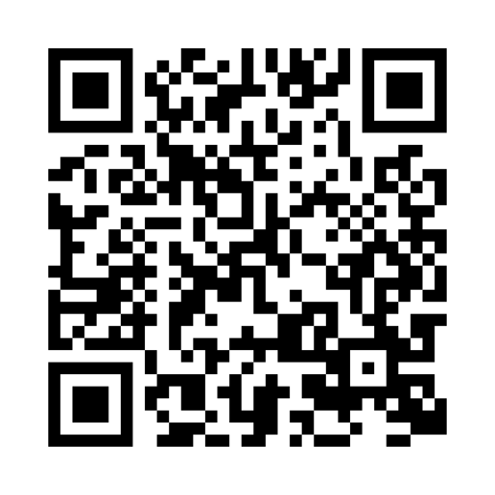
Fidelity Resources
Visit Your Financial Wellness Dashboard
Use NetBenefits.com/dashboard to track money goals, plan for the future, and view your financial picture—all in one place.
Contact a Fidelity Workplace Planning Consultant
Need more in-depth help with your savings goals, asset allocation, and retirement planning? Call 800-603-4015
to start your one-on-one conversation.
Take the Financial Wellness Checkup
Get a clear view of where you stand. You’ll find tips and insights to help you understand your spending, create a plan, and track progress toward your goals— all with personalized insights to fit your life. Visit NetBenefits.com/financialwellnesshelp to get started.
Live Web Workshops
Log on to NetBenefits.Fidelity.com/LiveWebMeetings
Download the NetBenefits App
Visit Fidelity.com/NetBenefitsApp.

Slide 39
Deferred Compensation Plan
39
| NXP | Internal

Slide 40
Deferred Compensation Plan
The NXP Deferred Compensation Plan (DCP) is offered to NXP employees with job level G7 and above. The DCP allows you to save on a pre-tax basis, above and beyond the NXP 401(k) Plan. Features of the plan include:
Elect to defer 1% to 50% of your base salary and 1% to 90% of your Annual Incentive Pay (AIP)
NXP does not match deferrals in the DCP, but there is a restoration match (NXP will contribute "missed" match in the 401(k) Plan to the DCP)
Distribution options include:
  Separation from Service - paid in a lump sum or in annual installments over 2-10 years
  Specific Date - paid in a lump sum or in annual installments over 2-5 years
Invest your contributions among multiple investment options
To participate you must enroll each year during the annual enrollment period. All eligible employees will receive additional information prior to enrollment.

Slide 41
Employee Stock Purchase Plan
41
| NXP | Internal

Slide 42

Employee Stock Purchase Plan (ESPP)
The ESPP is a voluntary plan that allows you to purchase NXP shares (NASDAQ: NXPI) at a 15% discount.
Eligibility
You must be employed directly by NXP to be eligible. Executives, contractors, interns/students and employees on a fixed term are not eligible.
Contributions
Contribute 2% to 10% of your gross base pay, deducted each pay cycle during a 6-month Offering Period.
Shares are purchased on the Purchase Date at the end of the Offering Period.
Enrollment
To participate, employees must enroll during an Enrollment Period in January or July.
Watch for email notices or digital banners on TVs around the office notifying you when enrollment is open.
For more information visit NXP’s ESPP SharePoint page
Notes:
As a reminder NXP offers an Employee Stock Purchase Plan that allows eligible employees to purchase NXP stock at a 15% discount.
Most employees are eligible however executives, contractors, interns/students, and employees on a fixed term are not .
Contribute between 2% and 10% of your base pay during a six-month Offering Period.
The maximum amount you can contribute in a year is $25,000 or $21,250 with the 15% discount.
The next Enrollment Period opens in January 2026. Watch for emails notifying you that the enrollment period is open.

Slide 43
Prepare for Annual Enrollment
Annual Enrollment is October 19 – October 30
Get familiar with your benefits and plan options so that you’re ready to make choices that provide you and your family with the most value.
1
Think about what’s in store for you in 2027. Visit nxp.com/benefits to review your options and read the Benefits Enrollment Guide.
2
Learn what’s new by speaking to a Benefits Team member at the benefits tables during our Annual Enrollment fair.
3
Complete the decision support tool, which is available after you start your enrollment, to receive personalized guidance on the best plans for you and your family.
4
Talk to Sofia and use the Decision Support Tool to obtain personalized support and guidance on the best plan(s) for you and your family.
5
Enroll in the options that best meet your needs and budget by October 30, 2026, at nxp.com/benefits
43
| NXP | Internal
Notes:
Our benefits team members will be on site during prior to Annual Enrollment and while we are not having vendor fairs this year, our team members will be there to assist if you have questions.
We encourage you to utilize the Decision Support Tool to help guide you in making some key benefit decisions.
As a reminder, you can ask Sofia, our virtual benefits advisor, many questions about our plans.

Slide 44
Important reminders
If you do not make new elections by October 30th, 2026, your current 2026 enrollment elections will carry over to 2027 except for spending accounts.
Your 2026 Flexible Spending Account, Dependent Care Account, Health Savings and Commuter elections will not automatically be renewed for 2027.
  Your current election amount will default to zero.
  You will be required to log in to Businessolver and make an election to contribute to the FSA, DCFSA and HSA again in 2027. Commuter elections can be made via NetBenefits.
Review your benefits, and make any changes by Friday, October 30th.
Visit nxp.com/benefits for details.
Notes:
If you do not make new elections by October 30th, 2026, your current 2026 enrollment elections will carry over to 2027 except for spending accounts.
Your 2026 Flexible Spending Account, Dependent Care Account, Health Savings and Commuter elections will not automatically be renewed for 2027.
Your current election amount will default to zero.
You will be required to log in to Businessolver and make an election to contribute to the FSA, DCFSA and HSA again in 2027. Commuter elections can be made via NetBenefits.

Slide 45
Q&A
usbenefits.office@nxp.com
| Internal | NXP and the NXP logo are trademarks of NXP B.V. All other product or service names are the property of their respective owners. © 2026 NXP B.V. Version 3.0.

