Slide 1
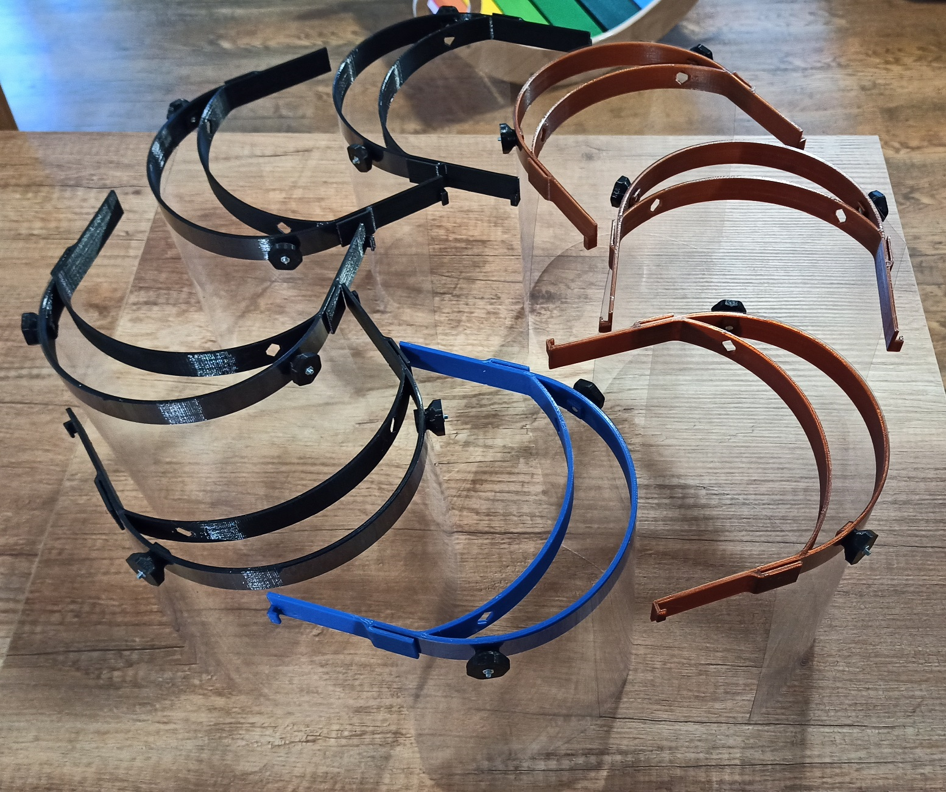
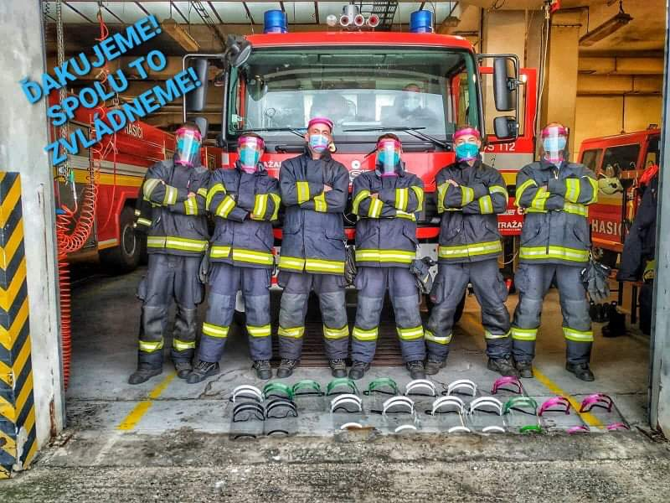
Thank you for your volunteer help
NXP Czech
Face Shields & Bias Tape Makers – 3D Printing
Created and donated ~ 500 pieces
Cooperation of both Czech sites Roznov & Brno
Face shields are mainly provided to healthcare workers

Slide 2
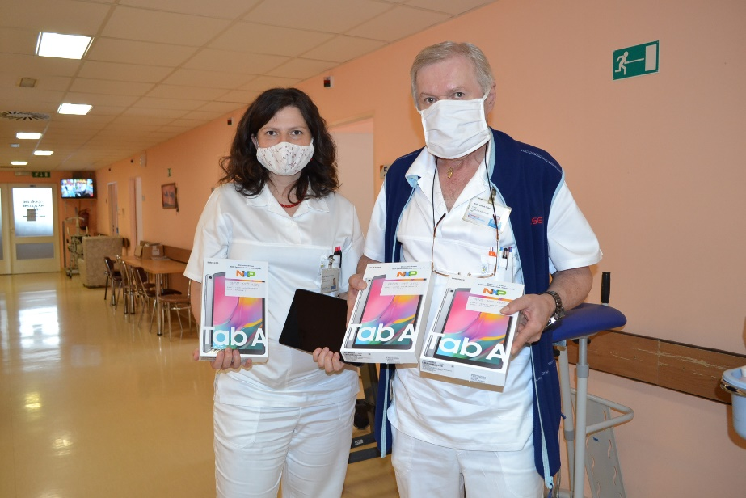
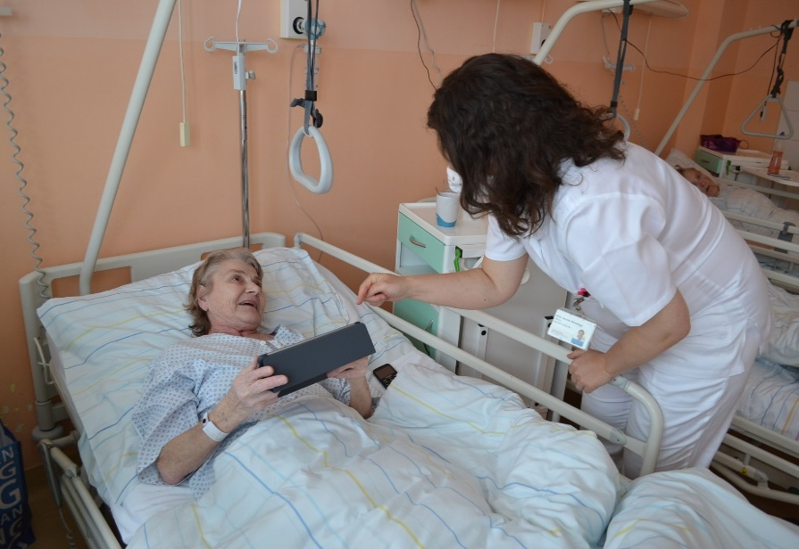
Tablets Donation to Senior House and Hospital
It is not easy to be without the family and not being able to connect face to face during COVID-19
NXP decided to donate tablets to senior house in Roznov and to the hospital with intensive care in Valasske Mezirici
NXP Czech

Slide 3
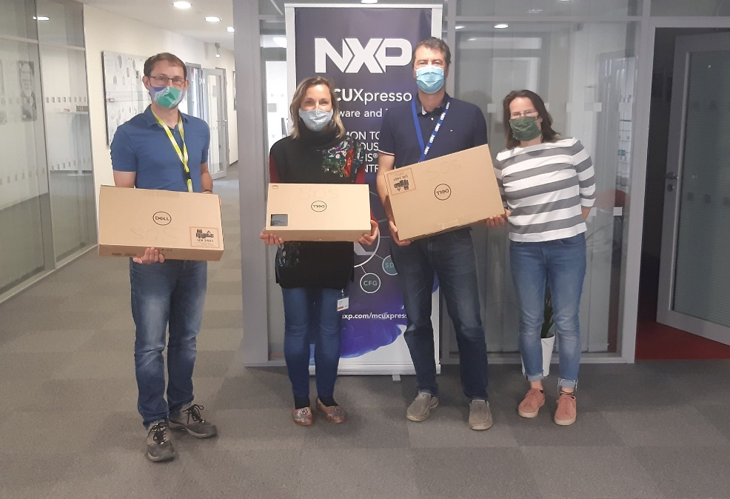
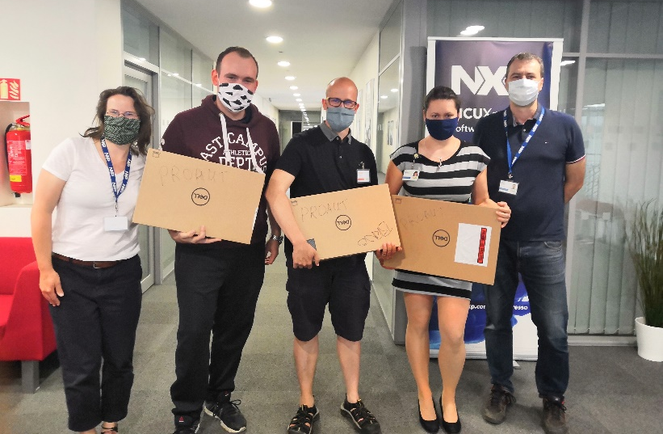
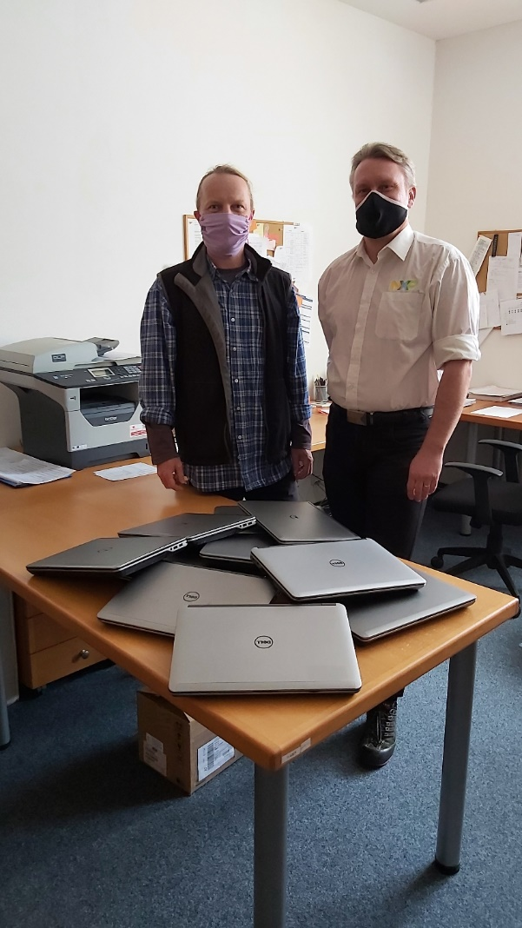
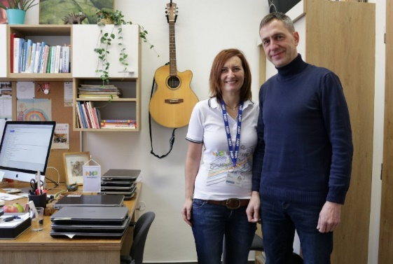
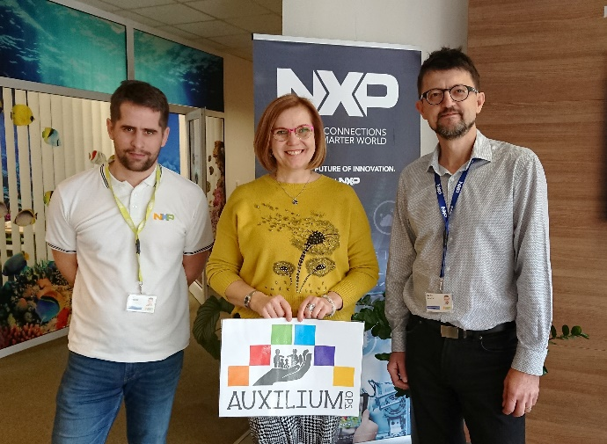
Donations of 46 used notebooks
ProAut in Brno– Autistic School
SOS dětské vesničky in Brno
Základní a Mateřská škola speciální in Nový Jičín
Primary school Sedmikráska i Roznov
AUXILIUM in Vsetín

Slide 4
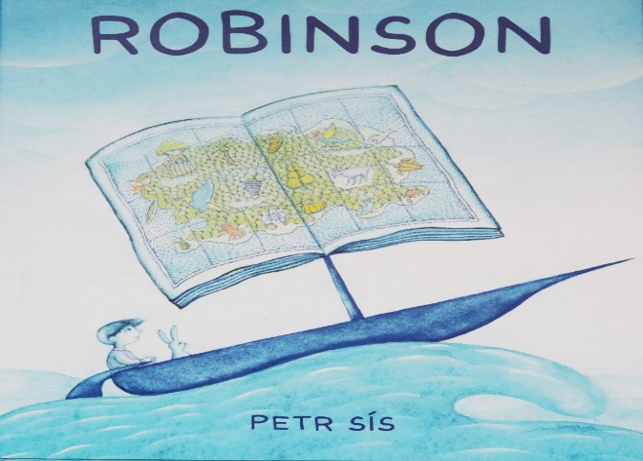
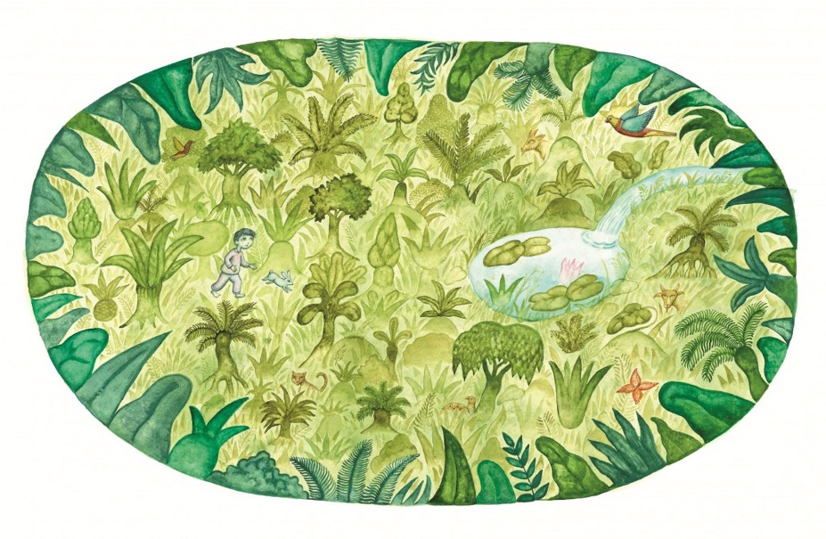
Supporting Kids in Home office and Schools
NXP team members are sharing and helping one another with creative ways to keep kids entertained while staying home
We created a game for kids with the theme Robinson Crusoe
Most of the tasks are based on the book of Robinson from Czech writer Petr Sís. Kids accomplished similar things as Robinson did on the abandonned island.

