Slide 1
Technology announcement
leveraging FD-SOI to achieve industry’s lowest power
Nik jedrzejewski product manager i.MX March 2017

Slide 2
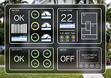
i.MX Processor Roadmap
i.MX 6QuadPlus
i.MX 8 family
ARM ® v8-A
(32-bit/ 64-bit)
i.MX 6Quad
Advanced Graphics & Performance
i.MX 8M family
i.MX 6DualPlus
Advanced Audio & Video
i.MX 6Dual
i.MX 8X family
i.MX 6DualLite
Safety Certifiable & Efficient Performance
i.MX 6Solo
i.MX 6SoloX
i.MX 7 family
i.MX 6SoloLite
Flexible Efficient Connectivity
i.MX 7ULP family
i.MX 6UltraLite
Ultra Low Power with Graphics
ARM® v7-A
(32-bit)
i.MX 6ULL
ARM® v7-A

Slide 3
Market Challenges
Battery-operated use cases seek ARM® Cortex®-A performance at Cortex-M power consumption levels
Growing number of embedded use cases require concurrent execution of isolated and secure software environments
Consumers expect rich graphics from portable products

Slide 4
Announcing i.MX 7ULP Applications Processors
Industry’s lowest power general purpose applications processor, enabling power efficient, graphics rich, portable applications.

Slide 5
NXP Taps into FD-SOI Technology to Enable The Industry’s Lowest Power Processors for Battery-Operated Devices
i.MX 7ULP
Cutting-edge power efficiency
Power management architecture designed to consume minimal power in both active and low power modes
15 uW in deep sleep mode; 17x improvement over previous i.MX processors
50% improvement in real time domain dynamic power efficiency
Low power GPUs targeting wearables and IoT
Efficient GPU design to offload and significantly reduce system resources
GC7000 NanoUltra supporting OpenGL ES2.0
GC320 Composition GPU
Industry’s 1st General Purpose processor based on FD-SOI Technology
NXP implementation of FD-SOI allows for a large dynamic gate and body biasing voltage (Vbb) range enabling higher performance at reduced power consumption and extremely efficient operation at moderate operation.

Slide 6
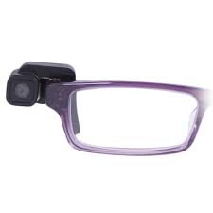
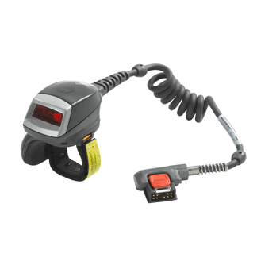
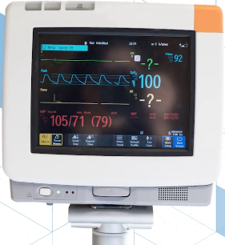
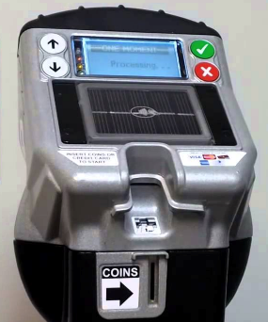
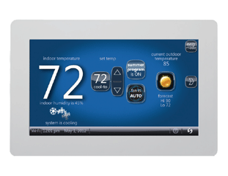
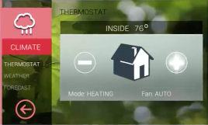
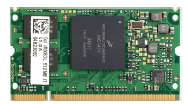
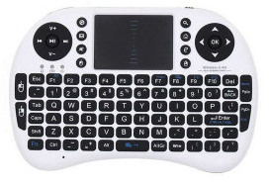
i.MX 7ULP Family Target Applications
Low Power Devices
i.MX 7ULP
Home Control
Wearables
Portable Healthcare
Gaming Accessories
General Embedded Control
IoT Edge
SOM Board Solutions

Slide 7
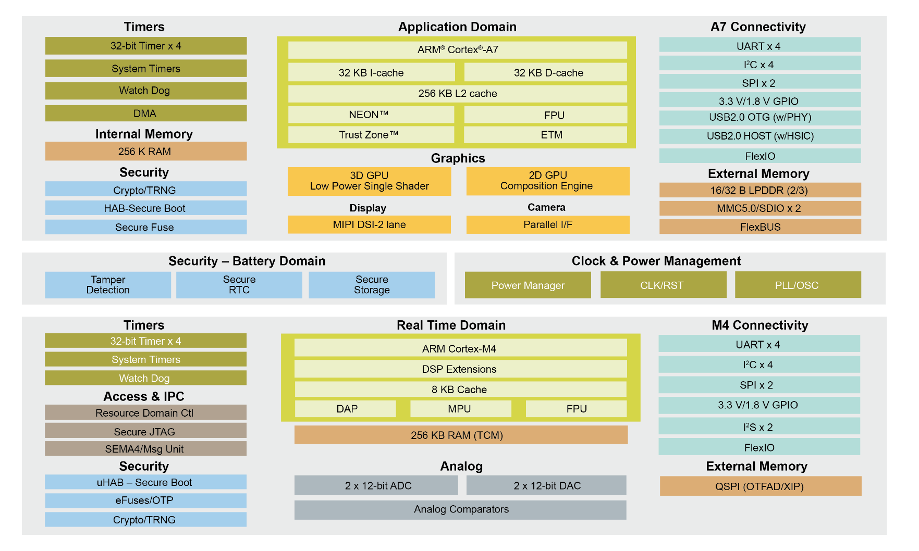
i.MX 7ULP Applications Processor
Specifications:
CPU:
Cortex-A7 @ 500+MHz target
Cortex-M4 @150+Mhz target
Process: 28nm FD SOI
Package:
14x14 393BGA, 0.5mm pitch
10x10 361BGA, 0.5mm pitch
Temp Range (junction): -40 to +105C
Qual Tiers: Commercial, Industrial
Key Features:
Graphics
GC7000 NanoUltra GPU: OpenGL 2.0 / OpenVG
GC320 Composition Engine
Ultra Low Power
Independent Real-time domain
Ultra Low Run Current
Low power peripherals
Memory Options
QSPI (on the fly decryption)
32-bit LPDDR2/3 @400MHz
eMMC 5.0 /SD3.0
Connectivity
USB HS OTG with PHY
USB HS HOST HSIC
I2C X 8, SPI X 4, UART X 8, SDIO X 2, I2S X 2
Security
High Assurance Boot
Crypto Acceleration: AES-128/256, SHA-1, SHA-224, SHA-256
RNG and Tamper Detection

Slide 8
28nm FD-SOI
Power – Performance Benefits
Improved electrostatics enables shorter gate lengths
Reduced device parasitics
Device back bias allows for lower Vdd while maintaining performance
Device tuning with back biasing to compensate process variation
Analog Integration and Performance Benefits
Higher gain, better matching and lower 1/f noise
Gate first integration removes density rules for precision analog
Better SER and Latch up Immunity
10-100x better SER performance versus 28nm bulk alternatives
Thin buried oxide layer makes device immune to latchup
Unique NXP FD-SOI enablement
Large dynamic gate and body biasing voltage (Vbb) range
Domain and subsystem optimization with custom standard cell library with mixed voltages
Low quiescent current (Iq) bias generators
Enhanced ADC performance with unique FD-SOI attributes
Body Biasing: Faster when required and more energy efficient when performance isn’t as critical

Slide 9
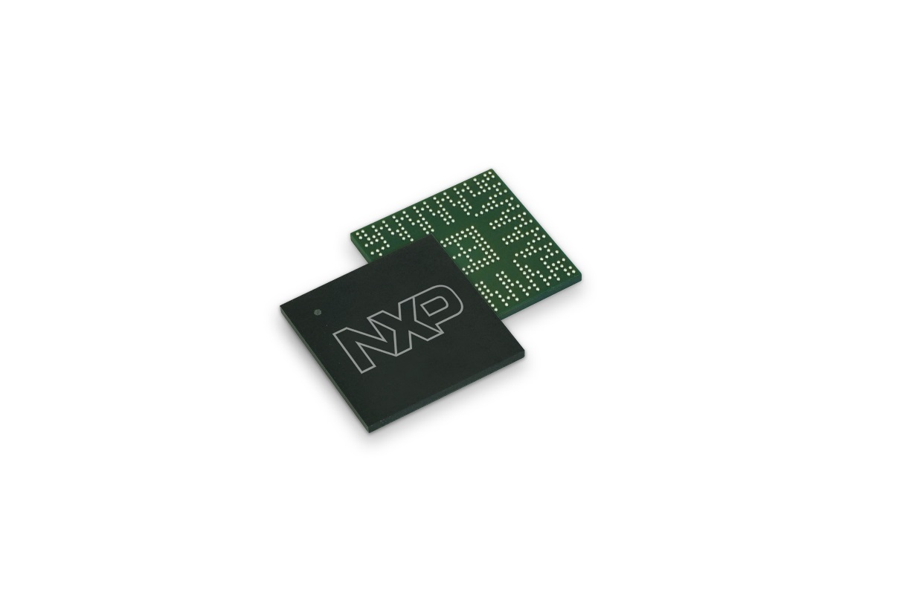
i.MX 7ULP Family Summary
Based on FD-SOI process technology
Ultra Low Power Consumption
RICH 3D & 2D GRAPHICS
HETEROGENEOUS COMPUTING
SOFTWARE, TOOLS, ECOSYSTEM
Product longevity
www.nxp.com/iMX7ULP

